Slide 1
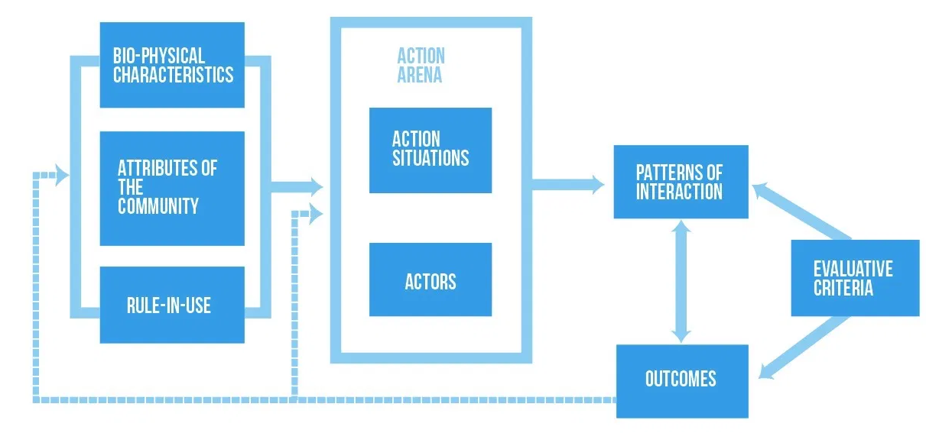
Viability Analysis of Public Water Supply Policy using Institutional Analysis Development Framework and Viable System Model
Dr. Pedro Pablo Cardoso – Leeds Beckett University
p.p.Cardoso-castro@leedsbeckett.ac.uk
Dr. Nirvia Ravena – Universidad Federal de Para
Nravena@gmail.com
MSc. Nircele Leal - Universiad Federal de Para

Slide 2
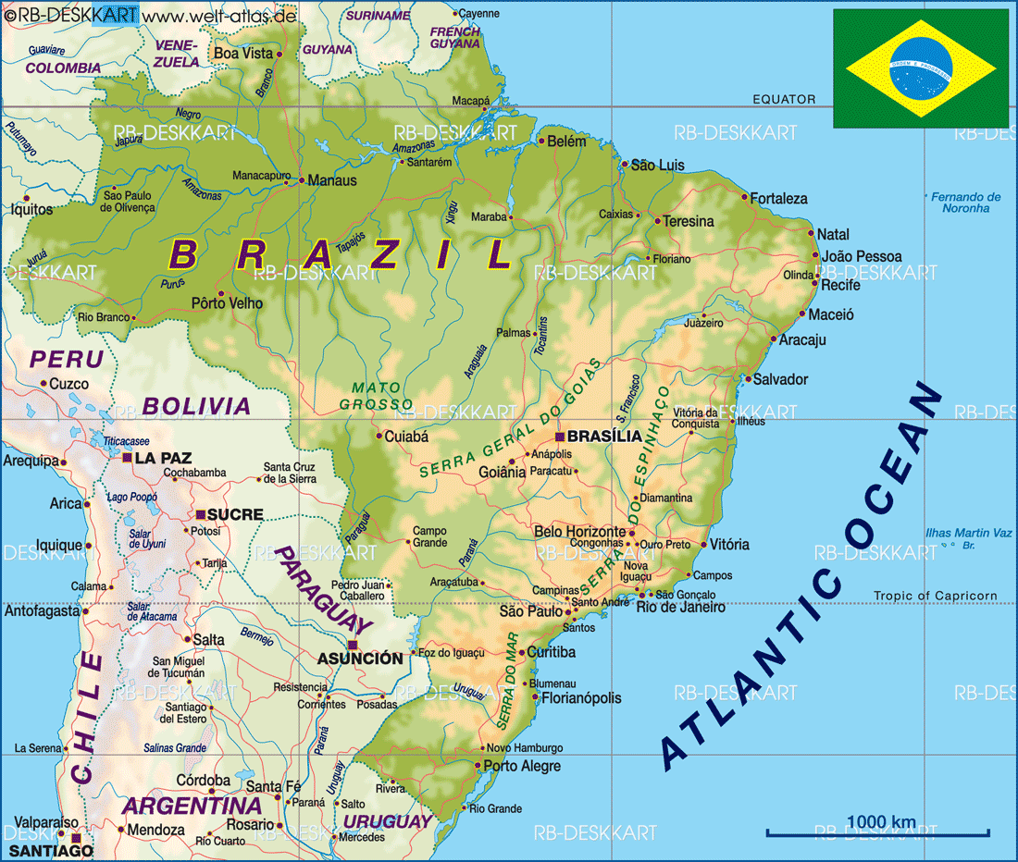
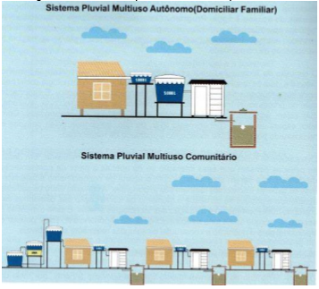
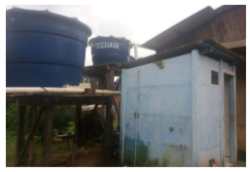
Sanear Amazonia
Multi-agency Selection of beneficiaries – vulnerable families
National program (Amazon)– federal bureaucracies /agents
Delivered locally by local agencies and NGOs
TARGET: 1’000.000 units of top roof rain water collectors + sanitation

Slide 3
SELF-GOVERNANCE
A group of people who share a common resource such as water, etc. can overcome the tragedy
They develop institutional arrangement s, norms and rules, to regulate the use of the resource
Among themselves
(INSTITUTIONS: are prescriptions used by humans to organize all forms of repetitive and
structured interactions including those within families, neighbourhoods, firms and governments
– a set of RULES actually used by a set of individuals to organize
REPETITIVE activities)
BUT..
Community approach can work IF in the right conditions
Community approaches ARE NOT the solution to everything, sometimes we need to use
governmental regulation or privatization.
How to know when you have the right conditions for self-governance?

Slide 4
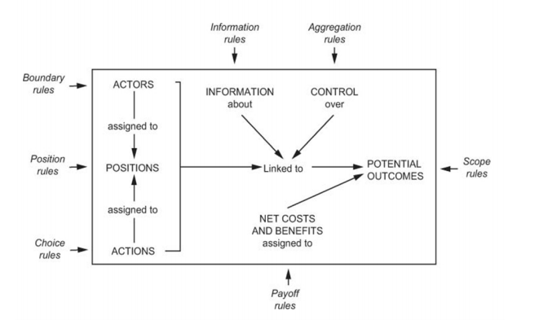
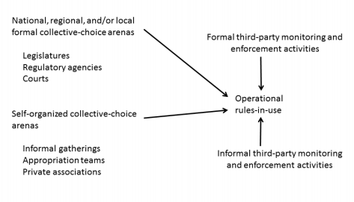
OSTROM’s Institutional Analysis Development
TIPOLOGY OF RULES IN USE
1. Boundary rules that specify how actors are to be chosen to enter or leave a situation (Entry/membership)
2. Position (Role) rules that specify a set of positions and how many actors hold each one
3. Information rules that specify channels of communication among actors and what information must, may, or must not be shared
4. Authority rules that specify which actions are assigned to a position at a node (Domain/prerogative)
5. Aggregation rules (such as majority or unanimity rules) that specify how the decisions of actors at a node are to be mapped to intermediate or final outcomes
6. Scope rules that specify the outcomes that could be affected
7. Payoff rules that specify how benefits and costs are to be distributed to actors in positions

Slide 5
VARIABLES | PARAMETERS | INDICATORS | SUB-INDICATORS
SOCIO-ECONOMIC | Infrastructure | Houses
 |  | Energy
 |  | Sanitation | Sewage
 |  |  | Water Supply
 | Education | Educational level
 | Health | Waterborne diseases
 | Rent | Economic Inclusion
INSTITUTIONAL | Management
 | Self-organization | Ostrom’s 8 SO principles
ENVIRONMENTAL | Sufficiency | Quantity and continuity
 | Acceptability | Supply diagnostic
 | Security | Management and treatment
 | Accessibility | Physic and economic
1. Define clear group boundaries. 2. Match rules governing use of common goods to local needs and conditions. 3. Ensure that those affected by the rules can participate in modifying the rules. 4. Make sure the rule-making rights of community members are respected by outside authorities. 5. Develop a system, carried out by community members, for monitoring members’ behavior. 6. Use graduated sanctions for rule violators. 7. Provide accessible, low-cost means for dispute resolution. 8. Build responsibility for governing the common resource in nested tiers from the lowest level up to the entire interconnected system.

Slide 6
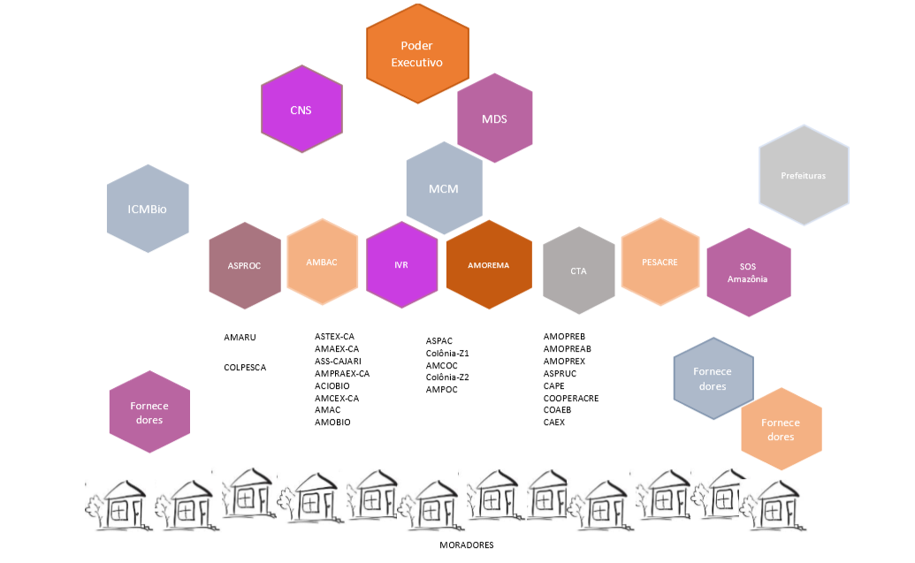
Identification of (institutional – hierarchical) Stakeholders
- Links with unfolding complexity

Slide 7
A
C
O
I
T
Transformation Actors Suppliers Customers Owners Interveners

Slide 8
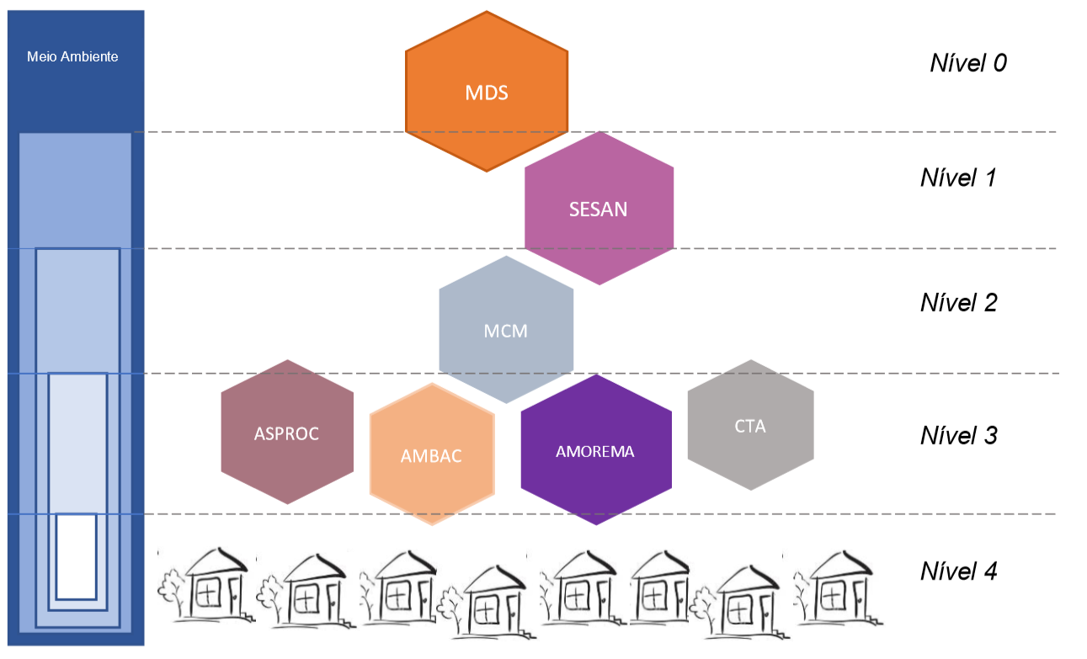
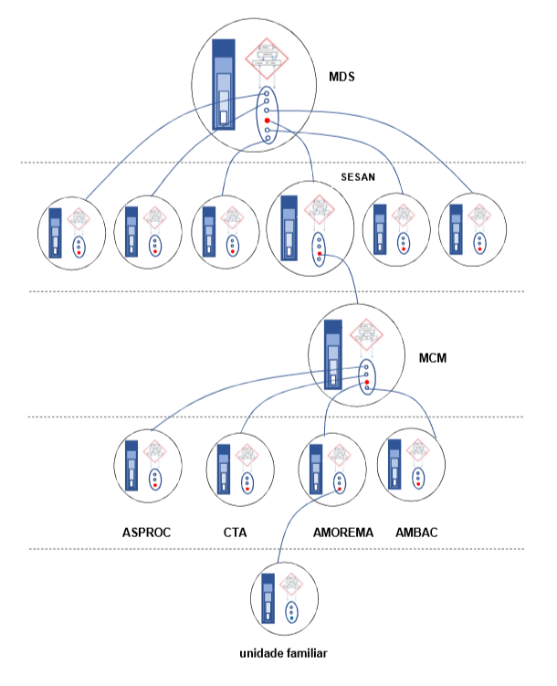
NGO
VARIABLES | PARAMETERS | RIO CAJARI | CHICO MENDES | MEDIO JUNUA | MARINHA DE SOURE
SOCIO-ECONOMIC | Infrastructure | 0.9 | 0.9 | 0.9 | 0.9
 | Education | 0.1 | 0.1 | 0.1 | 0.1
 | Health | 0.4 | 0.1 | 0.1 | 0.4
 | Rent | 0.1 | 0.1 | 0.1 | 0.1
INSTITUTIONAL | Management | 0.6 | 0.6 | 0.4 | 0.4
 | SO | 0.6 | 0.6 | 0.4 | 0.4
ENVIRONMENTAL | Sufficiency | 0.6 | 0.6 | 0.6 | 0.6
 | Acceptability | 0.1 | 0.4 | 0.1 | 0.6
 | Security | 0.1 | 0.1 | 0.1 | 0.1
 | Accessibility | 0.6 | 0.6 | 0.6 | 0.6
Users’ association
Breaking the rules:
Inconsistent selection of beneficiaries
Incomplete implementation
No feedbacks in/to the upper recursive levels – no accountability

Slide 9
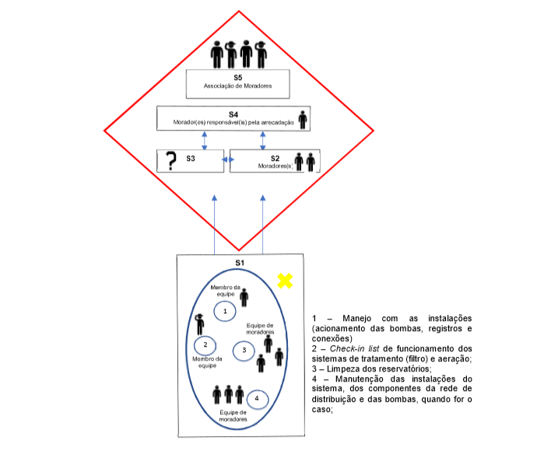
GENERAL OBSERVATIONS:
3-20 families
Critical mass (size matters?!) – users/roles
Viability constrained by external factors e.g. acces.: sufis.:
Facilities management (pumps, connections
Check-in list of treatment and filters systems
Cleaning of reservoirs
Facilities/infrastructure maintenance a). Distribution network.
VSM- profile of the association of users

Slide 10
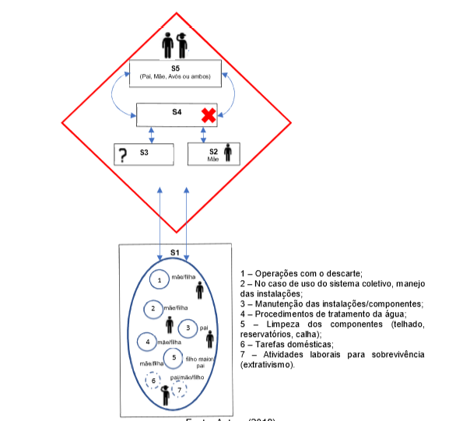
GENERAL OBSERVATIONS
Does size matters? Not enough human power (?)
S5 collapsing on many other systems – overwhelmed
Lack of S4 (reactive nature)
No well defined S3
More vulnerable to external factors (Accessibility, sufficiency)
Reactive Opps – on demand
No/some (reactive) infrastructure management
- Water treatment
Components maintenance (roof, filters, etc)
Domestic tasks
Extractive activities
VSM-Profile of the family unit

Slide 11
SUMMARY/CONCLUSSION:
-Methodologically, IAD- VSM seem to have complementarities: VSM provides a more systematic protocol to conduct the observation + better understanding of the implications of recursion i public management; and IAD suggest the inclusion of external (contextual) variables to the enhance the diagnostic of viability, S.:O.: and S-G.:
Emerging questions:
The current issue of polycentric governance - lack of understanding of recursion and distributed governance.
Inefficiencies in the hierarchical arrangement induce lack of governance and viability at lower recursive levels (always?)
Effects of environmental/socioeconomic conditions on the potential for viability and self-governance
Does size matters? If so.. Implications for the use of self-governance and SO in other contexts (?)

Slide 12
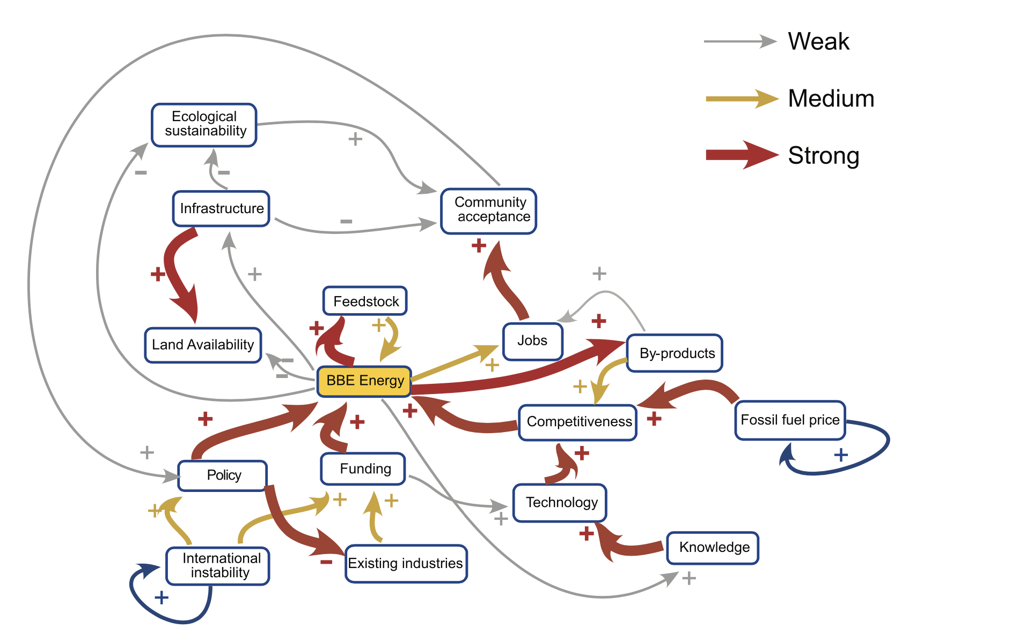
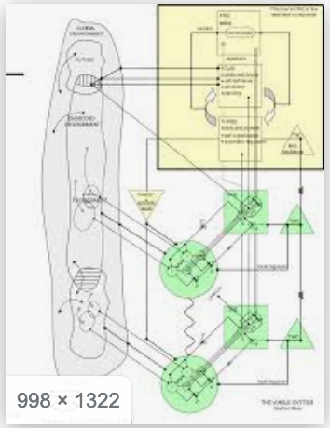
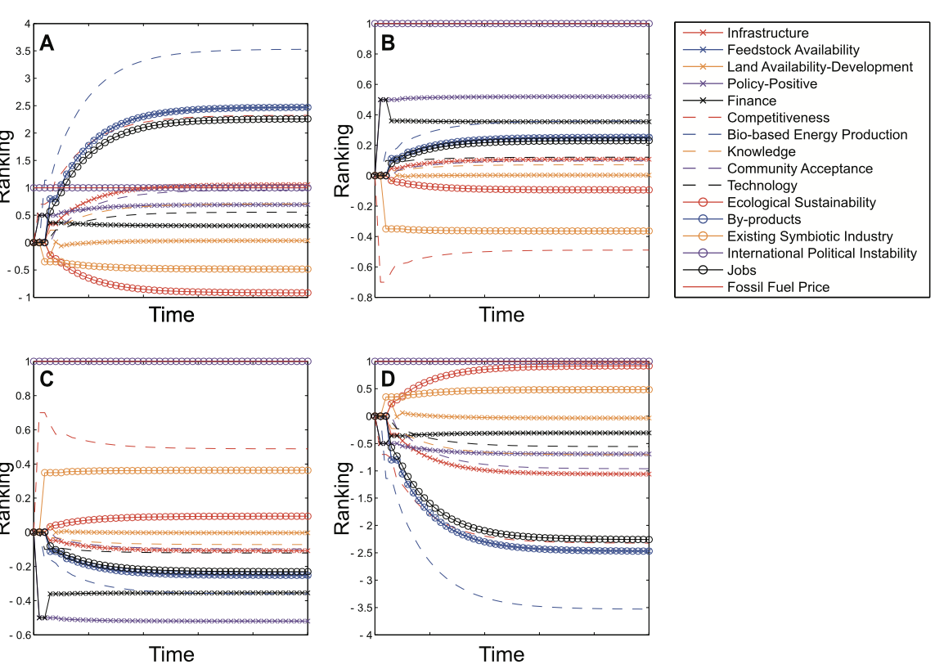
Future development
Validation of the IAD variables (and parameters) using Fuzzy logic/ Fuzzy cognitive mapping methods AND use such maps and quantitative modelling using VSM architecture

