Slide 1
CtRl ShIFt Del: Re-booting society. The nature and scale of the required massive systemic change A. Espinosa & J walker

Slide 2
Why we urgently need to re-boot society?
Escalating impact of global climate change – risk of catastrophic effects
Massive domination of global capitalism through trans-national corporations
Mind-boggling increase in inequality
Poverty for the majority of people in the southern half of the planet
Escalating risk of wars, given the rising geo political tensions
Corrupted political systems
Technocratic manipulation of people’s ‘will’ through the social media
Need for massive systemic change at all levels. -> need to invent:
New (sustainable and equitable) economic models,
New business models, and
New ways of relating to each other through technology
New political systems
New education and research systems

Slide 3
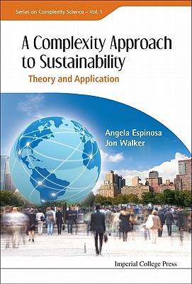
How can we contribute?
Our (VSM inspired) vision:
from individual to global systemic change
Self-organized teams, communities and projects innovating on sustainable systemic changes
‘Sustainable Self Governance’
Ecovillage (Ireland)
Ecoregional governance (Colombia)
Supply network (Mexico)
Amazonian Indigenous Community
Transition Network
UK Permaculture Association

Slide 4
What’s missing?
No evidence of massive change
Slow, difficult adoption of new paradigms/ models
Massive effect of new technologies mediating social relationships
How to avoid manipulation of the social media
Urgent need to address
Political, education and research systems
Powered mostly by those in power
systematic, disciplinary, competitive based education
education as a profitable business
How can we go further to:
Make more accessible VSM & TS ?
Contribute to design new education and political systems ?
Contribute to generate social consciousness on the most urgent environmental challenges and required changes ?

Slide 5
Transdisciplinary research
VSM Methodologies
Viplan (Espejo & Reyes)
Systemic Management (Schwaninger)
MoM (VSM, Super Syntegration)
Espinosa & Walker – Self transformation Methodology
The Viable System Approach
‘the extended VSM’
Cross fertilization with new organizational approaches and tools:
CAS/ SNA
Teal Organisations
Holocracy
Sociocracy
Commons governance
Canvas
Agile Systems
Blockchain

Slide 6
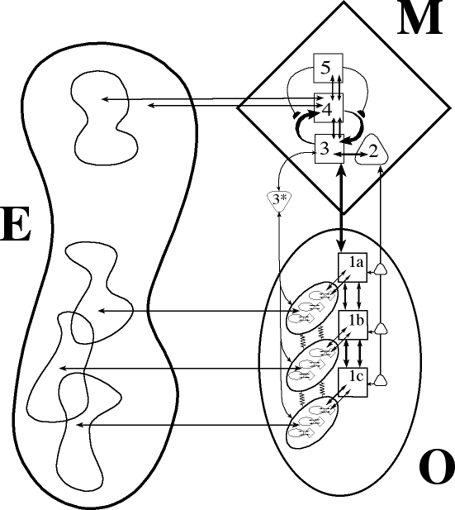
From last year: the model requires
An economy based on collaboration
Embracing environmental issues and designing structures that respond accordingly.
Structures based on unleashing: individual autonomy and creativity.
Managers who want their staff to surprise and delight them.

Slide 7
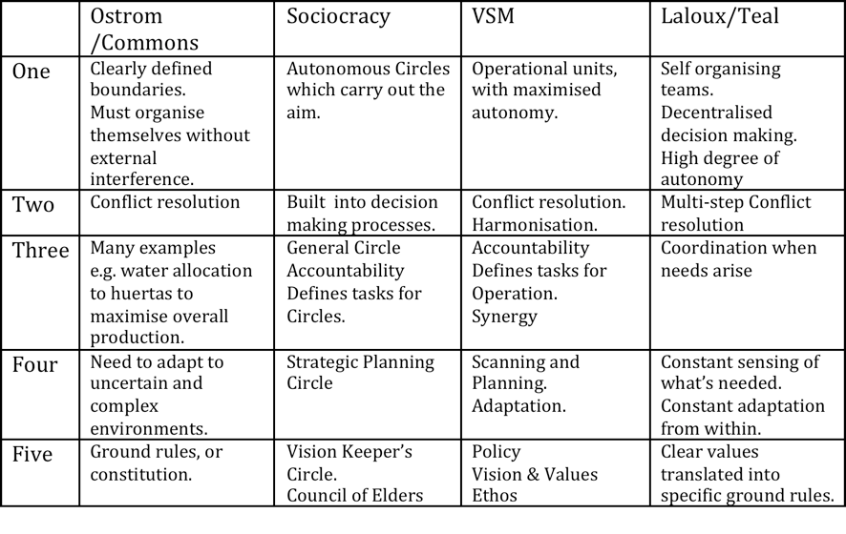
Four Current Approaches to Recursive, Non-hierarchical Organisation

Slide 8
In this Conference:
Need for massive systemic change at all levels. -> need to invent:
New education and research systems
Wolfgang New VSM books
Ivo – New approach to teach the VSM
Igor – New research (reviewing) system
Theodora – transdisciplinary research
New (sustainable and equitable) business and economic models,
Peter Tuddenham – VUCA
Bewick et al, Trilly, Jon Li –VSM & Health systems
Pedro Pablo – water governance
New political systems
Javier – capitalism, Socialism & VSM
Thomas – Anarchism & Cybernetics
John Raven- Beyond VSM?
Leonie- connecting the dots vs political elections
New ways of relating to each other through technology
Gary – PlaNET
Ian – Multi-sed Platform for change
Severin – DAO
Joe & Chris (TS)
Stephan & David (TS – crewmember spaceship Earth))

Slide 9
Conference Strategy:
Saturday and Sunday Morning : Talks/questions/debate:
(Time keeping by following speaker - Commons approach)
2. Sunday Afternoon : Creating new systems from autonomous parts.
Outcome : Identity of new systems ( e.g. Metaphorum new-economics group ?)
Objectives for next 12 months (? )
4 AGM Open to all.

