Slide 1
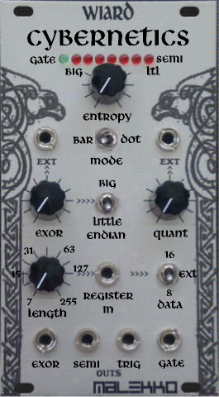
An Reflexive Look at several 3rd Order Cybernetics
Prof. Dr. Dr. Teodora Ivanuša &
Emer. Prof. Dr. Dr. Matjaž Mulej Founding President of IASCYS; Norbert Wiener Medal 2019
University of Maribor, SLOVENIA

Slide 2
Bona Diagnosis, Bona Curatio
The essence of current (and former & predicted) problems of Humanity is also in Education, which is urgently training for a narrow specialization and therefore equally urgently needs methodological training for:
Creative Interdisciplinary Cooperation + Social Responsibility
(in which we see systemic behavior applied) as being guided by the 3 KEY notions:
one’s Responsibility for one’s Influence on Society, Interdependence, and Holistic approach = CYBERSYSTEMIC approach

Slide 3
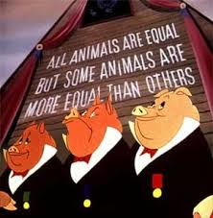
Ubi fumus, ibi ignis …
At the same time, the authors (T.I. & M.M.) eloquently / rather loudly justify the de facto unnatural divide between the Natural Sciences and the Social Sciences, which, he/she insists, is not narrowing, becoming a dangerous void, in which:
System Theory + Cybernetics = Synergy Science is not generated, but inhibited

Slide 4
Hic Rhodus, hic salta …
Synergy makes Systemic Behavior which makes Systems Thinking, Systems approach = Systems + Cybernetic Theories make sense
We are talking about a lack of sufficient and necessary integrity / Requisite holism, and Fictitious use of Cybernetics

Slide 5
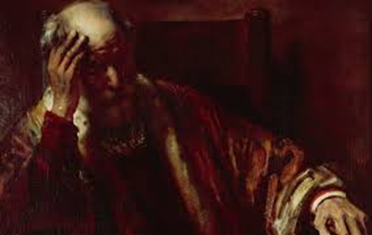
Ignorantia legis non excusat I.
In search of syntropies between the “above a certain scale?” Digital Ecosystem and “above a certain scale?” Natural Ecosystem as a:
Philosophical discussion of “Inverse & Reverse & Twisted” Cybernetics?
Detela (2014): “Syntropy is the natural ability of many complex systems to spontaneously self-organize to an increasing level of internal orderliness.“
/…/ goes beyond the Entropy law: natural systems always tend to become increasingly disorderly= tend to collapse. For simple systems, the validity of entropy can be proved, but for complex systems it cannot be proved /…/

Slide 6
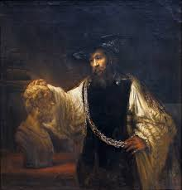
Ignorantia legis non excusat II.
Bar– Yam, Lynch & Bar– Yam (2018) noticed: „In general, any system without structure above a certain scale is unable to withstand structure arising above that scale.”
Finally, they formulated their findings as an Inverse Second Law of Thermodynamics; “while closed systems collapse into disorder, systems open to a structured environment spontaneously generate order.” (ibid.)

Slide 7
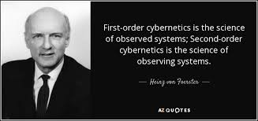
In Absentia …
Does “Observation Operator” Robert Vallée, 1951 used by the Cybernetic System to observe both the past and the present (for future) failing?
Synthesis of the 2nd and 3rd Cybernetics = Observation - Decision Making (Feedback) - Influence (for Feedforward) does not happen
…In Absentia

Slide 8
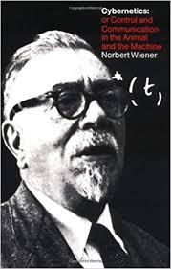
Tempora mutantur et nos mutamur in illis …
1. Engineering Cybernetics
2. Biological Cybernetics
3. Social Cybernetics
Morphostasis of Natural Ecosystem?

Slide 9
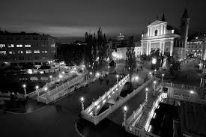
Cybernetics versus advanced Complexities
It is possible to conclude that Complexity theory restores the principles of General Systems theory after they have essentially lost the competitive struggle with narrow specialization. It developed five basic streams of Systems theory and Cybernetics
Complexity theory as a Mathematical discipline would fall into stream 1, as discipline about interdisciplinary treatment of complex phenomena into stream 3 if it has a mathematical basis, or stream 5 if it has a philosophical one
EMCSR: Trappl, ed., 2004; Mulej & Potočan, 2006; Umpleby, 2018

Slide 10
Positive & Negative Feedback and Mutual Causal Loops
Negative: absence of deviation; stabilizer of the system
Positive: mismatch (behavior : intended performance) ; initiator of modification
/…/ within highly complex systems, positive feedback can actually modify the goal(s), and hence the aim(s), of the overall system, itself
Circulus Vitiosus ? Mutual Causal Loops = Cybernetic Stability (System : Environment)
Feedback generates information, innovates novelty = elements within a system become informed and differentiated = are able to grow and evolve …

Slide 11
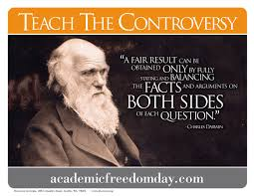
Employing Cybernetic model in Social/Behavioural Sciences …
Some general System theorists adopted Cybernetics principles with firm reservation …
Ludwig Von Bertalanffy – neglected that matter may serve as information
John Milsum at al – seem to resolve these issues (Biological Control System Analysis) but Bertalanffy‘ s resistance persisted …
Gregory Bateson chose to avoid this particular mode of Systems/Cybernetics controversy = „related disciplines“

Slide 12
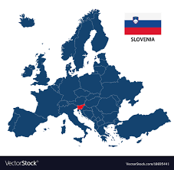
Slovenia … Remastering
Yet, Cybernetic systems exhibit a capacity for Pathology and Self-destruction
This attribute of + Feedback is termed Regenerative Feedback – IF left uncorrected, it leads to pathology and ultimately self-destruction …
In Cybernetics: what restrains are activated in order to maintain a system steady state (Bateson)
Degrees of Pathology = consequences of + Feedback versus related phenomenon= system‘s capacity for self-organization
This particular aspect of + Feedback is a result of: Deviation-amplifying processes of regenerative Feedback

Slide 13
+ Feedback = Nemesis?
Recognized in growth + learning + evolution = most significant consequence of + Feedback
Cybernetics: /…/ „whenever a lasting deviation from uniformity (thermodynamic equilibrium) develops, a system will move towards increased differentiation and complexification, and therefore, a more tenuous steady state … /…/ will adapt itself to environmental conditions by altering and complexifying its organization = increase complexification in all Natural systems represents movement away from systemic stability
= more sensitive and responsive to changes + less stable
Cybernetics stability – the System‘s ability for effective adaptation =
pattern of events; altering code
(Makridakis, 1977; Maruyama1963, Laszlo, 1973)

Slide 14
Mother Nature - Natural Ecosystem - in Danger …
Cybernetic model does contradict the linear concept of causality
Cybernetic Systems = sustain a viable steady state of interaction within changing context through stochastic processes of trial and error (! Must respond to its own input, other alterations in its environment) =exchange of: energy & matter – STILL – information & messages of effective control which restrain and govern system
Processes = Pattern of events in whole system + relationship: System : Environment = Regularities (not primarily subject to physical laws) = Proceeds according to regularities discovered in the transformation of perceived events into Symbolic Information

Slide 15
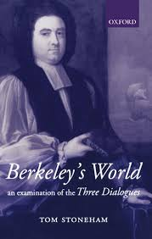
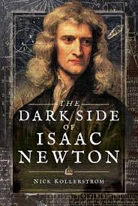
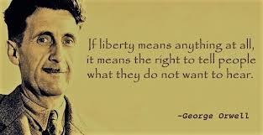
Esse est Percipi aut Percipere
Berkeleyan world of Communication versus Newtonian versus
Orwellian one ?

Slide 16
Vade Retro … Cartesian Fallacies?
Does / did Digital Ecosystem (confessedly dynamic in their nature) exceeded “a certain scale”, or is the Natural Ecosystem the one which reached such feature and started to collapse at spot where the physical world merges with the virtual (where boundaries are intangible)?
Are Safety & Security & Privacy & Autonomy & Integrity & Freedom & Humanism & Free will & Survival … a seriously endangered “species/organisms” in (dis)ordered Digital Ecosystem?
Does the Natural Ecosystem in interaction with the Digital one (Close)encounter(s) the + Feedback loop phenomenon = Inverse & Reverse & Twisted Cybernetics?

Slide 17
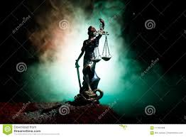
Miserere mei …
/…/ Between the nameless and the Name /…/
I don't think Cybernetic Systems are Cybernetics … Has N. Wiener ever considered his Cybernetics as a System? Or did he "meet" his own positive feedback loop? Anyway, the controversy is already, and shall remain …
What’s the Truth - the “Post-Truth”? - where to look?

Slide 18
Acta est Fabula
Let‘s Dance like no one’s watching …

