Slide 1
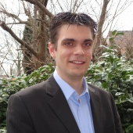
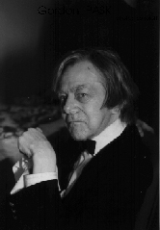
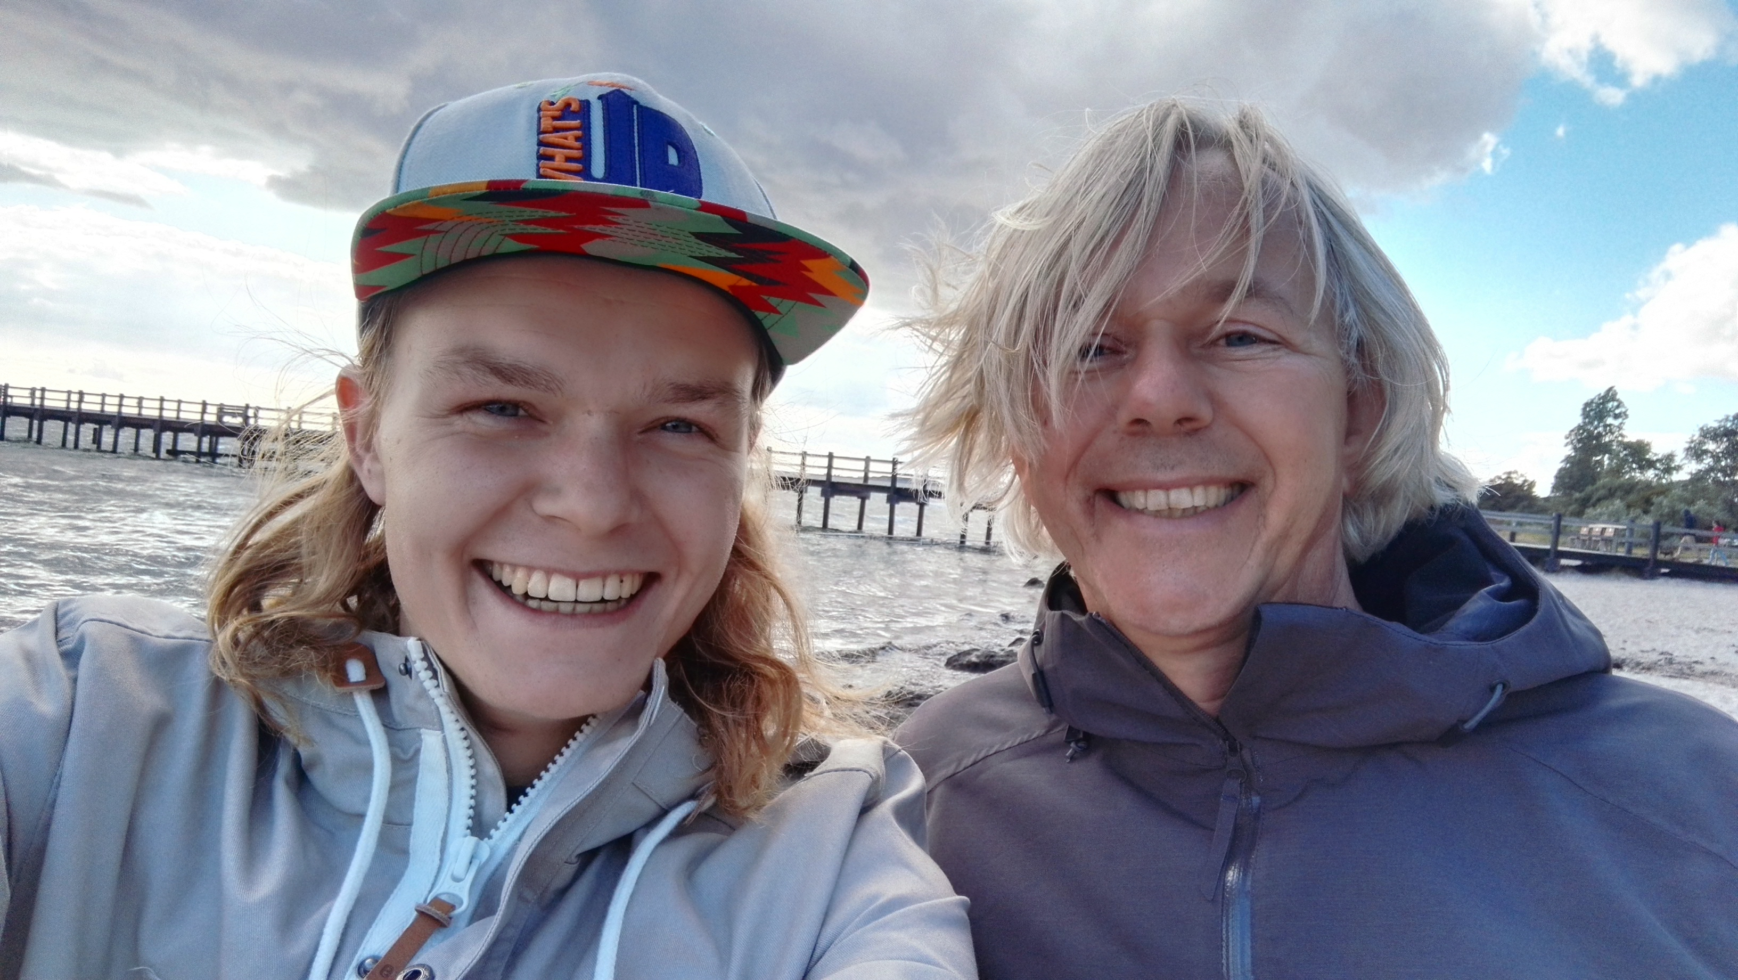
Jan Kuiper
no doppelgangers

Slide 2
A S-5 exercise

Slide 3
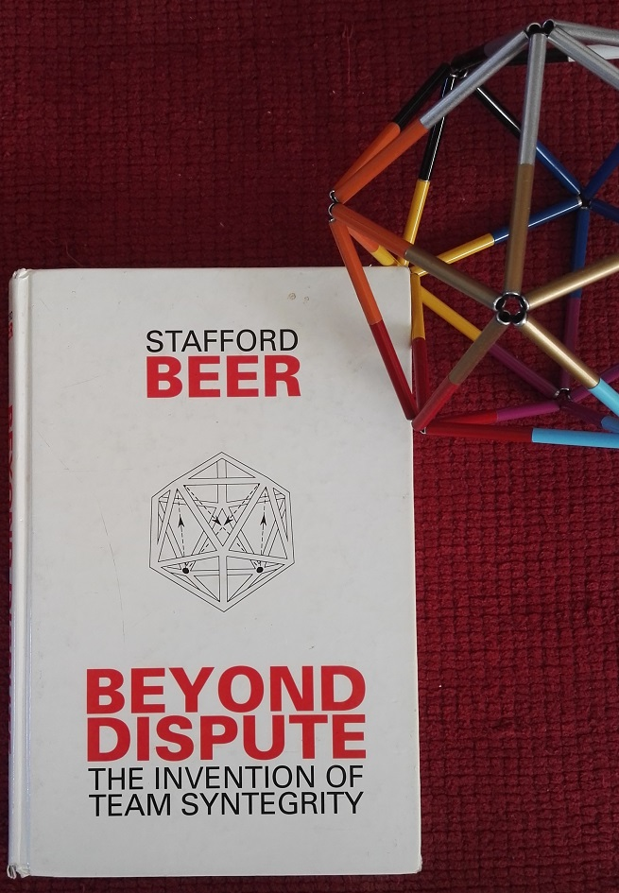
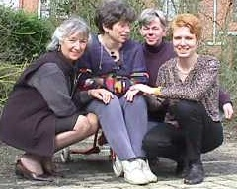
1995
Jan in IcoDrome: 1995 - 2008
Until 2008: 105 Syntegrations and varieties
> 40 certified Log’s, Fac’s and Organizers
Statistics:

Slide 4
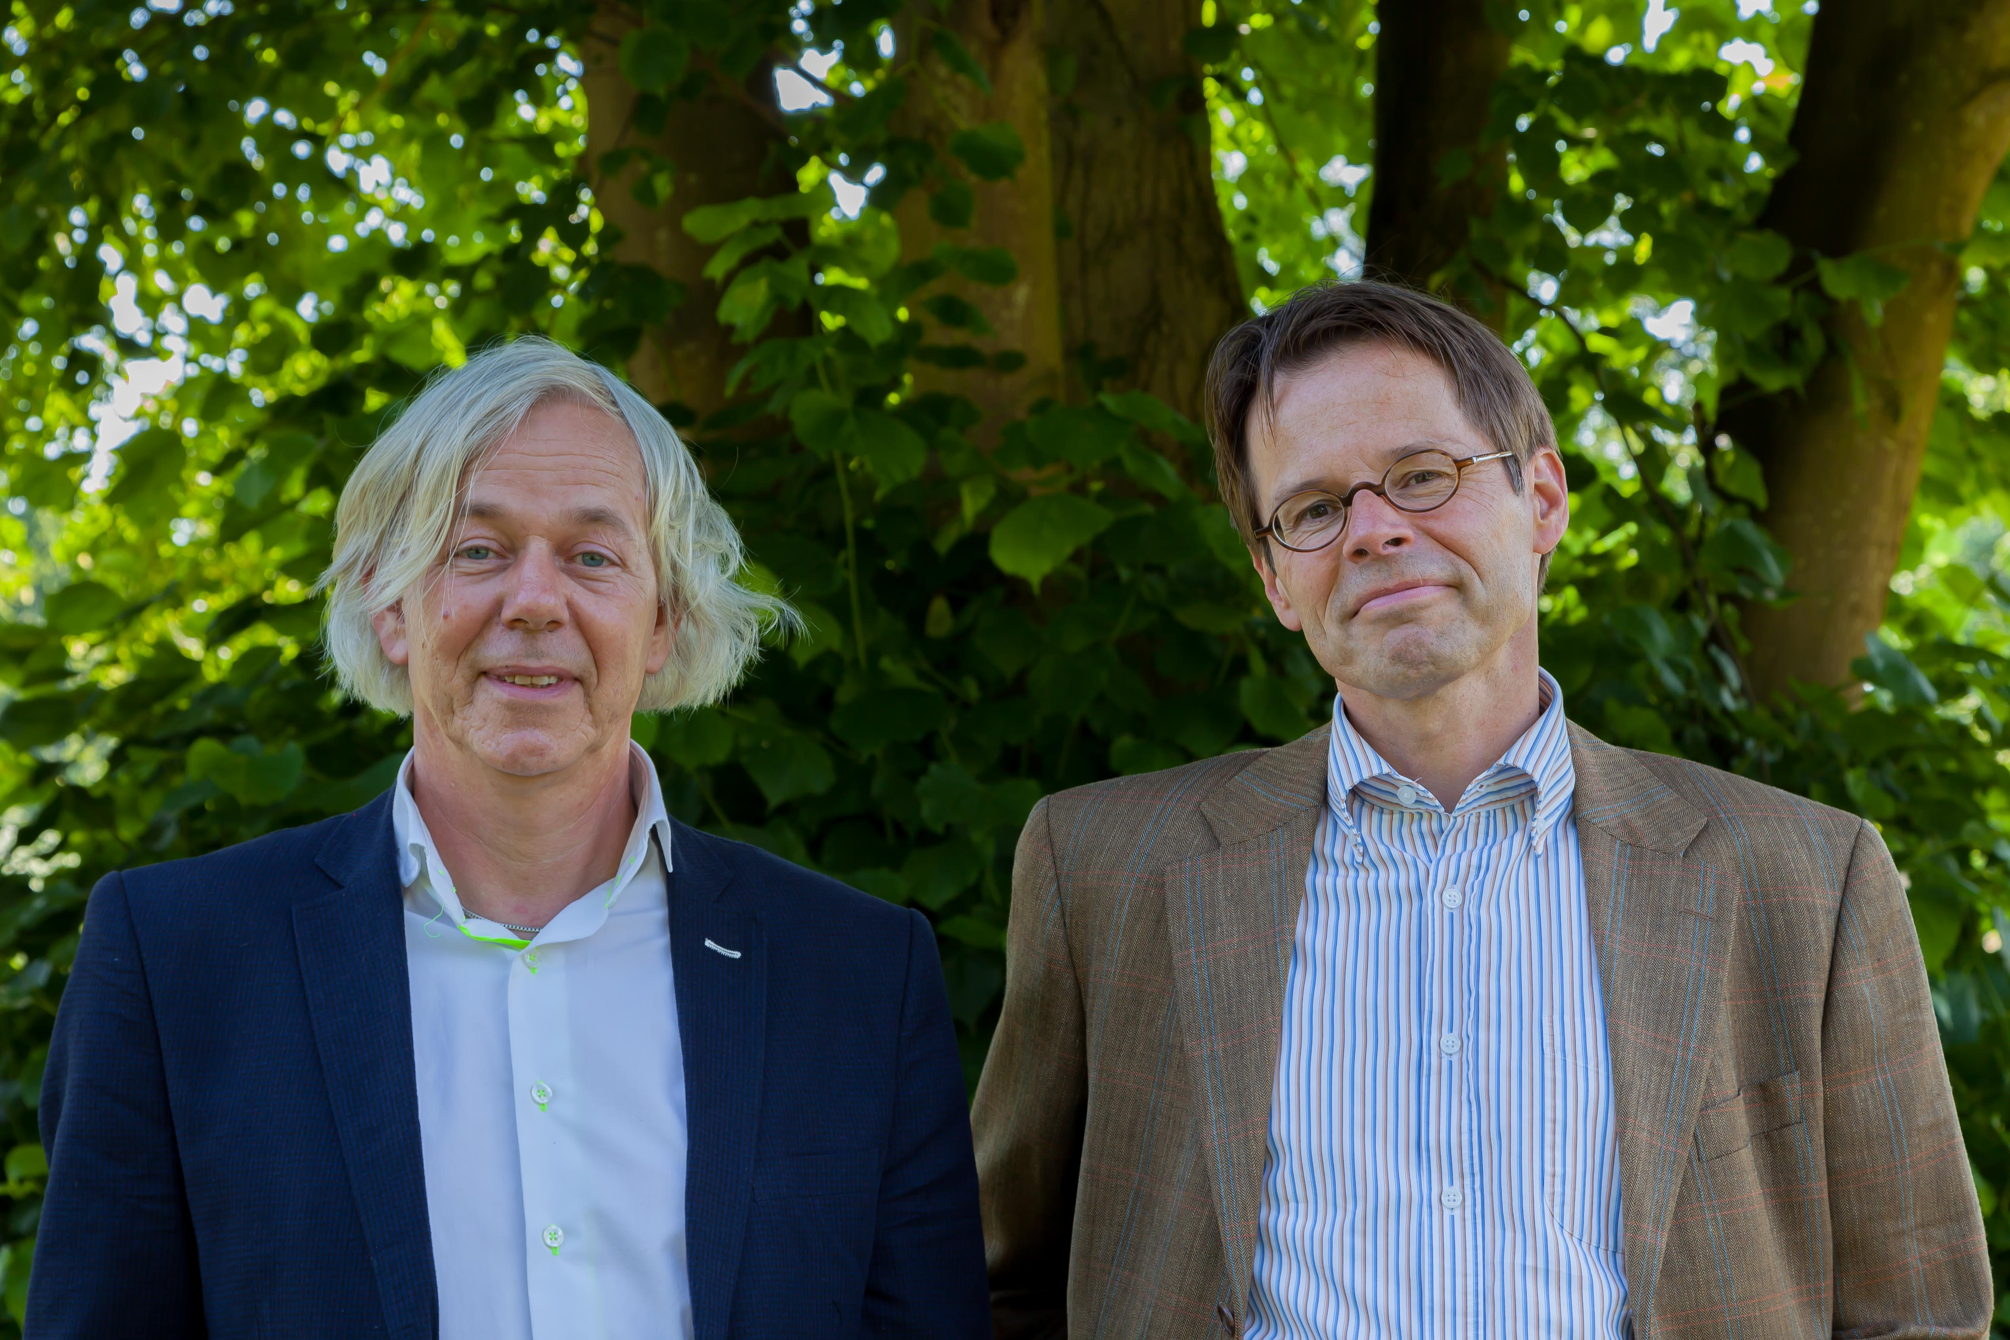
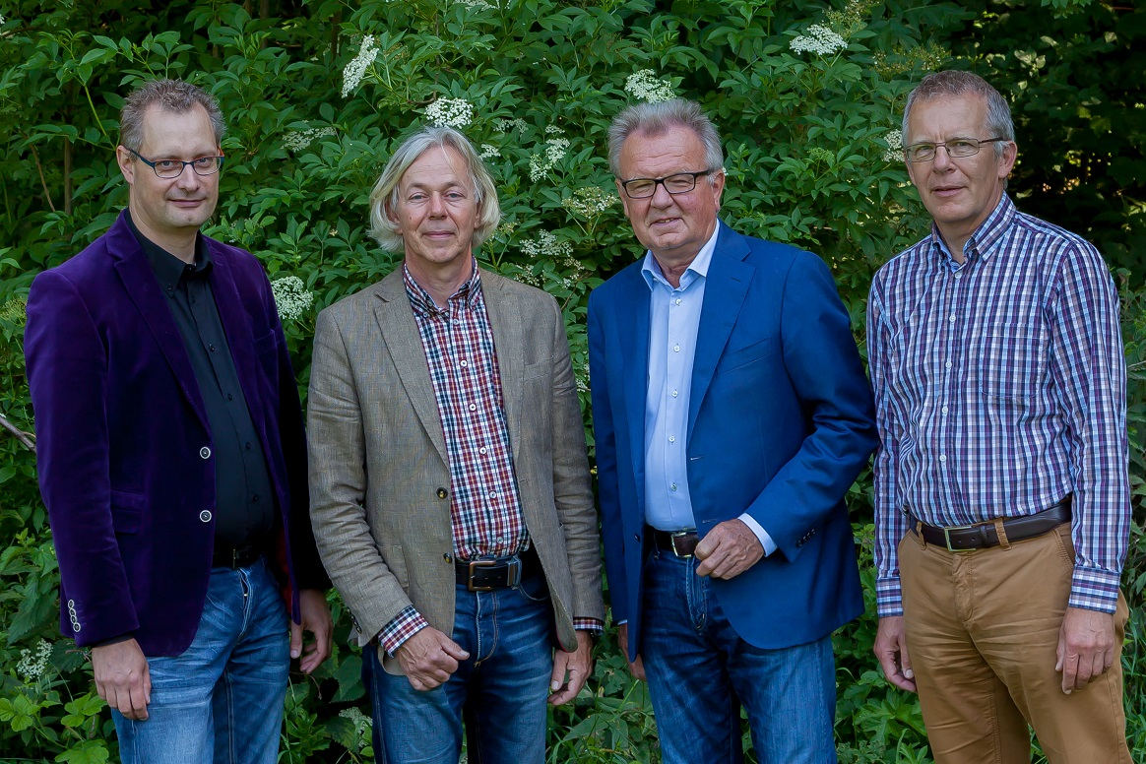
Sociological Economics
TradeUnion
Works Council Advisor
Kuiper & van de Kieft (est. 1993)
>300 clients
Appr. 70% Industry
Specialist Advice: Legal, Financial, processes, Labour conditions
Topics: Restructuring, merger, production replacement, rules and regulatiuons, conflict, negotiation
Results: power to the workers (influence), less redundancies, less outsourcing, better Social Plan, better merger conditions or no merger, etcetra.

Slide 5
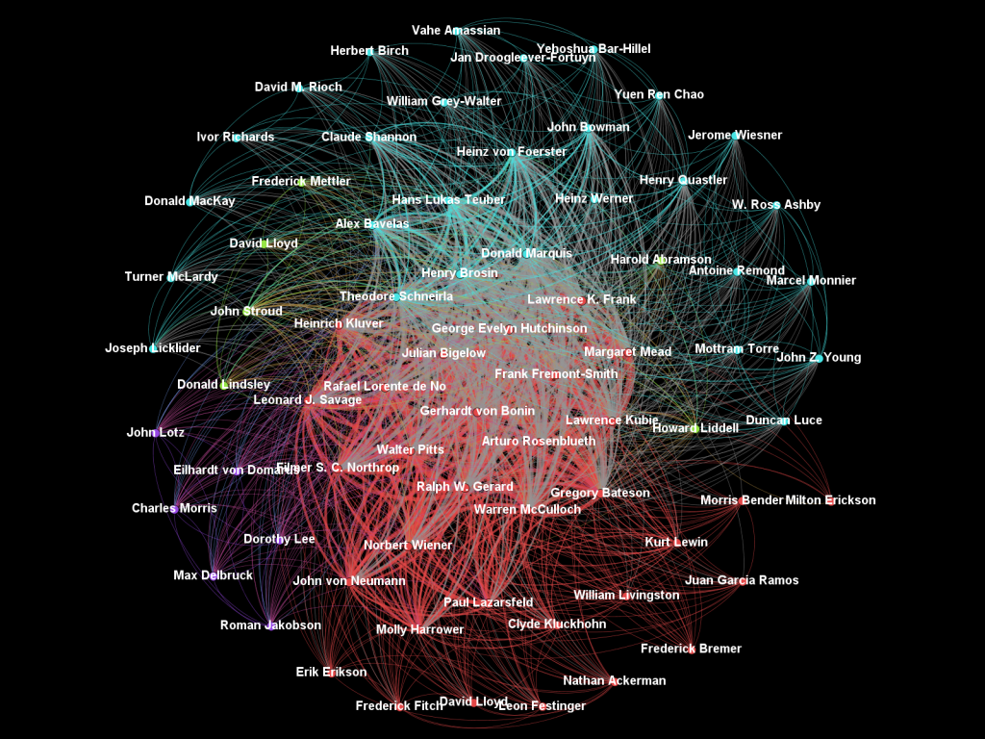
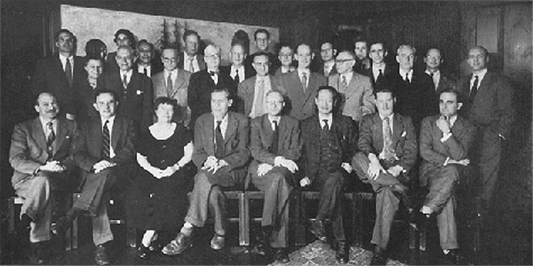
Cyberneticians should
do ‘Macy-conferences’
… Andrew Pickering, Norbert Wiener Learning Center…
“The next Macy Conference: A New Synthesis”
Shouldn’t Metaphorum start organizing this?

Slide 6
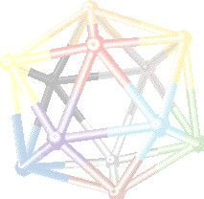
Pieter Kruijt
Psychology
Zen
Manage-ment Cy-bernetics
Conversa-tion theory
Buber, dialogue
Belbin
Herman van Gemerden
Stafford Beer
Addic-tion
Martial arts
Health
Zen
Exercsises
Pieter Kruijt
Herman van Gemerden
Roel Beijdorff
System Dynamics, Forrester
Biology
Mathe-matics,
Cyber-netics
VSM
Varela and Maturana
Roel Beijdorff
Core discoveries/secrets:
Self Organization
Second Order Cybernetics
I and/is VSM
POSIWID

Slide 7
What we learned from delivery and participation?
Organize/facilitate for self-organization: recursivity, ‘feed’ VSM, …
How to drive for internalised outcomes (insight)
Syntegrating is and should allways be an invitation to a personal journey
To deliver a Syntegration I must be a second order cybernetician
Organizing and facilitating is working like hell to do as little as possible
Participants can be anybody who connects (or should connect) to the OQ
VSM in (every) action

Slide 8
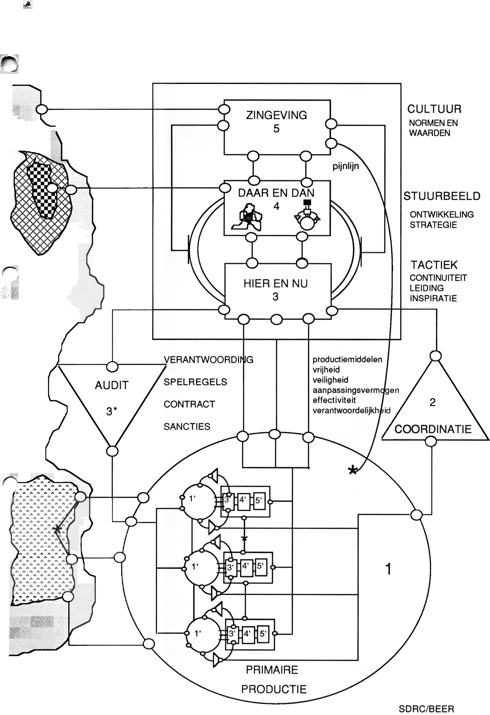
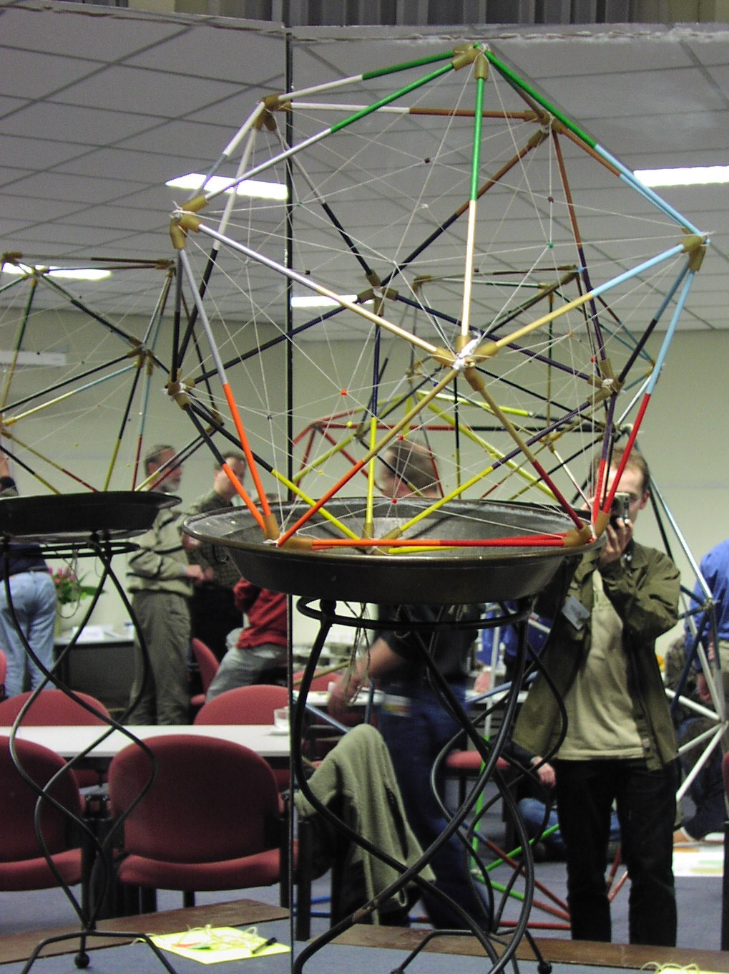
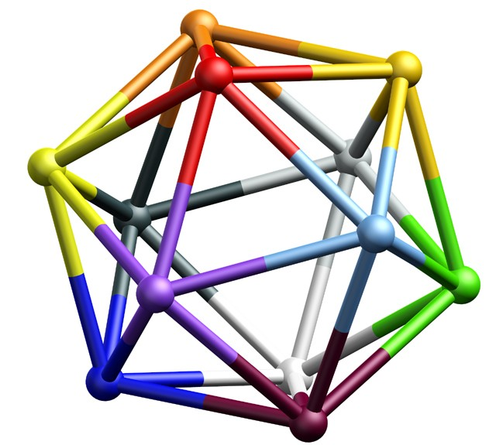
Syntegration = VSM = Syntegration
VSM-practicioners should allways syntegrate

Slide 9
Enterpreneur
consultation
Law on WorksCouncils (1971)
Business decisions with large impact: Right of advice
Labour issues: Agreement necessary
Rights: initiative, schooling, information, legal action, consultancy
Design syntegrative conversations
elections
Consultation >> conversation
Works
Council
Enterprise

Slide 11
Aspects:
What is in focus?
S-3*, S3, S4, S2 and Works Councils
S1 of Works Councils
Requisite Variety
Algadonic channel
Autopoiesis in enterprise, Works Council and me/the consultant

