Slide 1
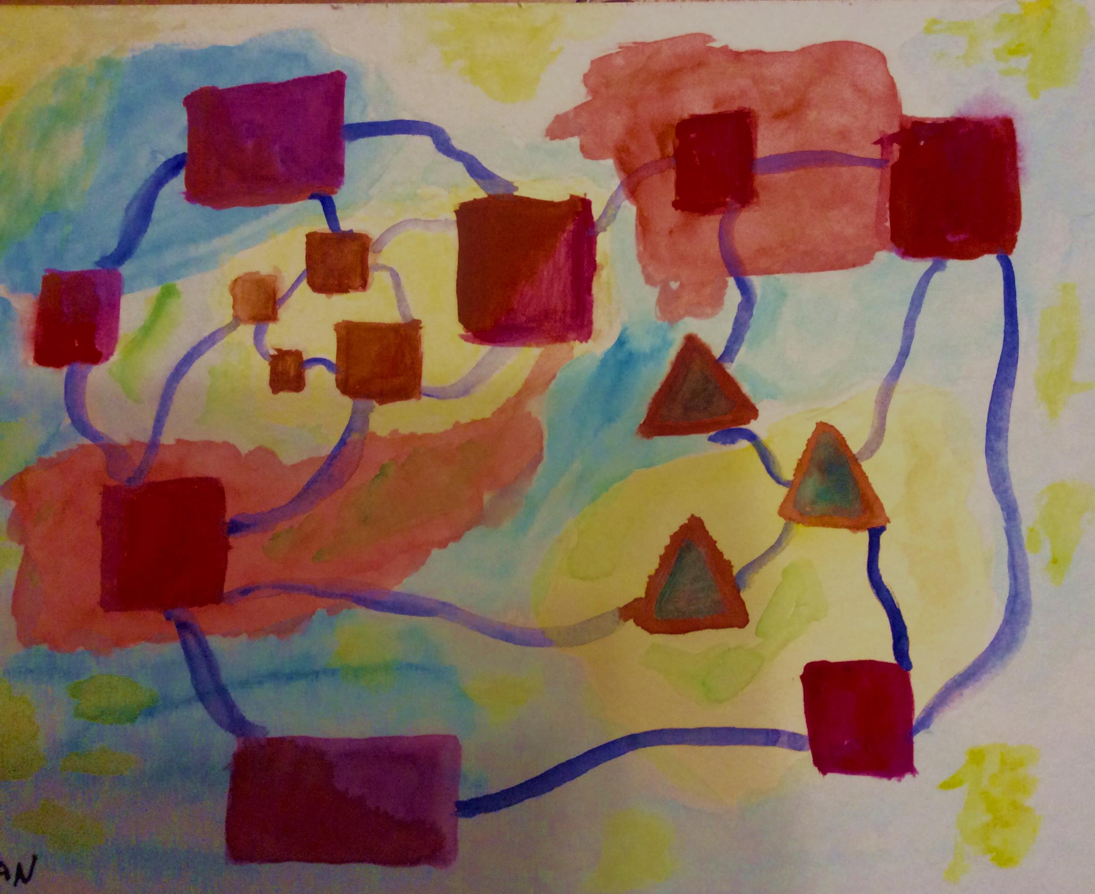
The Model in The Middle
Reflections on Dialogue and Governance
from a Viable System Model Perspective
Dr. Olaf Brugman
Metaphorum 2016 Leeds, 5 October 2016
(c) Olaf Brugman, 2016
Graphic: Floating Models, by © Olaf Brugman, 2016

Slide 2
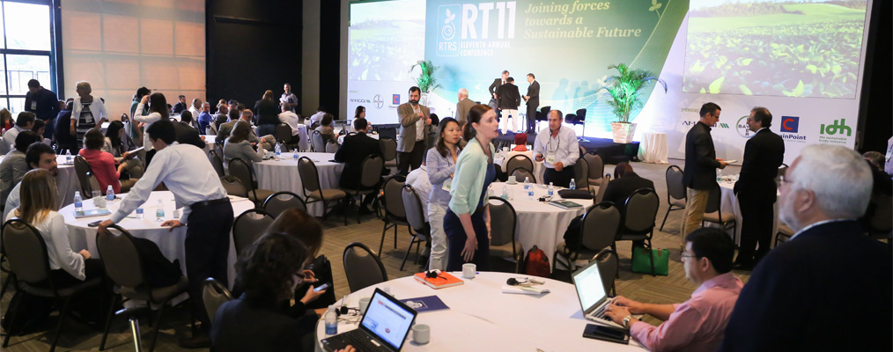
Introduction
Better functioning systems
Sustainable
Agriculture
Soy
Finance
Policies
Dialogue
(c) Olaf Brugman, 2016
(C) Photo: RTRS, 2016, used with permission

Slide 3
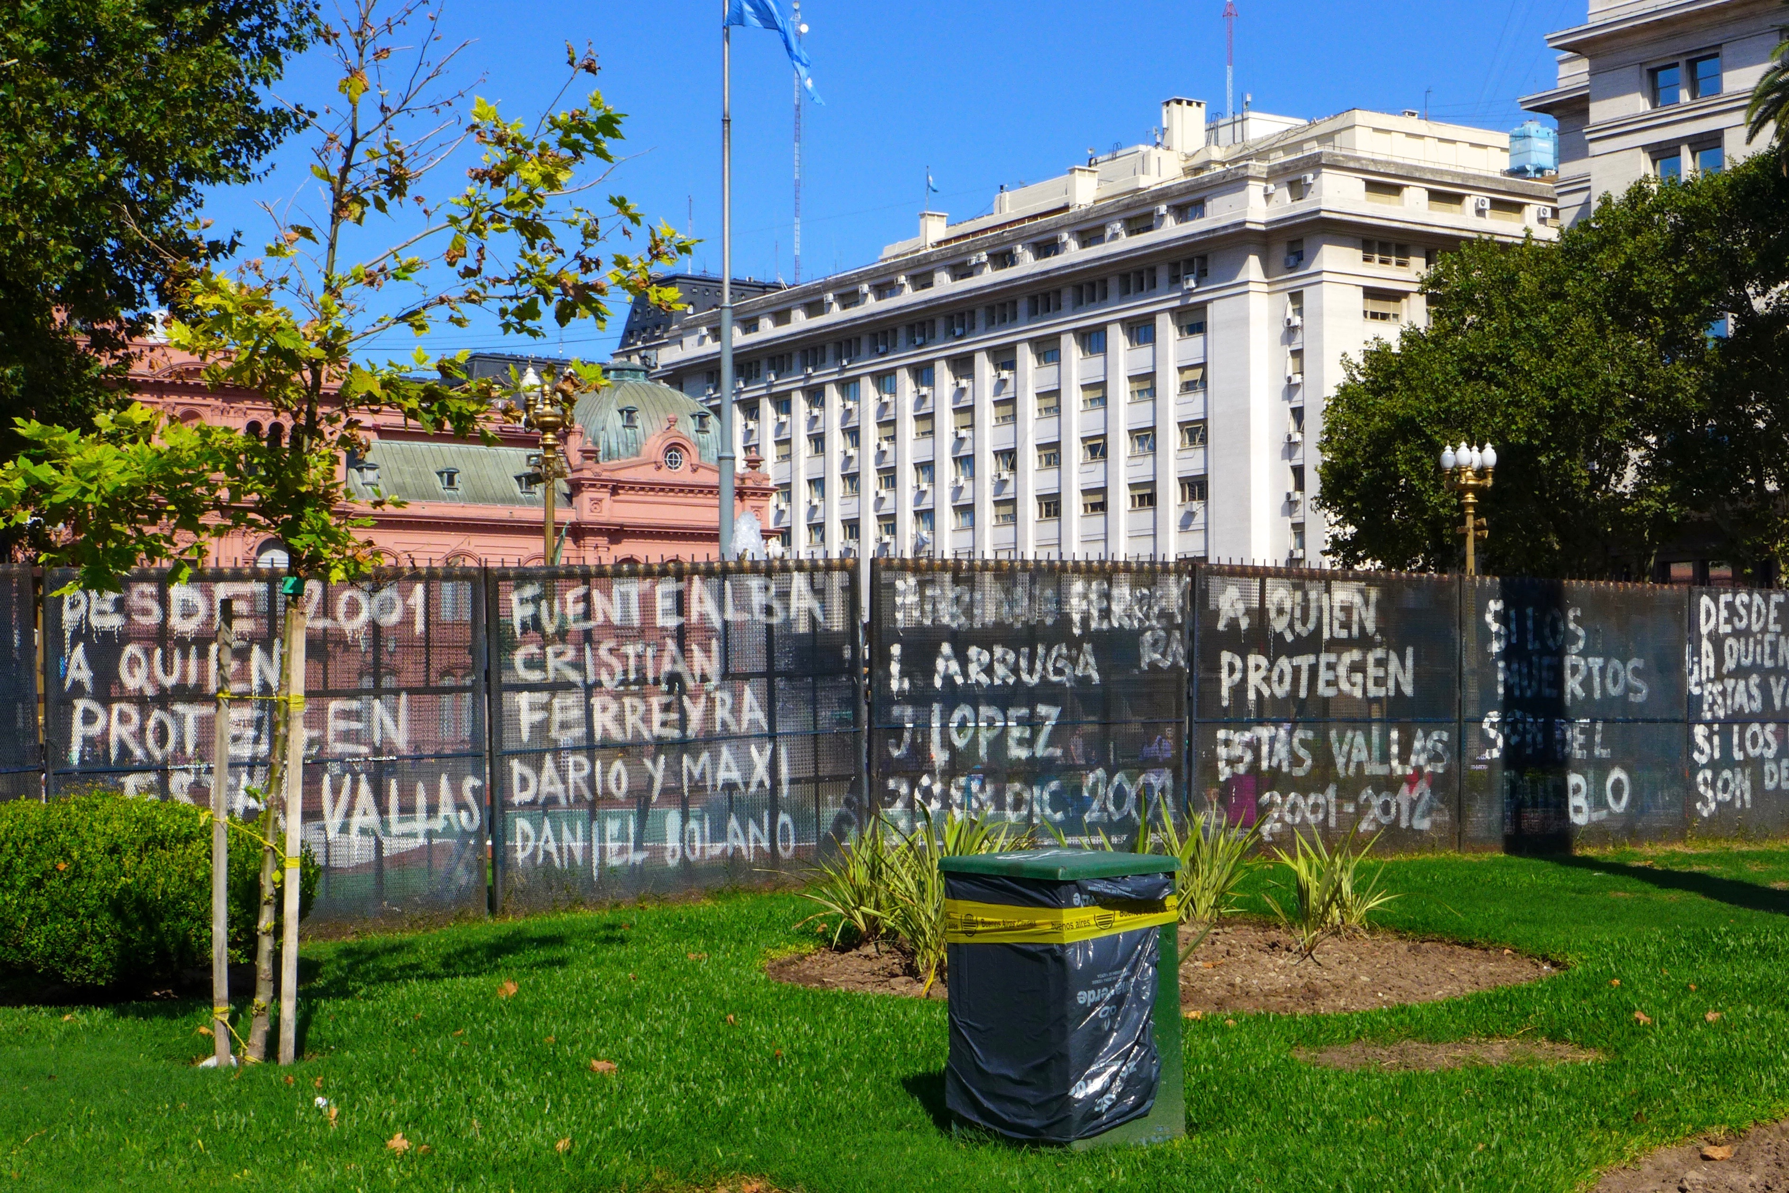
"Institutions are stuck with their ponderous machinery, while the newspapers reflect the public rage"
Our institutions need to change (be more in control)
Stafford Beer,
Designing Freedom
1974: p. 91.
Indignados, Casa Rosada, Buenos Aires. Photo (C) Olaf Brugman
(c) Olaf Brugman, 2016

Slide 4
Approaches to (controlled) change
Corporate
Governance
Stakeholder
Dialogue
Managerial
Cybernetics
Leadership Effectiveness Accountability Remuneration Shareholders
Stakeholders
(e.g, UK Corporate Governance Code)
Stakeholders
Interaction
Communication
From differing interests to shared objectives
Consultation
Cooperation
(e.g., GIZ, Wageningen UR)
Homeostats
Stability
Requisite variety
Scientific
Model-based
Knowledge
Invariant model effective organization
(VSM Model)
(c) Olaf Brugman, 2016

Slide 5
Managerial Cybernetics: regulates based on model of a system, its dynamics and scientific knowledge
Approach | Aims to regulate | Aspects & Issues
Corporate Governance | Board, Greed & Shareholder Interests | Manages accountability, not non-hierarchical learning and change
Stakeholder Dialogue | Conversation & Consensus | Increases understanding, Organisation-centred, Conflict and dispute? Consensus may not solve or dissolve the problem
Managerial Cybernetics | Dynamics of Complex Systems through effective organization | Functioning of systems Hierarchical and non-hierarchical, Works on system dynamics Where are people’s conversations, disputes and conflicts?
(c) Olaf Brugman, 2016

Slide 6
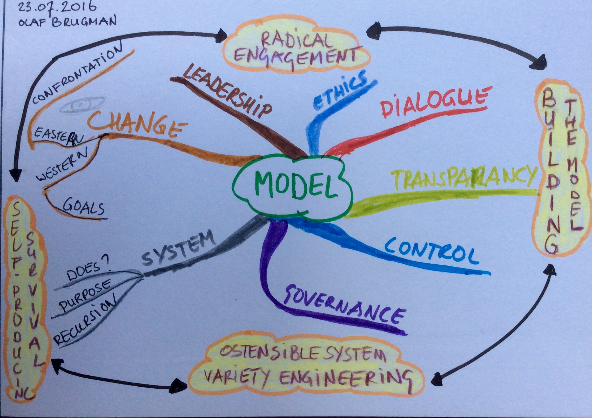
Better functioning systems require better functioning models
Graphic: “Model” mindmap, by © Olaf Brugman, 2016
(c) Olaf Brugman, 2016

Slide 7
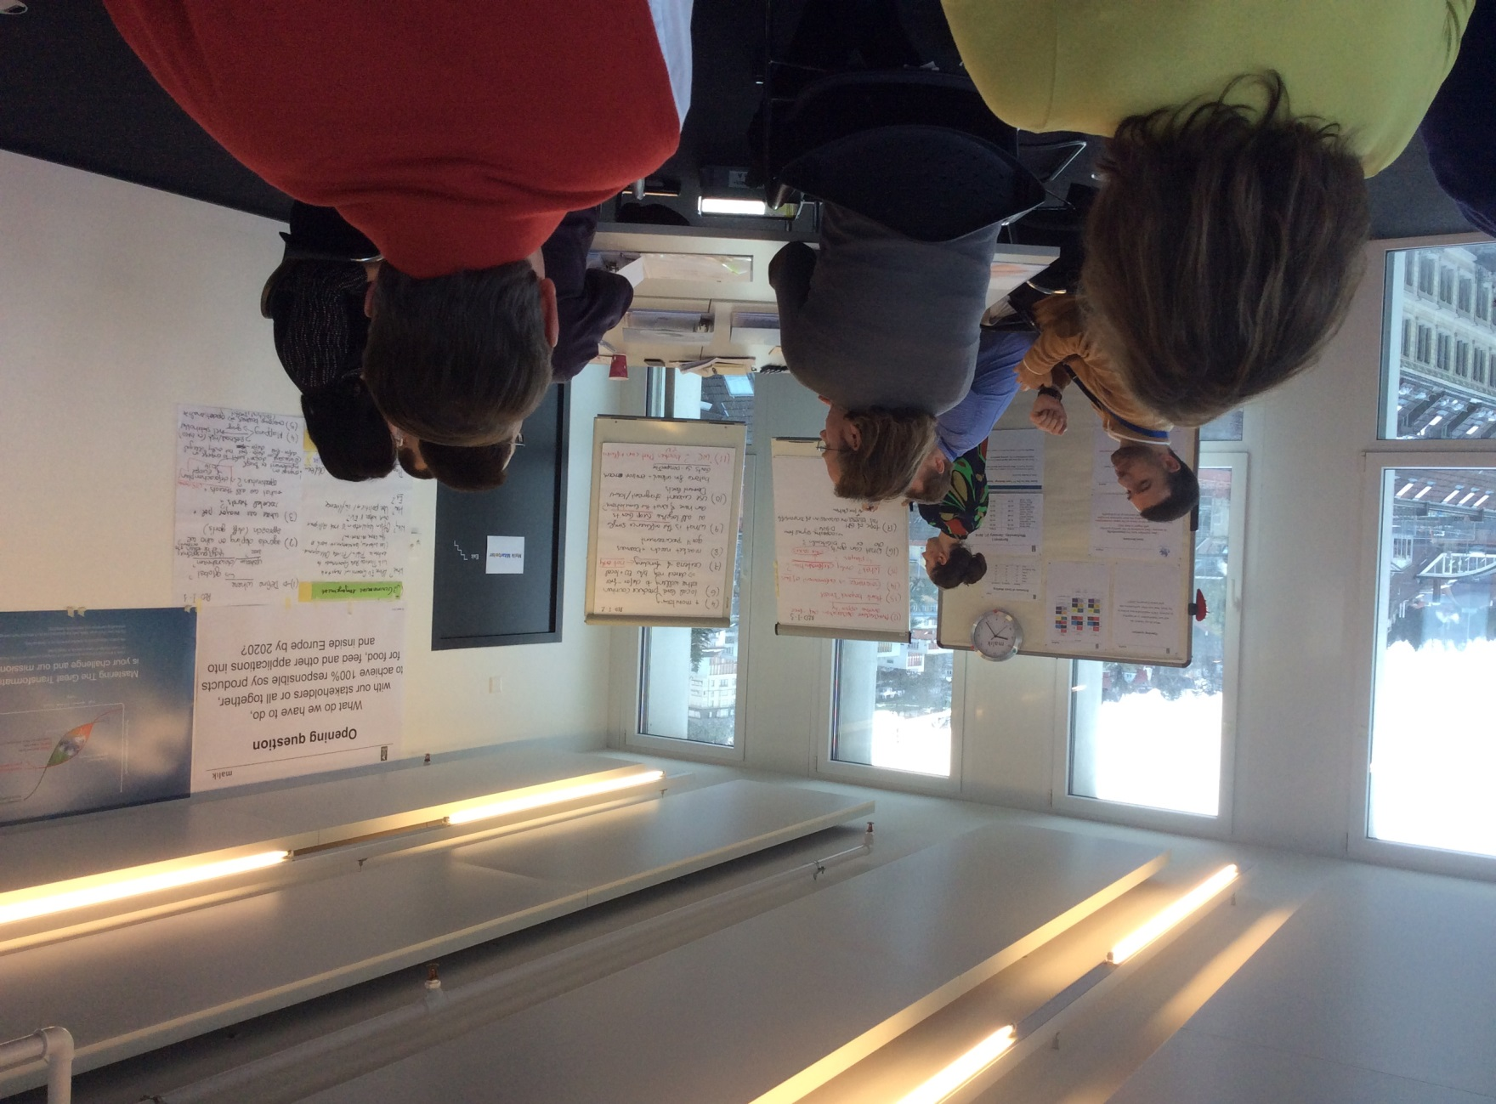
Multi-Stakeholder Dialogue and Action-seeking on Responsible Soy through Malik Super Syntegration®
“How to arrive at 100% responsible soy in Europe by 2020?”
Non-hierarchical network of experts and organisations
Intention: move the market to fully sustainable soy supply chains
Industry, trade, farmers, civil society; Nine countries
Soy Syntegration® powered by Malik Institute and Rountd Table for Responsible Soy (RTRS),
St. Gallen, Switzerland, 26-29 January 2016. Photo (C) Olaf Brugman
(c) Olaf Brugman, 2016

Slide 8
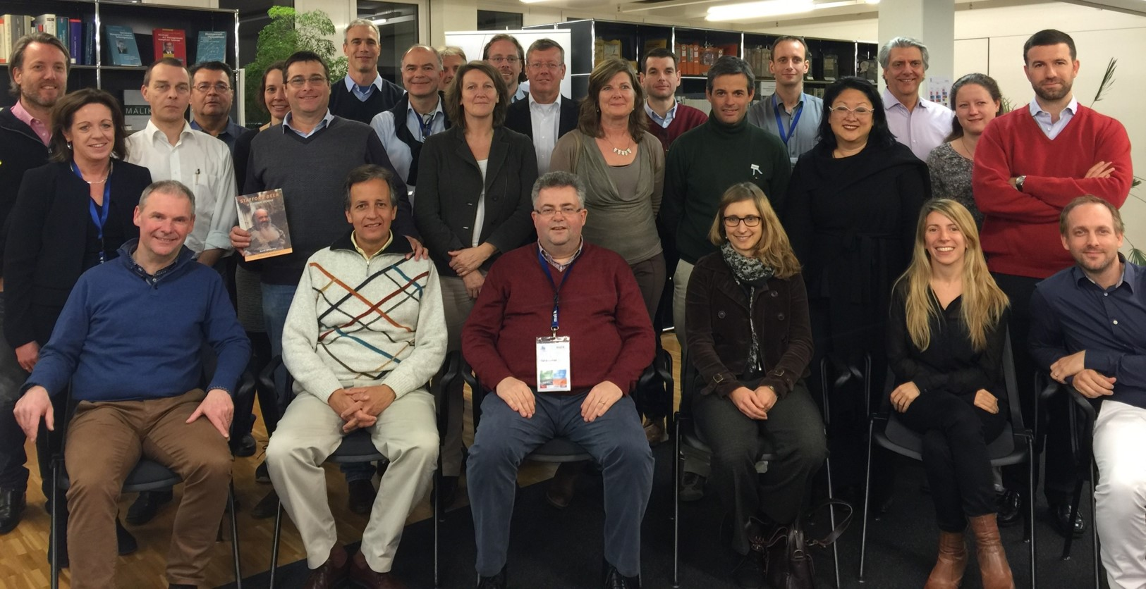
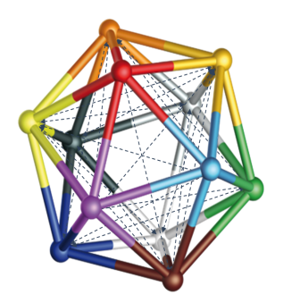
31 experts shaping Europe‘s future towards responsible soy
Malik Institute, St. Gallen January 26-29 2016
Source: Malik Super Syntegration® on responsible soy, by RTRS and Malik Institute. Used with permission

Slide 9
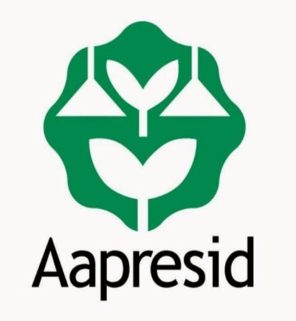
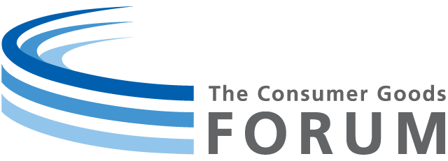
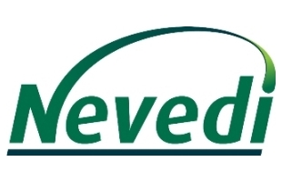
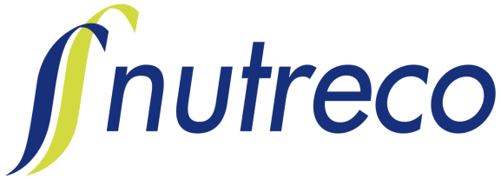
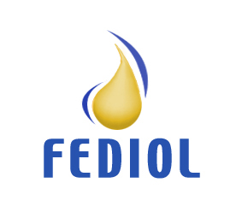
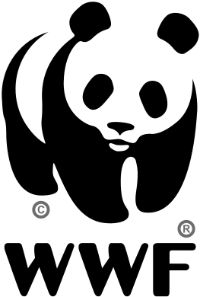
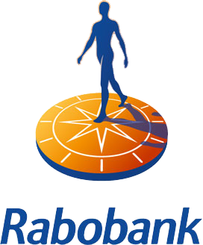
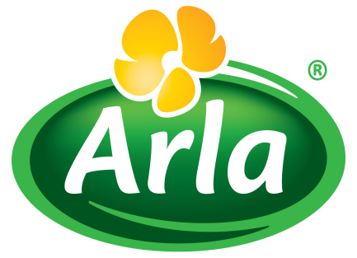
31 experts from 26 organizations contributed to the results Among them …
Source: Malik Super Syntegration® on responsible soy, by RTRS and Malik Institute. Used with permission

Slide 10
The Syntegration changed the participants’ perspective
1. Focus on crops
… value proposition of stakeholders in the value chain
2. Perfection
… stepwise approach, living labs and lessons learned
3. Everything
… Focussed
4. Why
… What and How
5. Proliferating complexity of the soy world
… stakeholder driven strategic pathways and pilot initiatives bring clarity
6. Blockages
… opportunities
7. Defensive
… experimental
Source: Malik Super Syntegration® on responsible soy, by RTRS and Malik Institute. Used with permission

Slide 11
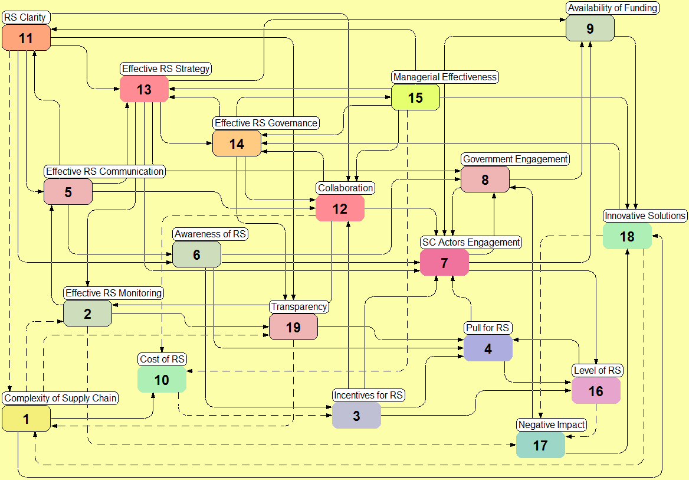
Having a holistic understanding of the system is crucial before taking action
System Facts:
19 Variables
63 Interrelations
1874 Feedback loops
981 stabilizing feedback loops
893 reinforcing feedback loops
Interpretation:
The system is strongly interconnected (degree of networking 3.32 = 32% more than average).
There are more stabilizing than reinforcing feedback loops. This means the Responsible Soy System is rather slow to move.
Though, there are several short and quickly reacting reinforcing feedback loops, e.g. 14→12→14, 13→14→13, 4→16→4. They can activate the system, if the variables are functioning properly.
The color of each variable correlates with its position in the Impact Map.
Confirming effect: The more/less, the more/less
Opposing effect: The more/less, less/more
Source: Malik Super Syntegration® on responsible soy, by RTRS and Malik Institute. Used with permission

Slide 12
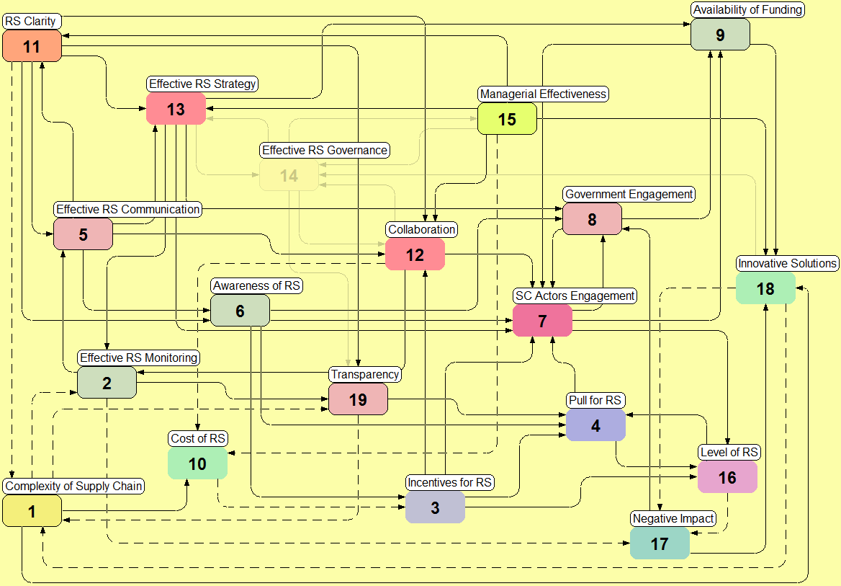
Effective Governance is the most essential variable for moving the system
System diagnosis:
If the variable “Effective RS Governance” is deactivated, the number of reinforcing feedback loops is reduced to 12% (114 instead of 893).
The color of each variable correlates with its position in the Impact Map.
Confirming effect: The more/less, the more/less
Opposing effect: The more/less, less/more
Source: Malik Super Syntegration® on responsible soy, by RTRS and Malik Institute. Used with permission

Slide 13
64% of the actions equals 80% of the change effect within the Responsible Soy System Create a “Responsible Soy Alliance” and “Determine Multi-Stakeholder Governance” have the greatest systemic impact
Single effect¹ of 12 (=35%) of the 34 actions, which account for 50% of the total systemic impact.
Single effect¹ of the further 10 measures, which account for an additional 30% of the total systemic impact, together =80%.
Accumulated effect
Relative system-cybernetic effect per action
Relative system-cybernetic effect accumulated
1) System-cybernetic effect = percental effect of each action on the overall system compared to effect of all actions.
Source: Malik Super Syntegration® on responsible soy, by RTRS and Malik Institute. Used with permission

Slide 14
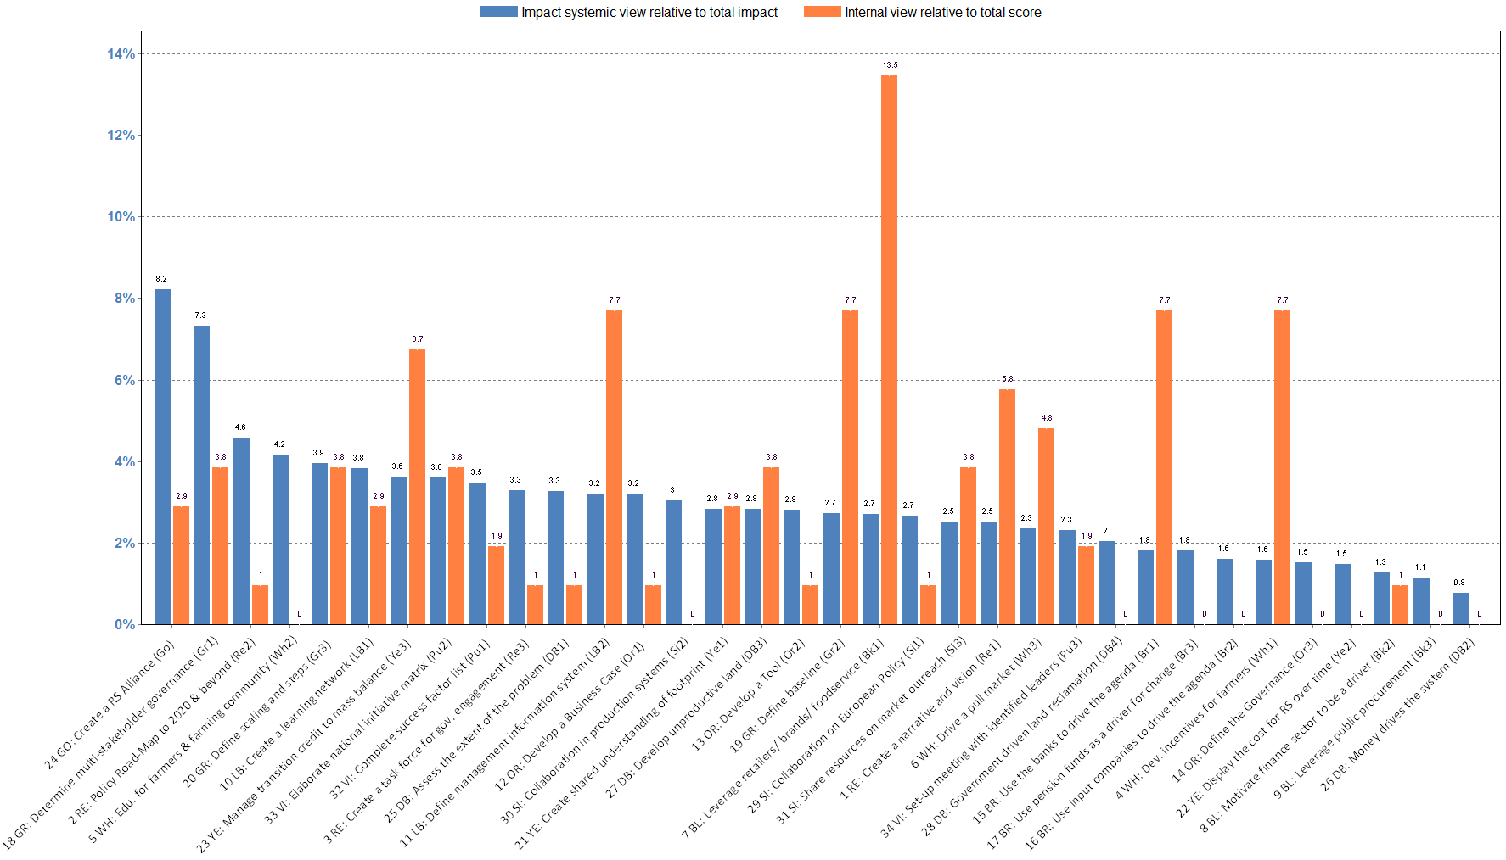
Complex systems are counterintuitive Ordinary rankings are in many cases drastically misleading as compared to a systemic diagnosis
Systemic Impact
Prioritization by Participants (final visual applause after 3rd iteration)
The prioritization by the participants is focusing on initiatives, which according to our systemic diagnosis will not have the desired effect, and thus will not bring about change.
But it may even destroy the whole system…
Source: Malik Super Syntegration® on responsible soy, by RTRS and Malik Institute. Used with permission

Slide 15
The Transformation Navigation Hub (TNH): How to turn initiatives into actions with clear accountability to drive them forward?
Topics/Actions/Projects
Topics/Actions/Projects
Red
Black
Orange
Green
Gold
Silver
Red
Black
Orange
Green
Gold
Silver
White
Light blue
Brown
Yellow
Dark blue
Purple
White
Light blue
Brown
Yellow
Dark blue
Purple
TNH
1
2
3
4
5
6
7
8
9
10
11
12
13
14
15
16
17
18
19
20
21
22
23
24
25
26
27
28
..
34
1
2
3
4
5
6
7
8
9
10
11
12
13
14
15
16
17
18
19
20
21
22
23
24
25
26
27
28
..
34
Many different stakeholders
Many different stakeholders
The interconnection of the 12 topics, the 34 measures and the relevant stakeholders of the “Responsible Soy Initiative” is immense (reaching a potential of around 650’000).
This demonstrates once again the level of complexity of the system.
Without governance and coordination the implementation will be cumbersome, conflict-laden and slow.
Source: Malik Super Syntegration® on responsible soy, by RTRS and Malik Institute. Used with permission

Slide 16
Lessons-learned
Process and setting accelerates learning
All knowledge used
Participants cannot dominate or hijack the conversation
Enriched definitions of problems/solutions (models)
New solutions appeared
Concerted action seen as high leverage factor, previsously unaddressed
Understanding of dynamics and potential synergies.
(c) Olaf Brugman, 2016

Slide 17
Dialogue and conversation in the Viable System Model?
Language is context in which system’s purpose is defined, which creates contexts for analysis and design (From Stafford Beer’s earliest books and articles on)
Dialogue, conversation, interaction: not directly treated in Stafford Beer’s books up to Platform for Change (1975), although themes and focus have always been explicitly humanistic and social.
Interactions in/by/between Systems 3-4-5 and System 1 vs 3-4-5 homeostats (Brain of the Firm,1972; Heart of Enterprise, 1979; Diagnosing the System, 1985)
Change, adaptation and (dis)solving problems and undecidable propositions: by reframing undecidable propositions (models) at higher system level with different language (Platform for Change, 1975) => Change the model of the regulator, at a higher system level if you need to.
Beyond Dispute (1994) (!): non-hierarchical solutions to problems of regulatory systems (e.g. variety-destroying hierarchy), Team Syntegrity, recursive consciousness, structure as process.
Spiritual growth, Indian philosophy to rethink wholeness and concept of system/environment (e.g. living systems, biology, Maturana/Varela)) ( Think before you Think, 2009)
(c) Olaf Brugman, 2016

Slide 18
Dialogue and the VSM: Final conclusions
The Viable System Model allows every conceivable application or function of dialogue regarding system problems and (dis)solving them through isomorphous and homomorphous cybernetic mapping of ostensible systems to the VSM and vice versa.
In doing so, dialogue becomes an explanatory principle to adjust regulator models or regulator adjuster models based on feedback in cybernetic systems.
Dialogue then has the function of increasing or decreasing the variety of (the regulator models of) systems.
Cybernetically speaking, dialogue derives its sense from its contribution to adapt models, regulation and the scientific knowledge on which they are founded.
As a consequence, the effectiveness of dialogue can be evaluated in terms of the valid knowledge that was produced, their amplification and attenuation in cybernetic systems, and the regulatory models regarding what it is that is to be regulated.
Dialogue should be designed to do so. Syntegration® is a powerful and effective way to do it.
The dynamics of dialogue could and should be analysed and designed at all recursive levels of systems
Recursive application: the effective dialogue on the application of the VSM: how could (knowledge of) its application and dissemination be accelerated? We could create a VSM Transformation Navigation Hub for that!
(c) Olaf Brugman, 2016

Slide 19
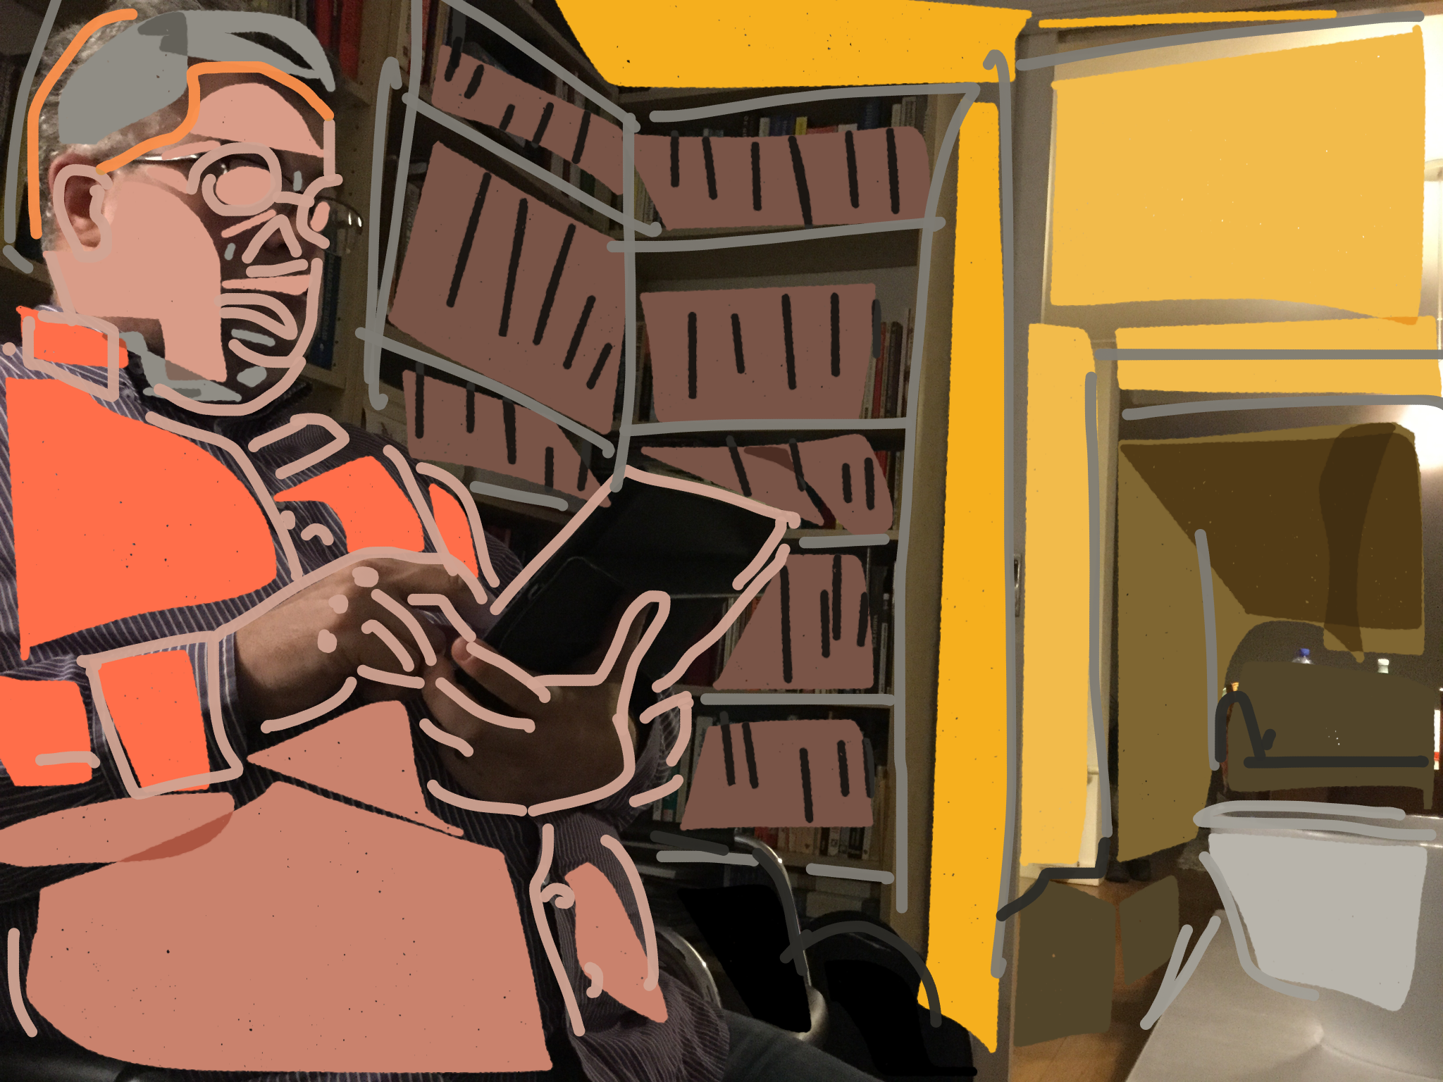
Thank you!
Where to go:
Dr. Olaf Brugman
Email: obrugman@me.com Skype: olafbrug Twitter.com: olafbrugman Researchgate.com Linkedin.com
Photo art by © Vilma Machado.. Used with permission
(c) Olaf Brugman, 2016

