Slide 1
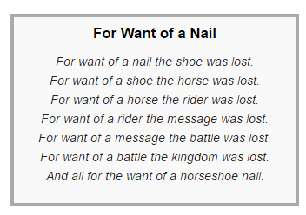
Black Swan River Colony

Slide 2
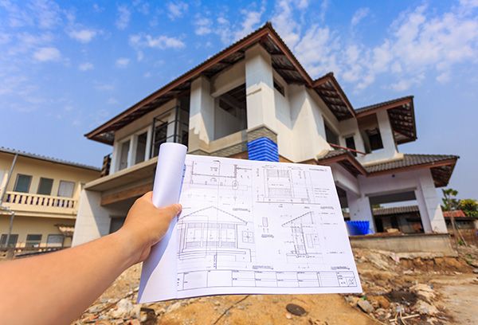
“Builders and surveyors are now monitored but there are still gaps” #
Building Construction Regulation through the (VSM 3*) ‘Looking Glass’
Russell Clemens, Metaphorum Conference
Leeds Beckett University: 5th – 7th October 2016
[# Office of Auditor General (WA), 2016]

Slide 3
4 objectives of this presentation:
Briefly outline a 2-year case study project
Interpret events & dynamics using the VSM (& some amateur Org. anthropology)
Comment on industry/organisational cultures (with respect to the ‘feasibility’ for desirable change & the risk triangle).
Suggest possible future research directions (as indicated by ‘data’ related to risk, ‘gaps’ & supervision)
Notes:
2 year on the job project (one of three) as ‘wild card’ additional staffing resource during transition times (relocation Cannington & identity submersion into DoC)
Use of Beer’s works ; Checkland’s SSM & some amateur anthropology looking at “cultures of (in) feasibility…
Also Risk Communications (Sandman = Total risk = Hazard + Outrage) & risk fraud triangle (Cressey) with focus on “justification” etc

Slide 4
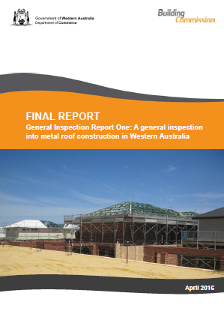
An Analysis of a 2-year ‘on the job’ (as an informal action research project)
From… To…
Stakeholder Discussion Draft – the rubber hits the road
Final Report – cycle completed & historical record

Slide 5
Case Study: Housing Construction Industry Regulation
What: General Inspection Report (1st of … the ‘icebreaker’)
Why: Evidence of roofing system failure & anecdotal evidence of poor practice within the industry
Where: Western Australia (WA) – principally, Perth
When: February 2014 – April 2016
How: 123 houses (with metal roofs under construction) against Australian Building Codes & Standards
By whom: Building Industry Regulator using experienced building inspectors & other related staff resources

Slide 6
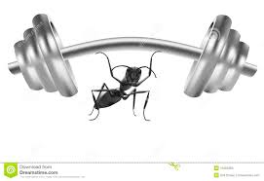
Transformation: Built Environments (Including Technology, Economic & Ethos )
From traditional heavy materials ➔ To new light-weight materials
Heavy clay/cement tiles
Heavy hardwoods (Jarrah)
Hammering the ‘right’ nails
Apprenticeships
Corrugated iron (tin) – now 60%
Softwoods (pine)
Nail guns (standard machine nails)
Training students
Force: Dead weight
Force:
wind uplift

Slide 7
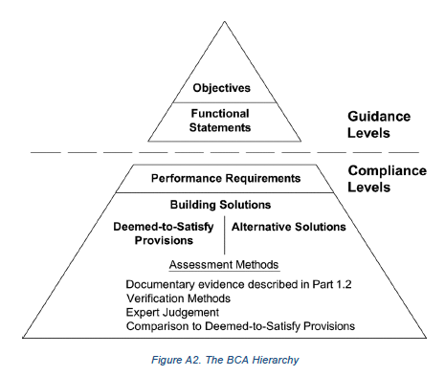
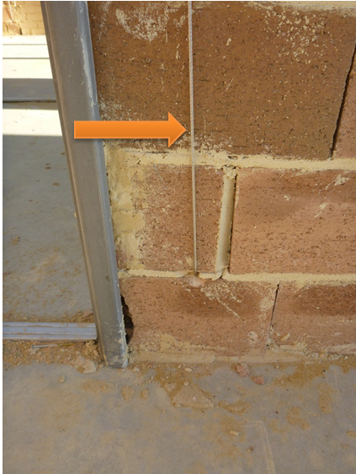
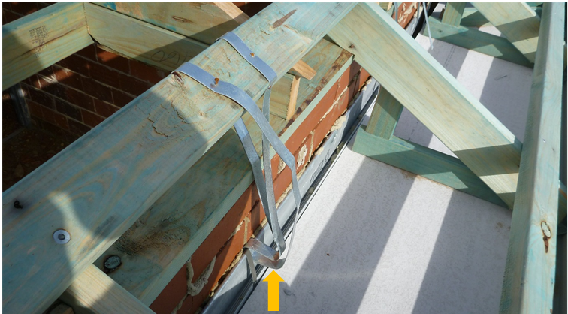
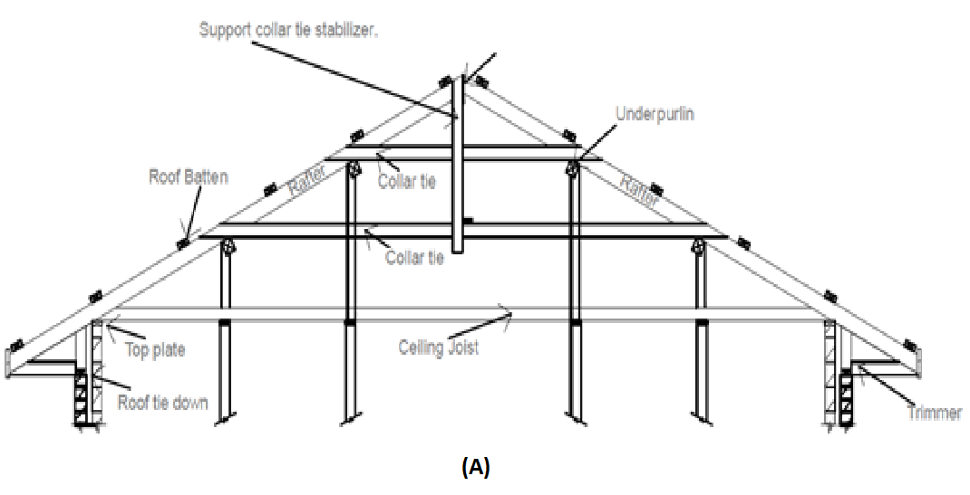
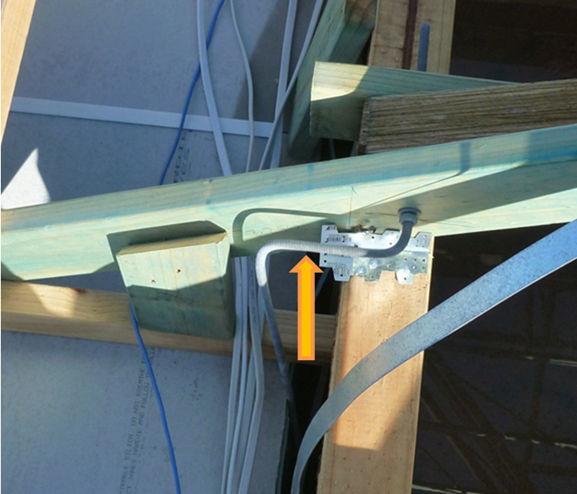
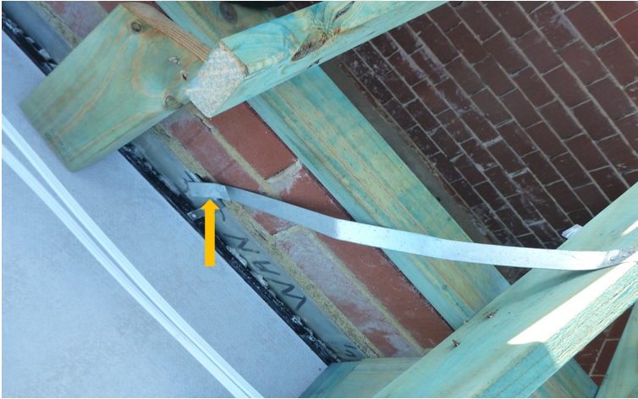
Focus: Tie downs – ‘wood to brick’ Stick roofing: Constructed on site as distinct from using standard pre-assembled trusses.
The algedonic concern: Another one of these & ‘contagion’ ?
Hunn Report into “weathertightness” (Hunn, Bond & Kernohan 2002) or, as it is more commonly known, as ‘New Zealand Leaky Building Syndrome’.
(PriceWaterhouseCoopers 2009) – indicate the potential magnitude and economic impact of such structural problems in the building industry should not be ignored.
The consensus forecast of the costs associated with the weathertightness issue was calculated at just over $11M which does not include Government costs. An extreme view estimate put the costs in excess of $22M.

Slide 8
Organisational Overview
Management levels involved
Minister
Director General (Acting/Commerce)
Building Commissioner
Directors (x3 – Licencing, Policy, Compliance)
Audit Inspection group
Manager (x1 Building Surveyor)
Inspectors (x3 – experienced trades people)
Stakeholders
Industry bodies (Housing, Building…)
Consumer Reps (High female index)
Professional bodies (Engineering, Architecture, …)
Local government (140 as implementing agents)
The following stakeholders were invited to provide feedback on the discussion draft:
• Australian Institute of Architects
• Australian Institute of Building Surveyors (WA)
• Building Services Board
• Consumer Advisory Committee
• Engineers Australia
• Housing Industry Association
• Master Buildings Association
• James Cook University, Cyclone Testing Stn.
• Royal Institute of Chartered Surveyors
• WA Local Government Association

Slide 9
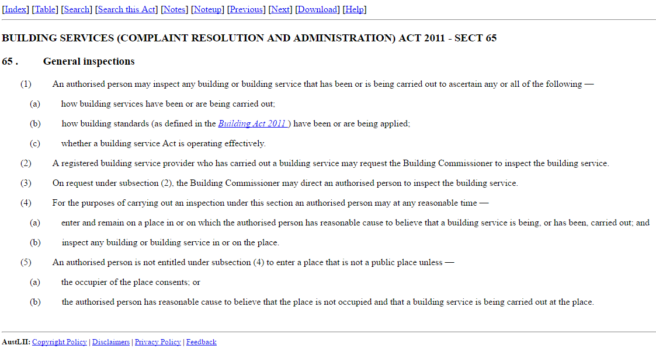
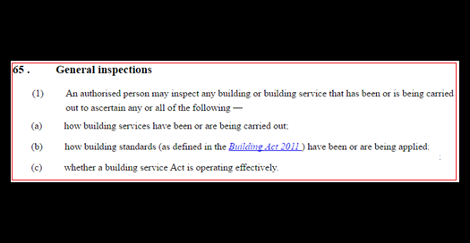
General Inspection: Boundaries
http://www.austlii.edu.au/au/legis/wa/consol_act/bsraaa2011583/s65.html

Slide 10
Artefact: ‘The Report’
Autoethnography: “A Beginning with the End in Mind…”
Outcomes:
An extensive stakeholder consultation & engagement process.
Final report with 5 strategic recommendations published April 2016.
Narrative containing detailed technical material; plus ‘Plain English’ analytical analysis; & broad executive summary.
Industry Working Groups established to implement recommendations.

Slide 11
Interpret events & dynamics using the VSM

Slide 12
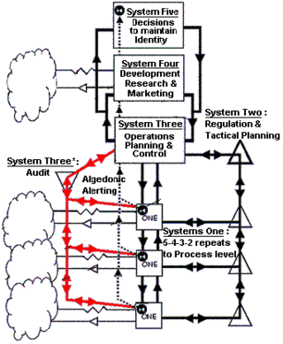
A VSM Framework@Work
Industry scale: Building Industry Regulator – VSM Systems 2 Home construction businesses – VSM System 1’s
Meta-system (Gov. scale): Building Commissioner – VSM System 3 &4 Agency & Minister – VSM System 5
Audit/feedback: Building inspectors / surveyors – VSM System 3*
Alert/risks: Through to the Minister – Algedonic link

Slide 13
VSM Feedback Framework
3 levels of VSM S3* audit/feedback recursion
Office of Auditor General (to Parliament)
Building Commission (to Minister, via Director General)
Building inspector (to Commissioner)
Impacts on VSM S5 & S4?
S5 identity very engaged (reputation risk)
S5 ‘policy’ less engaged (somewhat in denial)
S4 mainly PR/Marketing (control of information release to maintain/control formal narrative)

Slide 14
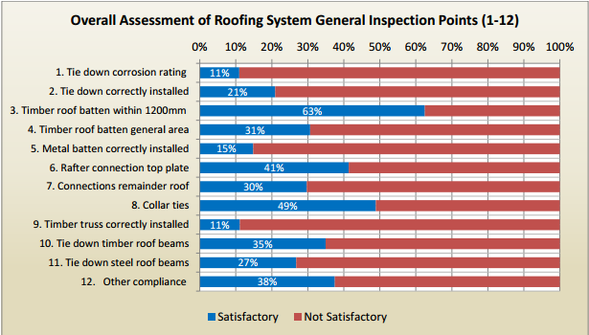
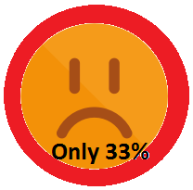
System Performance “What it does/did…”

Slide 15
Industry/organisational cultures
(with respect to the ‘feasibility’ for desirable change & the risk triangle).

Slide 16
Organisational Cultures & Feasibility “How anthropology gives meaning to organisational culture” *
Most organisations refer to culture as “the way we do things around here” – but is shallow & these views typically only describe strategy, processes or systems.
Culture in real terms is more the why – literally, why people respond & behave the way they do inside the organisation.
Trends are towards replacing traditional surveys with something called “internal conversations”.
* Ref: Corporate Anthropologist, Michael Henderson, 2014
See http://ashtonmedia.com.au/anthropology-meaning-organisational-culture

Slide 17
Organisational Culture: “Involves extremely high levels of stealth”
If you don’t know what culture is, or how to look for it, then your culture will work on your organisation’s future before you’re even aware that it’s become a problem.
Impacts adaptability capacity (i.e., anticipation & agility) – now being considered as part of risk management.
Tribal cultures are more effective than organisational cultures (as tribes are dependent on culture for future viability)
Ref: Corporate Anthropologist, Michael Henderson, 2014
http://ashtonmedia.com.au/anthropology-meaning-organisational-culture

Slide 18
Cultural Dynamics Customer 360 Symposium 2014
Circular format (tribe & animals) – ‘selective’ circle is an organic archetypal pattern of connecting with others.
3 underlying dynamics within 128 general values:
Control (circumference, branding)
Relationships (members on the internal; & tribe on external domain)
Developing & changing to the world around (R&D; & Human Resources etc)
Ref: Corporate Anthropologist, Michael Henderson, 2014
http://ashtonmedia.com.au/anthropology-meaning-organisational-culture

Slide 19
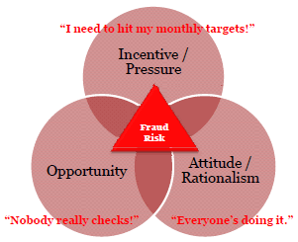
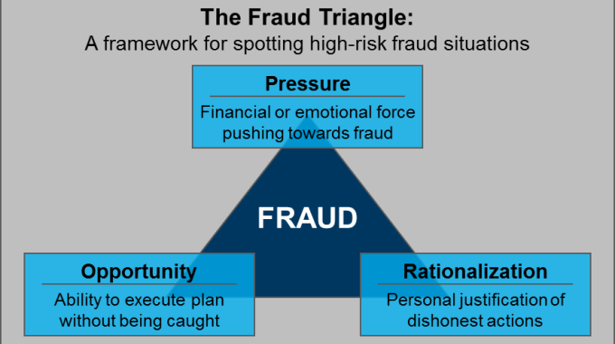
Fraud Risk Triangle
Donald Ray Cressey (1919 –1987)
“Everyone’s doing it!”
Common rationalizations are:
The company owes me.
I am borrowing the money & I will pay it back. (The most common rationalization)
I’m not hurting anyone.
We’ll fix the books after this difficult time passes.
If I can’t meet my obligations, people will know & I will be humiliated.

Slide 20
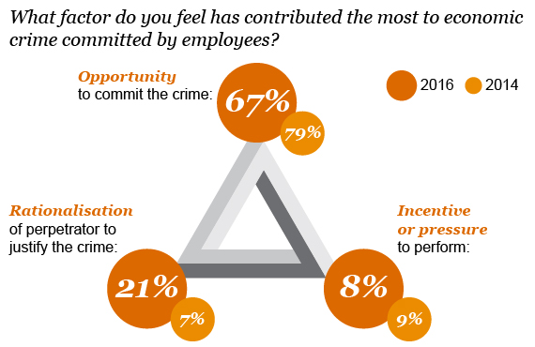
Emerging Cultural Risk Trends
www.pwc.co.uk/services/forensic-services/insights/global-economic-crime-survey-uk/culture.html

Slide 21
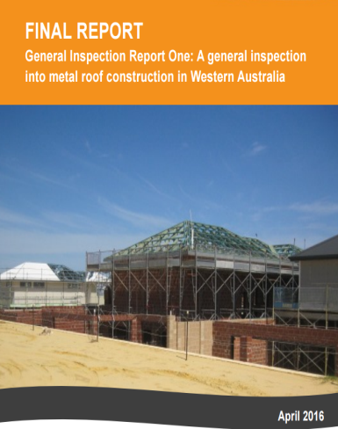
Final Outcomes
Final published report
Tone: Less focus on ‘compliance’ – the new language of a ‘general inspection’ was discovered & defined (as a shared experience)
Greater engineering background detail added (why explanation & informative)
Less word emphasis on the poor ‘33%’ rating (only mentioned once or twice)
Pitched to the Building Commissioner (& then shared by him with the WA public)
Recommendations
Reduced from 9 tactical (draft) to 5 strategic recommendations (by Building Commissioner himself after stakeholder feedback stage)
Industry Working Groups to implement recommendations (not formulate them)
Stakeholders
Auditor General noted report & ‘gaps’ (see quote in title)
Industry bodies complied (eventually)
Consumers largely unaware (media silence)
Professions on notice (& mainly supportive at ground level)

Slide 22
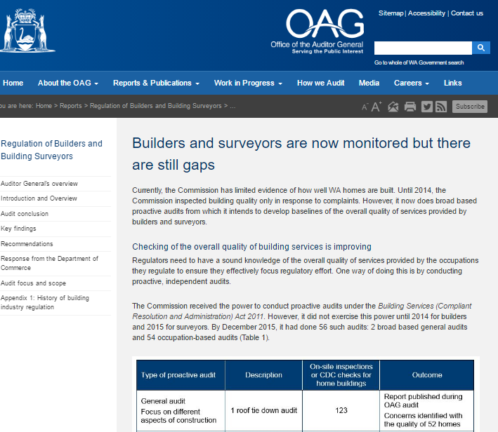
Auditor General’s Opinions
"The audit did not assess the effectiveness of reforms in building industry regulation introduced in 2011 but we did review the status of their implementation.“
https://audit.wa.gov.au/reports-and-publications/reports/regulation-builders-building-surveyors/introduction-and-overview/

Slide 23
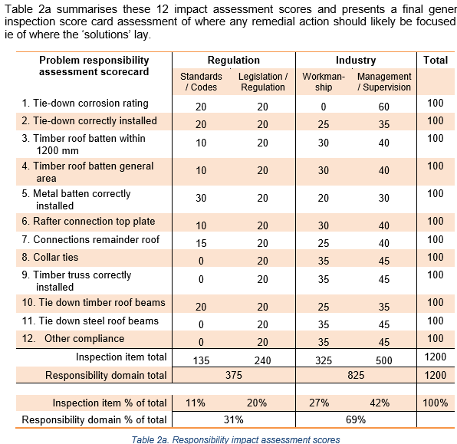
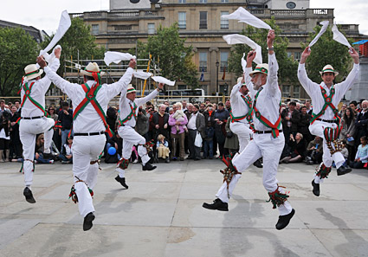
Evidence Based Policy: So what?
A perspective informed by Sullivan (2008)* – quote:
“The paper [Sullivan’s] suggests that bureaucratic culture is established and maintained by the operation of hierarchy and manipulation of the flow of information through the system, both of which are mediated by ideologies of accountability.
“The danger is bureaucratic involution, where policy making appears like a morris dance, deeply satisfying to the participants, but ultimately with unintended and confusing effects.
* “Bureaucratic process as morris dance: an ethnogrraphic approach to the culture of bureaucracy in Australian aboriginal affairs administration”, critical perspectives on international business, Vol. 4 No. 2/3, 2008)

Slide 24
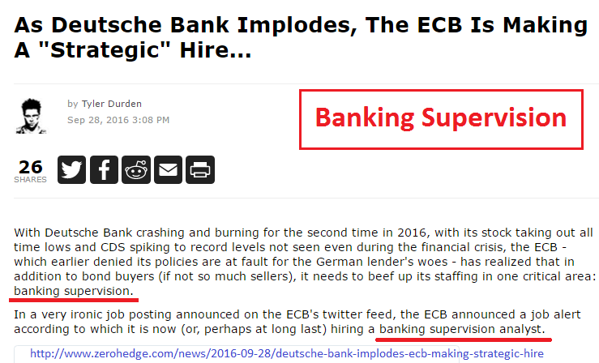
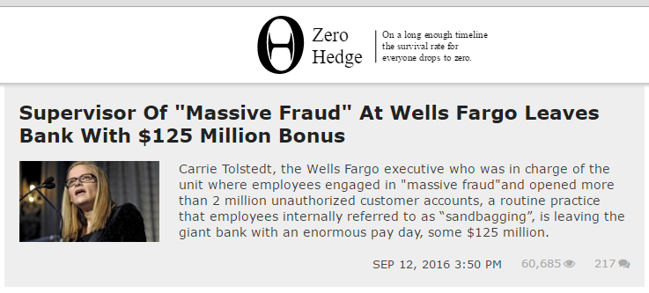
Gap1: Supervision = super_vision?
(Missing in action…)
The Queensland Building and Construction Commission (2015) considers at least 60% of reported seriously defective domestic building work is the result of poor supervision.
The Rationalisation?
http://www.zerohedge.com/news/2016-09-12/supervisor-massive-fraud-wells-fargo-leaves-bank-125-million-bonus

Slide 25
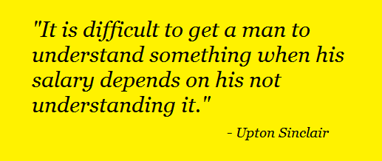
Gap2: ‘QA’ Endorsement = tick✓…?
Data showed no meaningful statistical distinctions in ‘satisfactory compliance’ between buildings by companies with ‘QA’ endorsements & others.
The Rationalisation?

Slide 26
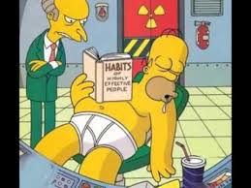
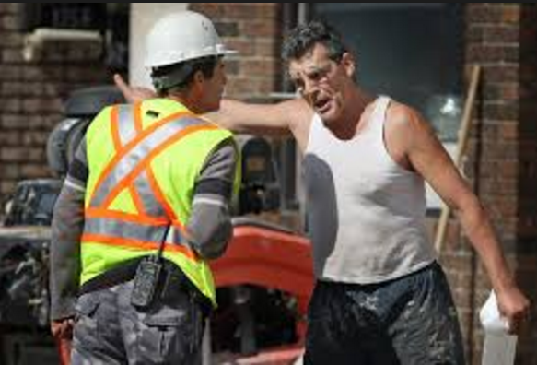
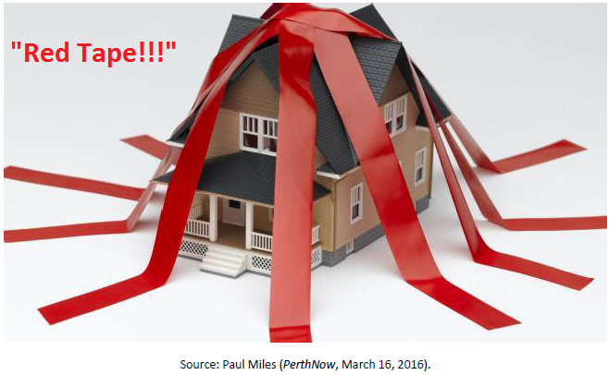
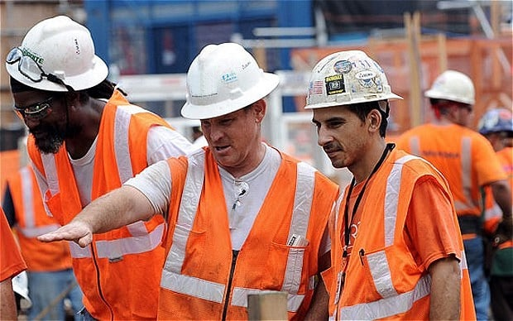
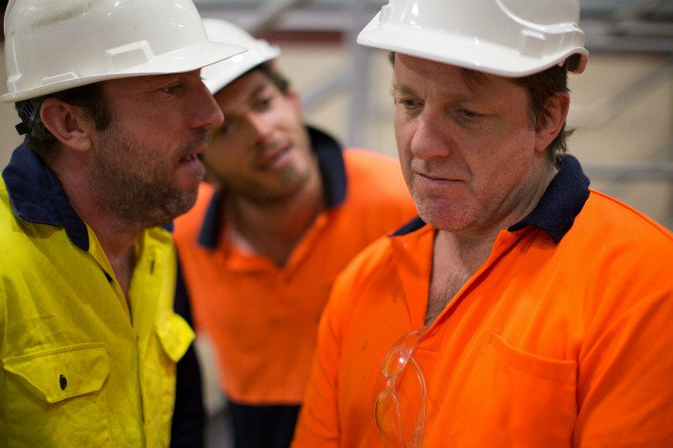
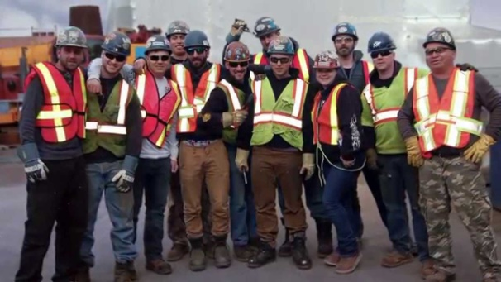
Gap3: Operations Theory = Y for X?
Data supports anecdotal knowledge (of the trades within the industry) that applying a ‘self-regulation’ Theory Y ethos to a construction domain known to have a strong culture of ‘bullying’ index … is a miss-match.
The Rationalisation?

Slide 27
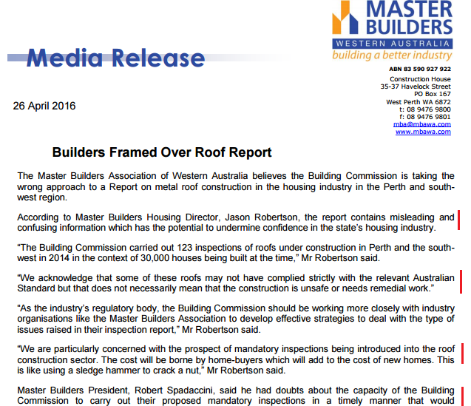
One Industry Public Response…

Slide 28
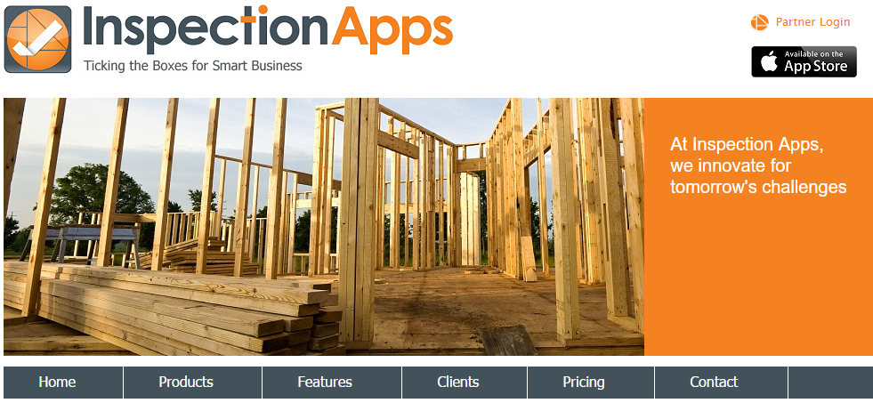
Possible future research directions (suggested by ‘data’ related to risk, ‘gaps’ & supervision)
Viable ‘fit for purpose’ evidence based Regulation Theories which are suitable for an age of systemic complexity & cultural ‘gap’ fraud risk … cui bono?
Supervision – how to determine what is requisite?
Risk – fraud triangles & rationalisation trends
Culture – Org. dynamics of ‘infeasibility’
Audit – determining the right balance & strategy
Innovation – Applied technologies for evidence collection
Time for a New Viable Audit Society? *
“Regulators need to have a sound knowledge of the overall quality of services provided by the occupations they regulate to ensure they effectively focus regulatory effort. One way of doing this is by conducting proactive, independent audits.”
(WA OAG 2016)
* Power, M. (1994), “The Audit Society”

Slide 29
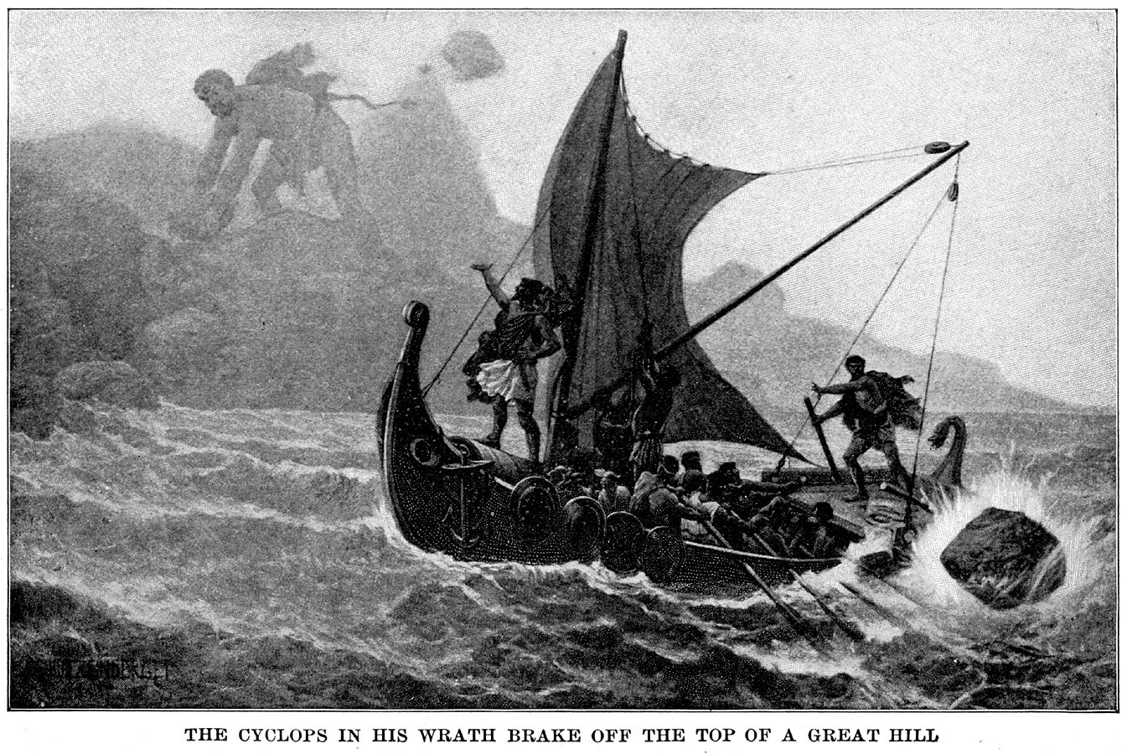
Questions?
– and so, with in the end (in mind) –
Bottom-line: “A shared sense of natural justice & shop-floor appreciation for a ‘win’ at last… they found their voice, and the long-haul effort seemed worth it …”
As for ‘management’ -- the risk to the status quo is …?

Slide 31
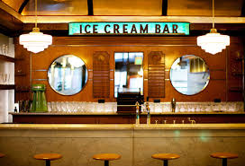
So, …Later in the bar …?

Slide 32
Beyond Dispute …?

