Slide 1
Digital Transformation
A new management for a new era.
Dr. Markus Junginger

Slide 2
Digital @ R&D
– Motivation & solution

Slide 3
Business Transformation – The consequent and systematic application of the theory of constraints uppon all relevant workflow-parameters.
Engineering Effectiveness | Overview
Theoretical Frameworks
Erlang (1909), Little (1961), Goldratt (1984), Nyhuis/Wiendahl (1999), Beer (1972), Luhmann (1982)
Workflow parameters:
Market pressure of dynamic competitors
Increasing complexity
Human behavior
Processes
Structures
Enterprise
Embedding via behavioral culture and tailor-made IT- and leadership tools
Sustainably achievable effects:
Unleashing the same agility as hyper-productive software firms
Mastering throughput limitations
Context-sensitive adaptation of the existing analog and digital process landscape

Slide 4
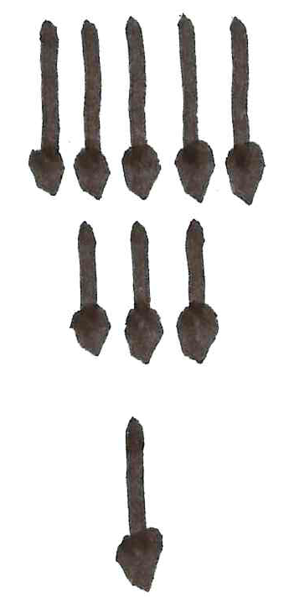
In a digital world the core economic life could appear to be centered on the processing of ever-greater numbers of new ideas into workable innovation.
Digital @ R&D | Motivation
Past challenge
Future challenge
Growth constrained by number of potential new ideas
Growth constrained by the ability to process potential new ideas
Weitzmann (2016) Recombinant Growth.

Slide 5
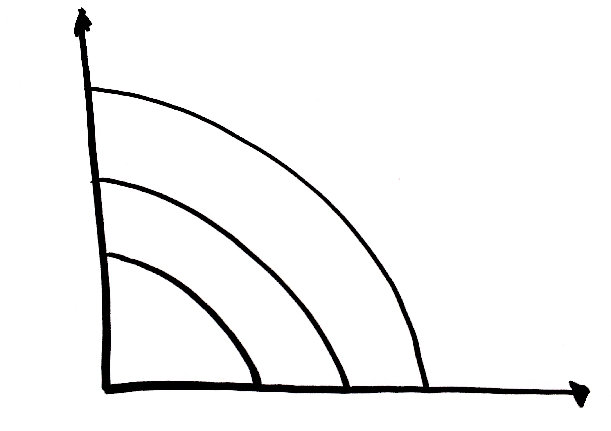
In order to maximize the innovative spirit of engineers, their capacity should be shifted from solving “complicated” towards solving “complex” tasks.
Digital @ R&D | Solution
Far from agreement
Complex
Empirical Process: Agile Methods
Requirements
Complicated
Lean methods
Simple
Defined oder determined process
Close to agreement
Close to certainy
Far from certainy
Technology
Snowden (1999) Cynefin, A Sense of Time and Place.

Slide 6
„Only variation can force variation down.“ Therefore a system can only cope with a level of complexity that is equivalent to its own complexity.
Ashby, W.R. (1956): An Introduction to Cybernetics

Slide 7
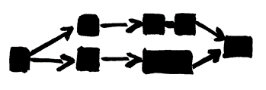
In order to maximize the innovative spirit of engineers, their capacity should be shifted from solving “complicated” towards solving “complex” tasks.
Digital @ R&D | Solution
Complex tasks
Surprise
Principle
Flow
Leadership
System with low dynamics
System with high dynamics
„People with ideas“
Complicated tasks
Repetition
Rule
Structure
Administration
„Process description“
Wohland (2004) Vom Wissen zum Können. Merkmale dynamikrobuster Höchstleistung.

Slide 8
The larger part of complicated tasks should be automated via digital tools. Engineers could then become true digitally enabled „masters of complexity“.
Digital @ R&D | Solution
Complex tasks
Surprise
Principle
Flow
Leadership
System with low dynamics
System with high dynamics
„People with ideas“
Complicated tasks
Repetition
Rule
Structure
Administration
„Process description“
Mostly automated by means of digital tools
Digital tools enable engineers to master complexity

Slide 9
Digitization makes complication manageable and enables human talent to utilize complexity.
Digital @ R&D | Solution
Control
Broad tool portfolio for simulation, PLM-integration and migration, collaboration, 3D-data conversion
Syncronize
Standardized software, protocols and formats within the entire R&D network in order to maintain a consistent process and data backbone along the cyber/physical value chain
Set free
Opening systems architecture for new use cases and business models (including also the social systems involved - problems to be solved by those who are capable)
Adapt
9 out of 10 ideas fail – adapt the „venture capital approach“ through coexisting initiatives, migration and redundancy – efficiency follows effectiveness
Create
Crafting innovations bit by bit in a continuously improving, seamlessly-integrated collaboration atmosphere
Maintain
Safety and traceability along the engineering value chain (e.g. automated data transfers) – fostering transparency and compliance

Slide 10
Dr. Markus Junginger
markus.junginger@mhp.com

