Slide 1
Digital @ R&D
Rage with machines.
Dr. Markus Junginger

Slide 2
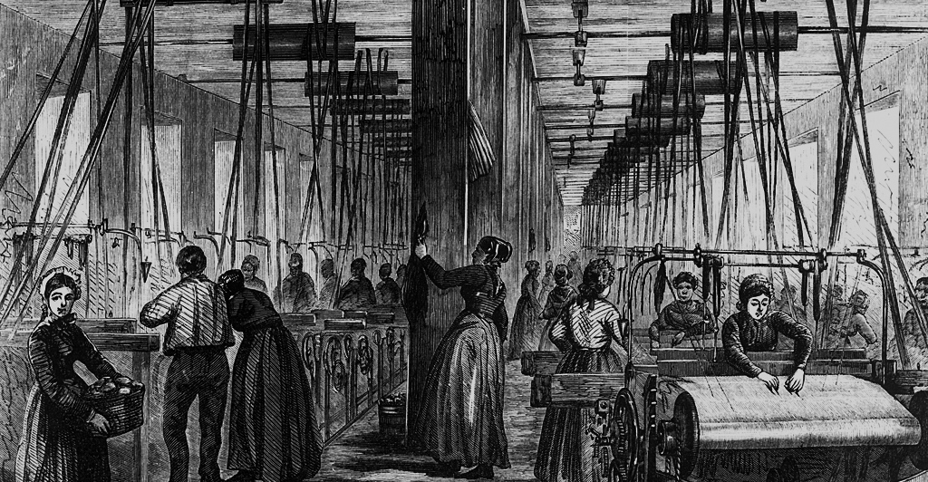
In order to unleash the full power of digitization well established dogmas need to be overcome – just as it happened in the age of electrification.
Digital @ R&D | Motivation
Studies show that American factories when they first electrified often retained a similar layout and organization to those that were powered by steam engines.
In a steam engine-driven plant, power was transmitted via a large central axle. If the axle was too long the torsion involved would break it, so machines needed to be clustered near the main power source.
Exploiting all three dimensions, industrial engineers put equipment on floors above and below the central stream engines to minimize the distances involved.
Years later, when the hallowed GPT electricity replaced the steam engine, engineers simply bought the largest electric motors they could find and stuck them where the steam engines used to be. Even when brand-new factories were built, they followed the same design.
Perhaps unsurprisingly, records show that electric motors did not lead to much of an improvement in performance.

Slide 3
In order to unleash the full power of digitization well established dogmas need to be overcome – just as it happened in the age of electrification.
Digital @ R&D | Motivation
Only after thirty years – long enough for the original managers to retire and be replaced by a new generation – did factory layouts change.
The new factories looked much like those we see today: a single story spread out over an acre or more. Instead of a single massive engine, each piece of equipment had its own small electric motor.
Instead of putting the machines needing the most power closest to the power source, the layout was based on a simple and powerful new principle: the natural workflow of materials.
For most of the subsequent century, additional complementary innovations, from lean manufacturing and steel minimills to Total Quality Management and Six Sigma principles continued to boost productivity.
McAffee/Brynjolfsson (2014) The Second Machine Age.

Slide 4
“In such a world the core of economic life could appear to be centered on the more and more intensive processing of ever-greater numbers of new seed ideas into workable innovation. […] In the early stage of development, growth is constrained by number of potential new ideas, but later on it is constrained only be the ability to process them.”
Weitzman, M. (1998): „Recombinant Growth“.

Slide 5
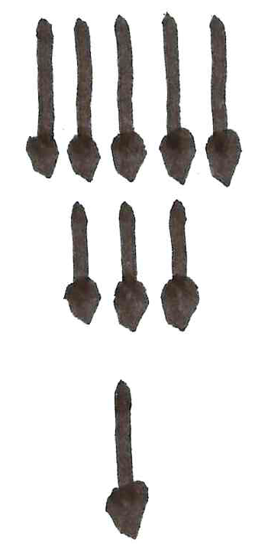
In a digital world the core economic life could appear to be centered on the processing of ever-greater numbers of new ideas into workable innovation.
Digital @ R&D | Motivation
Past challenge
Future challenge
Growth constrained by number of potential new ideas
Growth constrained by the ability to process potential new ideas
Weitzmann (2016) Recombinant Growth.

Slide 6
In order to maximize the innovative spirit of engineers, their capacity should be shifted from solving “complicated” towards solving “complex” tasks.
Digital @ R&D | Solution
Far from agreement
Complex
Empirical Process: Agile Methods
Requirements
Complicated
Lean methods
Simple
Defined oder determined process
Close to agreement
Close to certainy
Far from certainy
Technology
Snowden (1999) Cynefin, A Sense of Time and Place.

Slide 7
„Only variation can force variation down.“ Therefore a system can only cope with a level of complexity that is equivalent to its own complexity.
Ashby, W.R. (1956): An Introduction to Cybernetics

Slide 8
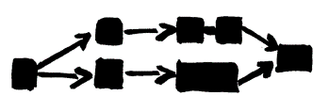
In order to maximize the innovative spirit of engineers, their capacity should be shifted from solving “complicated” towards solving “complex” tasks.
Digital @ R&D | Solution
Complex tasks
Surprise
Principle
Flow
Leadership
System with low dynamics
System with high dynamics
„People with ideas“
Complicated tasks
Repetition
Rule
Structure
Administration
„Process description“
Woland (2004) Vom Wissen zum Können. Merkmale dynamikrobuster Höchstleistung.

Slide 9
The larger part of complicated tasks should be automated via digital tools. Engineers could then become true digitally enabled „masters of complexity“.
Digital @ R&D | Solution
Complex tasks
Surprise
Principle
Flow
Leadership
System with low dynamics
System with high dynamics
„People with ideas“
Complicated tasks
Repetition
Rule
Structure
Administration
„Process description“
Mostly automated by means of digital tools
Digital tools enable engineers to master complexity

Slide 10
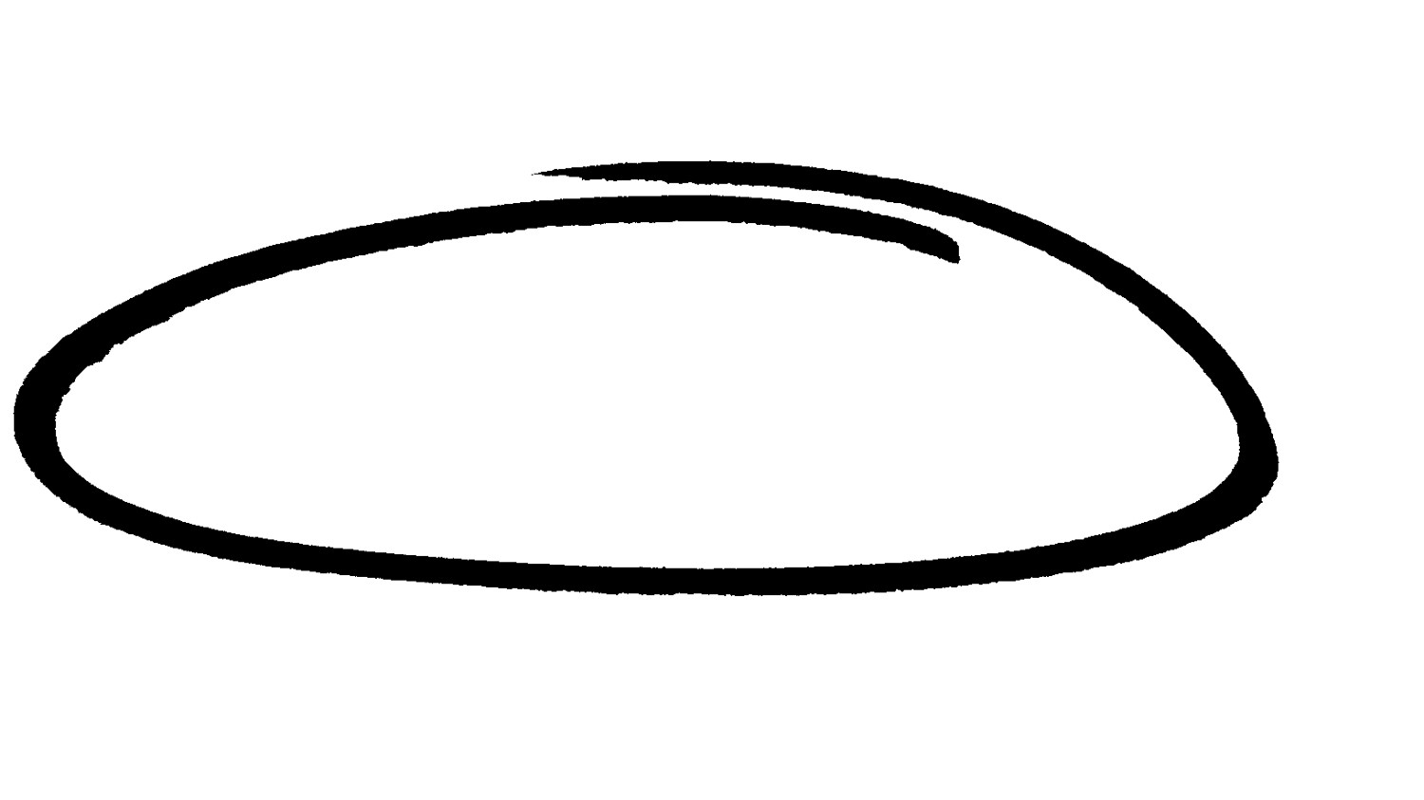
Business Transformation – a consequent and systematic application of CAS theory uppon all relevant workflow-parameters.
Engineering Effectiveness | Overview
Theoretical Frameworks
Erlang (1909), Little (1961), Goldratt (1984), Nyhuis/Wiendahl (1999), Beer (1972), Luhmann (1982)
Workflow parameters:
Market pressure of dynamic competitors
Increasing complexity
Human behavior
Processes
Structures
Enterprise
Embedding via behavioral culture and tailor-made IT- and leadership tools
Sustainably achievable effects:
Unleashing the same agility as hyper-productive software firms
Mastering throughput limitations
Context-sensitive adaptation of the existing analog and digital process landscape

Slide 11
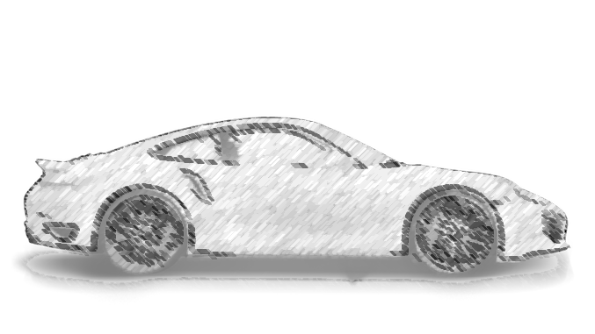
Next generation R&D is aiming to change dominant automotive eco-systems.
Digital @ R&D | Automotive View
1970
2016
2020
2025
Art of
engineering
Masterpiece
Digital
Transformation
Automotive
eco-system
R&D and engineering in “traditional” disciplines
Chassis
Power train
Engine
Electrics and electronics
Individualization and integration of innovations
R&D networks (external partners)
Merge of mechanics, electronics and software
Disruption of R&D and engineering
Product development based upon new business models and use cases
Systemic development based upon use cases
Realization of requirements of a connected automotive eco-system

Slide 12
Disruption is a core challenge for automotive R&D – defining the pathway of a master piece in times of digital transformation.
Digital @ R&D | Automotive View
2016
2025 ff.
Future challenges need to be focused and prioritized…
R&D systems increasingly dependent of complex social adaptations
Market dynamics and maturing technologies (esp. AI) demand adaptability, which cannot be achieved in current structures
Shortening time-to-user demands focus on throughput instead of cost-efficiency
Decreasing precision of planning requires redundancies of business models and complex data models
Laser-like focus on seamlessly integrated cyber-physical value chains, fractally scalable
Securing brand and IP in times of a permeable legal membrane of PAG
New challenges need to be adressed…
Traditional challenges will remain…
Autonomous driving
Connected vehicle
Machine learning
Engineering effectiveness
Big Data
Complexity management
Product cost management
Effective and efficient testing and validation processes
Variant handling

Slide 13
Digitization makes complication manageable and enables human talent to utilize complexity.
Digital @ R&D | Solution
Control
Broad tool portfolio for simulation, PLM-integration and migration, collaboration, 3D-data conversion at all fractal recursions
Syncronize
Standardized software, protocols and formats within the entire R&D network in order to maintain a consistent process and data backbone along the cyber/physical value chain
Set free
Opening systems architecture for new use cases and business models (including also the social systems involved - problems to be solved by those who are capable)
Adapt
9 out of 10 ideas fail – adapt an evolutionary „venture capital approach“ through coexisting initiatives, migration and redundancy – efficiency follows effectiveness
Create
Crafting innovations bit by bit in a continuously improving, seamlessly-integrated collaboration atmosphere, solving real problems at the perimeter of the membran.
Maintain
Safety and traceability along the engineering value chain (e.g. automated data transfers) – fostering transparency and compliance, led by a common vision.

Slide 14
Dr. Markus Junginger
markus.junginger@mhp.com

