Slide 1
Evolving Complexity: The Reality of Success and Failure
Peter M. Allen, Cranfield University, UK
Presented at Metaphorum Conference
Leed Beckett University, 5th – 7th September, 2016

Slide 2
Edmund Burke and the French Revolution:
In 1790 Edmund Burke said:
A developed society is so complex that a single mind cannot possibly understand it. It has come into being over many generations through numberless acts of initiative and organization on the part of individuals and groups who have had to cope with reality. Its institutions and arrangements embody innumerable choices and decisions, balanced judgements arrived at through experience, preferences based on knowledge.
The whole thing is like a vast and complex organism; and it changes organically developing new capacities in response to need, and perpetually adapting to ever-changing circumstances. It is not at all like a machine which can be built from scratch from a blueprint, and whose working parts can be removed and replaced at will. Neither in theory nor in practice could any one political thinker or any small group of political leaders wipe out a developed society and replace it with one that was adequate.
But if people have nothing to lose, then……

Slide 3
Governance: Understanding, Knowledge, Wisdom??
To understand/govern a situation you will need:
Data but what data? What is significant? Only after I have understood can I know!
Information - Difference that makes a difference (Bateson?) but we do not know what makes a difference until we have understood!
Knowledge - an interpretive framework. Classifier, History, Internal constitution, behaviour of a ‘class’ of entities….
Wisdom – To doubt one’s ‘knowledge’ and recognize the openness of existence …LUCK? The Dao de Jing speaks of the ‘underdetermined nature of the world’!
And Governance can be good or bad depending
on INTENTIONS and Job Definition!

Slide 4

My youthful illusions!
My (very reasonable) starting point
Physics must be right (and me too)
A “system” is a set of interacting components, whose behaviour can be predicted providing we can define their behavioural rules, and their interactions
All problems can be understood and “solved” if a serious attempt is made to “model” them
And life is therefore:
Input
Output
No ‘progress’, learning or HUMANITY – neither fear, greed nor love!

Slide 5
Our mechanistic model is WRONG!
Shock 1
Our MODEL is a simplified description of reality. We have made simplifying assumptions. Our model is only the dynamics of average types of element interacting through average processes.
Fluctuations of density and parameters may lead to self-organizing spatial and temporal structures
BUT micro-diversity gives adaptive self-restoring capacities to each population, as any decline takes out the “vulnerable” leaving the less vulnerable
Any ecology is made up of populations whose micro-diversity deals with changes from other populations or the environment. But we cannot know ahead of time WHAT micro-diversity we will need!

Slide 6

From REALITY to UNDERSTANDING?
Complexity
Successive Assumptions
Simplicity
Shock 2
Qualitative Research
Stationarity –
Sand Piles, Rank-Size rules
Cities, Firms…
Boundary
Classification
Structural Stability Fixed Variables
Attractors
Reality
Practice
Time
Stationarity
Equilibrium
X
Quantity
COMPLEXITY
Equilibrium
Z
Understanding?
X Y Z
Y
Average Dynamics
Soft Systems
Evolutionary Models
QUALITATIVE
CHANGE
Price
Probabilistic
Non-linear
Dynamics
X
Long Term
Origami
Medium Term
Short Term
Z
Strategy
Y
Contingency
Operations
Becoming
Being

Slide 7
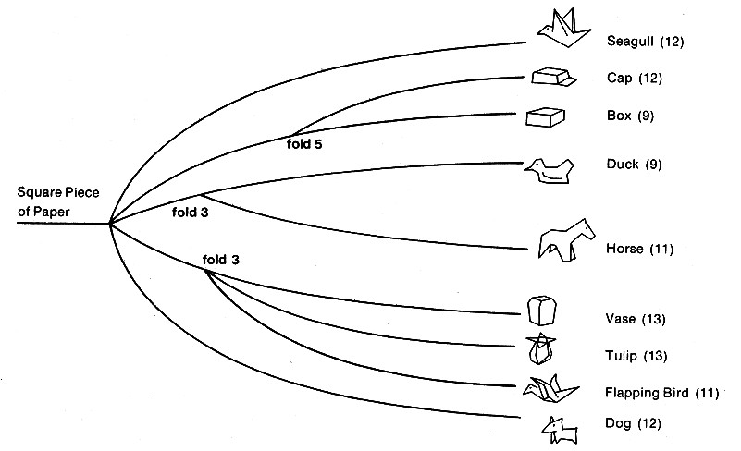
Origami – Emergence in Action
Emergent Features
Emergent Variables
Emergent Dimensions
Emergent Functionality
Physics deals with the PAPER
3rd Shock!
Symmetry Breaking is very PROFOUND!
Folds <-> Form <-> Emergent Capability
We “select” on the basis of the EMERGENT
properties and features of the system!
- But so does the world!
Scaling Effects
Emergent Forms
1982, Environment and Planning B, P. Allen
1986 Ev of Multifunctionalism in Ezymes, J McGlade and P Allen,

Slide 8
Ashby’s Law of Requisite Variety
Control can be obtained only if the variety of the controller is at least as great as the variety of the situation to be controlled. Variety absorbs Variety
But Variety defines different entities with the same qualitative features. Diversity considers elements that are qualitatively different from each other
BUT Evolution is about qualitative evolution
New variables, new dimensions, new problems, new opportunities, new characteristics and new functions

Slide 9
The Law of Excess Diversity:
This states that: For a system to survive as a coherent entity over the medium and long term, it must have a number of internal states greater than those considered requisite to deal with the outside world.
In addition to what we know about a situation, there is also what we do not know! This translates itself into deviation from prediction and eventually to change. If a system is to respond successfully to this unknowable future, then it must have within itself more “diversity” than was strictly necessary for its functioning at present.
Variety concerns a selection of possibilities that share a common attribute space, but diversity concerns a selection that spans different attribute spaces. This new law means that either there is hidden diversity within an “adaptable” system or it has within it mechanisms that can produce diversity as and when required. A persistent system must maintain/create underlying diversity before it can be shown to be necessary.

Slide 10
Since 1970 – only 2 Good Ideas! (3 more than average)
Evolution occurs through structural instabilities:
  Unintentional and intentional novel actions – experiments - caused by internal heterogeneity, micro-diversity, ignorance, emotion or error.
  To what ‘experiments’ is the system unstable? Which new actions, mutants, innovations, new practices will grow in the system if they occur?
For an innovation to persist:
  Its component parts MUST TOGETHER possess an EMERGENT Capability
  The Environment of the sub-system must REWARD this capability
  This is the definition of SYNERGY! The Second Law, or economic Value

Slide 11
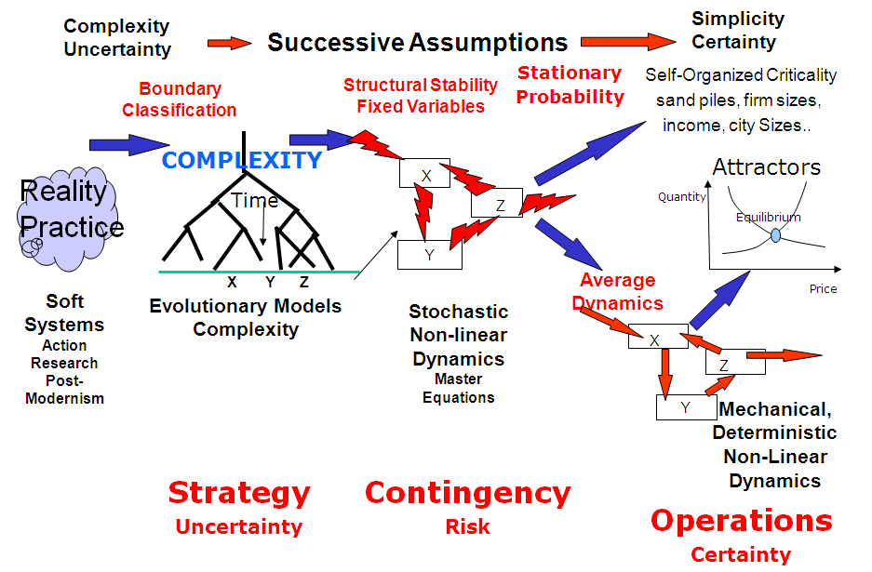
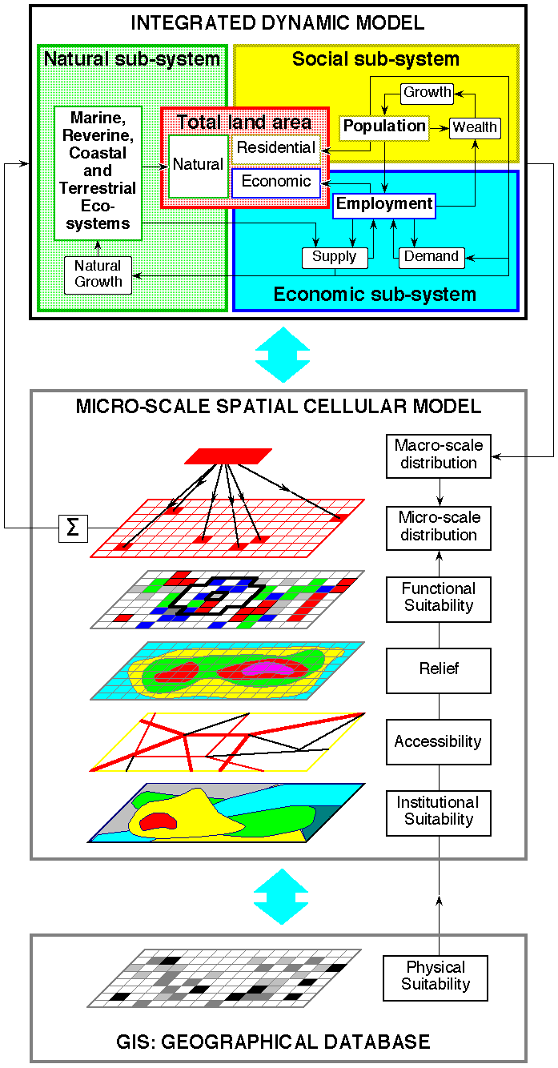
The Urban and Regional System – Not Static:
People
Housing
Jobs
Offices etc.
Transport
Travel
Leisure
Changing transport costs or
access changes locational
choices of people and activities,
that change the locational choicesof people and
activities, that change the locational choice of people
and activities…..

Slide 12
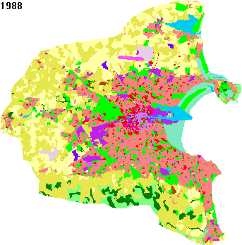
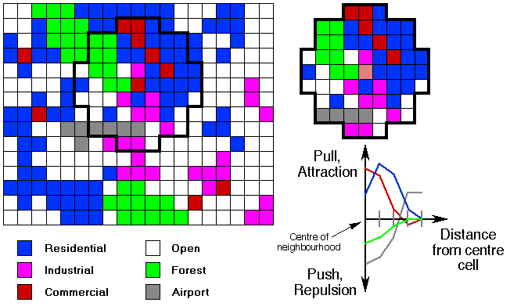
Dynamic spatial models…..
Connected evolution of the different Variables
Recent models use cellular automata
Spatial Interaction
Mutual interdependence of multi-actor system,
flows of goods, services, energy, water…..
From Guy Engelen, www.vito.be
Notes:
Very sophisticated GIS based dynamic spatial models can be built that allow us to study possible, coherent trajectories inot the future
The question that can be examined is whether running the model forward increases or decreases the values in the conflict matrix.
If running the system increases the intensity of bad feeling in the conflict matrix, then it can only end in crisis. Our models allow us to study simultaneously the vulnerable parts of our system AND the groups that may be driven to attack them.

Slide 13
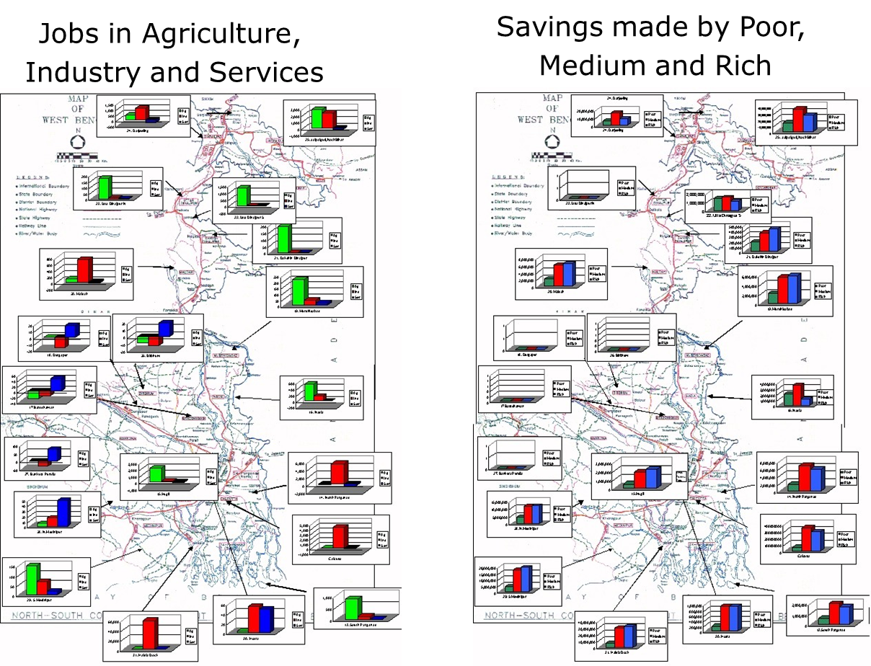
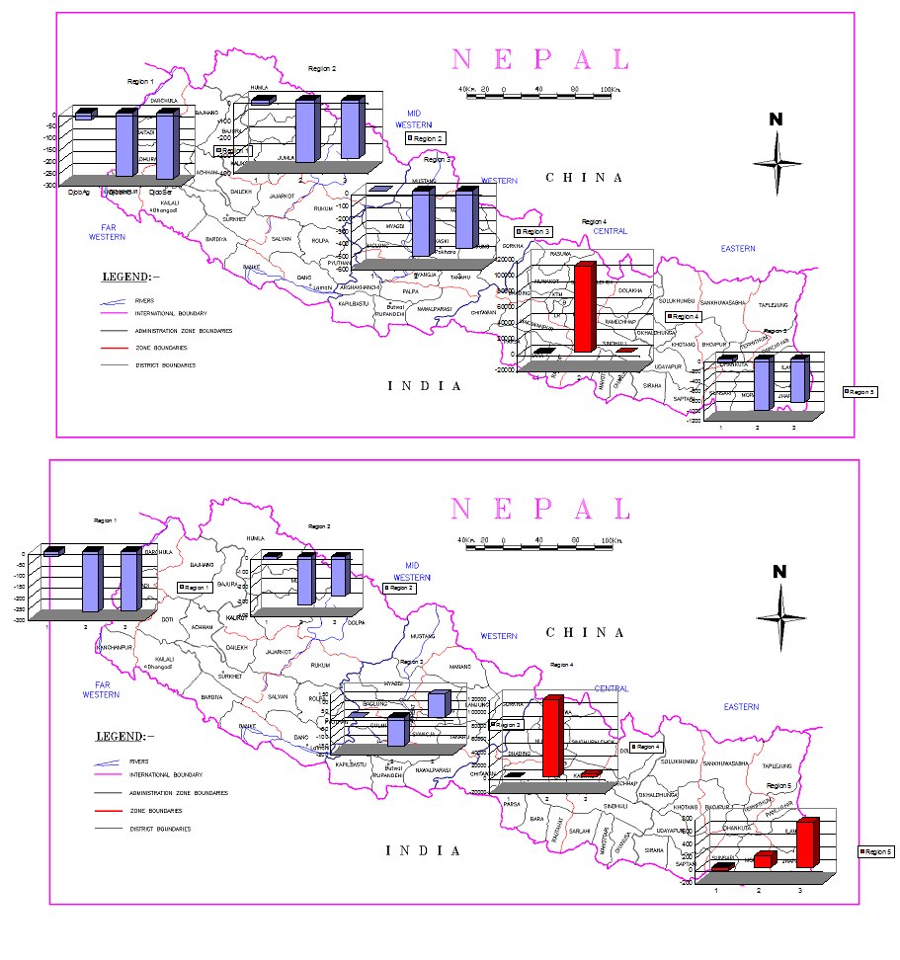
Past Spatial Modelling: Planning with Complexity:
Nepal:
Investments
Bengal:New Roads
Predicting Diversity
Canadian Fisheries
Rhone Valley

Slide 14
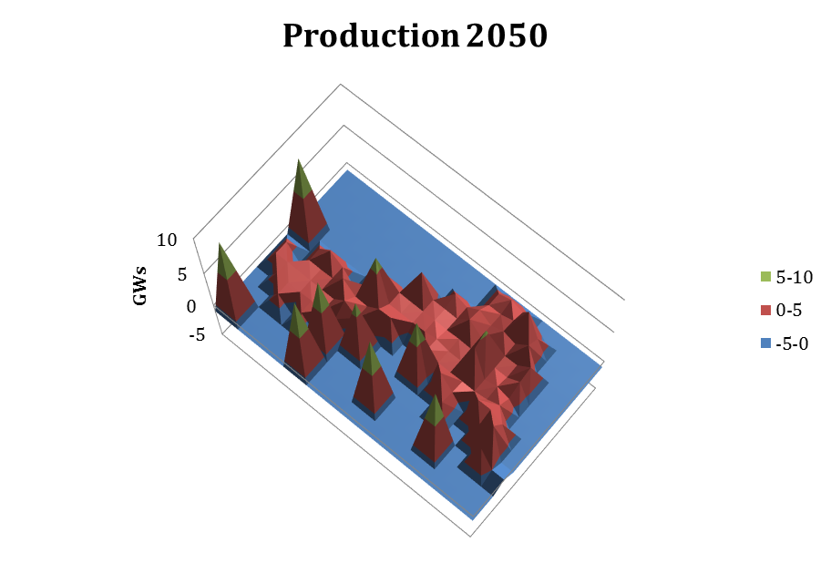
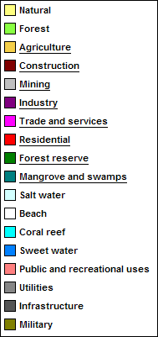
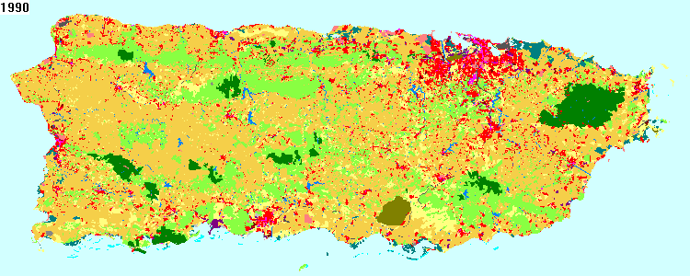
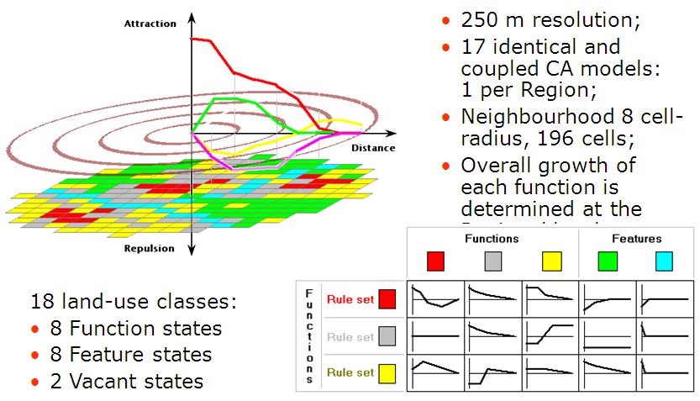
Applications: Integrated Spatial Models
Marina Baixa
Argolid Valley
Senegal
180GW UK Electricity 2050
Guy Engelen & Roger White

Slide 15
A Multi-Agent Economic Market Model:
Agent 1
Customer Agents
Other Agents
Strategy on Profit Margin,
Quality, R&D, Design….

Slide 16
Total MARKET returns depend on Luck:
No Learning
Imitate the Winner
Luck
Luck
All Learn by Experiment
Diverse Strategies
Path and Meta-strategy
dependent
Luck
Luck

Slide 17
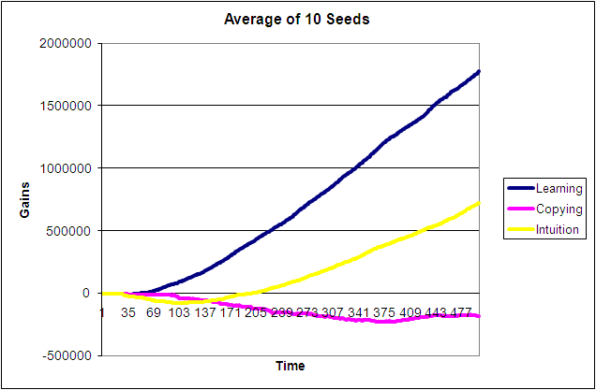
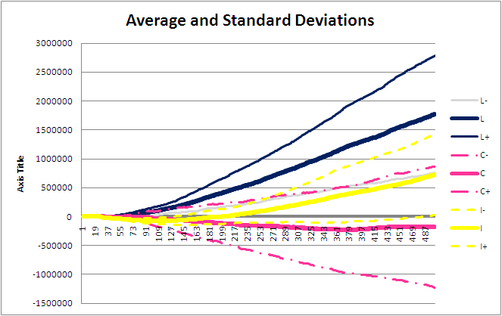
Performance for 10 different random sequences
Running 10 different random
Sequences confirms the Result:
Learning wins
Darwinists second
Imitation last
LUCK MATTERS!
The result is PROBABILISTIC!
However, on average, the best
Advice is to be a LEARNER

Slide 18
Markets are a Theatre of Learning:
There is NO INVISIBLE HAND. For a given POTENTIAL market the number and strategies of firms that actually emerge depends on LUCK!!!!!!!
Learning by experiment is the best meta-strategy, Learners tend to keep apart. Darwinists (intuitive leap) are next best. Imitators do worst! They arrive ‘late’ at a point of maximum competition
Some risk takers are needed for market evolution - Schumpeter was right! Markets structures do not reflect RATIONAL behaviour, but arise when self-belief gets lucky

Slide 19
Evolution of Organizational Structure:
How do organizations evolve? Partly, as “bundles” of working practices
Look at auto- manufacturing like this (McKelvey, McCarthy et al.). Cladistics of Organisations – history of successive “invasions” of organizations by new practices and ideas.
Innovations in practice become routines as in Nelson & Winter view.
Complexity allows us to model organisational evolution as bundles of practices, where the competitive performance depends on the synergy or conflict of its practices
NEXSUS: work involving Cranfield and Jim Baldwin at Sheffield,
Inst of Mechanical Engineering

Slide 20
Evolving Dictionary of “practices” - 53 Characteristics
Pair Interaction
Matrix of the
53 x 53 practices
4 of the
possible 53
practices
Patterns of potential Synergy or Conflict
Derived from Survey carried out by J. Baldwin
70 firms responded – over 700 questions each!
Notes:
From a survey of manufacturers opinions, we can see how different practices interact with each other.

Slide 21
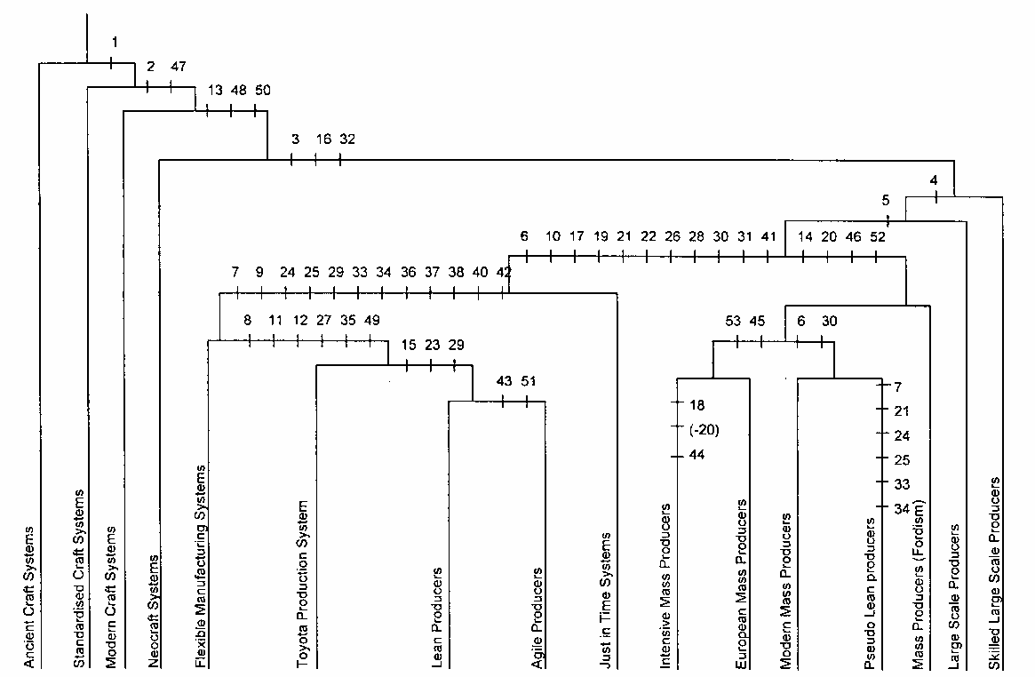
Auto Manufacture: 16 Organisational Forms:
Ancient Craft System
Standardised craft System
Modern craft System
Neocraft systems
Flexible Manufacturing
Toyota production
Lean producers
Agile producers
Just in time
Intensive Mass producers
European mass producers
Modern Mass Producers
Pseudo lean producers
Fordist Mass producers
Large Scale producers
Skilled large Scale producers
These are different “Networks” of practice.
Are these COHERENT bundles
of practices?
Are these Structural Attractors?
Notes:
We can see history as an evolution of different srtructures

Slide 22
The Evolution of a Single Organisation
Manufacturing Evolution
The dictionary of practices
leads to sentences that
selection ensures have
meaning

Slide 23
But different branches compete….
Performance
As performances evolve at different rates some evolutionary branches are eliminated
On the whole faster innovation tends to win, but enough time is needed for “co-evolution”
Ignorance about which practice
to introduce when – leads to great
production of diversity!!
Extinctions
Time
An Industry is a bundle of bundled practices that
can co-evolve at the same rate - an “ecology” of
possible species of organization

Slide 24
Aerospace Supply Chains desired performance?
Joint ESRC project with AMRC, Sheffield . A list of 27 possible practices was developed from a series of interviews
The different dimensions of performance that matter to customers are:
  Quality of fabrication
  Cost efficiency
  Reliability of Delivery
  Level of Technology and innovativeness
  Degree of Vision in the conception of a product

Slide 25
Aerospace Supply Chain Practices
Expected Dimensions of Performance
For the 27 Practices
Pair Interactions
Synergy/Conflict

Slide 26
The Synergetic Practices for each Quality:

Slide 27
EU Innovate: Household Agent Profiles
End User Innovation – for Sustainability
Access/Mode
Occupancy
Space
Living
Emissions
Mobility
Fuel
Household Waste
Type
Fuel Consumption
Location
Efficiency
Construction
Km travelled
Source (location)
Domestic Emissions
Preparation
Food
Energy
Usage
Source
Waste
Source (production)
Food Consumed

Slide 28
Possible Innovations:
Living:
  Coop Living; More Insulation; Size Reduction; Household Waste
Food:
  Change Source; Reduce Consumption; Reduce Waste; Reduce preparation
Mobility:
  Reduce Travel; Increase Efficiency; E-Cars; Change Mode
Energy:
  Reduce Consumption; Switch Source (PV) Green Energy

Slide 29
Cross-Domain Impacts
Energy Use
Food
Mobility
Domestic Source
Living
Food
Consumed
Preparation
Energy
Domestic Emissions
UK | PV% Dom En | Dom Energy | Dom Emiss | Mob Emiss | Diesel | Petrol | Waste | food consumed | Food Waste | Total Emis
Coop Living | 15% | 32% | 48% | 4% | 2% | 7% | 18% | 0% | 18% | 33%
Improved Con | 0% | 39% | 31% | 0% | 0% | 0% | 0% | 0% | 0% | 20%
Reduced Waste | 0% | 0% | 0% | 0% | 0% | 0% | 37% | 0% | 0% | 0%
Reduced Space | 0% | 26% | 21% | 0% | 0% | 0% | 0% | 0% | 0% | 14%
Reduced Food | 0% | 0% | 0% | 0% | 0% | 0% | 0% | 28% | 28% | 0%
Change Source | 0% | 0% | 0% | 26% | 20% | 37% | 1% | 0% | 9% | 9%
Reduce Preparation | 0% | 0% | 1% | 0% | 0% | 0% | 0% | 0% | 0% | 1%
Reduce Food Waste | 0% | 0% | 0% | 0% | 0% | 0% | 0% | 0% | 37% | 0%
Reduce Kms | 0% | 0% | 0% | 26% | 20% | 37% | 0% | 0% | 0% | 9%
Electric Cars | 0% | -17% | -31% | 42% | 49% | 42% | 0% | 0% | 0% | -5%
Increased Efficiency | 0% | 0% | 0% | 0% | 20% | 36% | 0% | 0% | 0% | 0%
Change Mode | 0% | 0% | 0% | 27% | 17% | 44% | 0% | 0% | 0% | 10%
Reduce Consumption | 0% | 5% | 9% | 0% | 0% | 0% | 0% | 0% | 0% | 6%
PV+ Green | 10% | 0% | 22% | 0% | 0% | 0% | 0% | 0% | 0% | 14%
Food
Source(1)
Food
Waste
Space
Household Waste
Construction
Location
Type
Occupancy
Fuel
Food
Source(2)
Emissions
Transport Access
Fuel Consumption
Efficiency
Km Travelled

Slide 30
Towards Sustainability:
These are the Flows and Emissions in 2015
These are the Household ‘kgs’ (footprint) after Innovations
These are the ‘kgs’ per person after innovations

Slide 31
From Being to Becoming:
Need to change our view to one that accepts that change will and is happening
Can we look at a ‘household’ as it were a ‘product’ and find a design that is ‘sustainable’
Complex Systems models embrace the interconnected evolution of humans and their living space from households through towns and cities to city hierarchies and the planet.
In the words of Ilya Prigogine, we now see the world as an evolving multi-level system in which static thinking and static modelling will not help

Slide 32
Modelling Social Systems: ABMs, Multi-Agent Models
Model: Ask agents what they are trying to do. But agents may not reveal their real thoughts and might lie!
Even if agents are honest, when the model results are discussed people may change their behaviours! Reflexivity!
For Regional Sustainability we need to develop multi-agent models that can put together the aims and powers of the different agents present. Learning could occur!
Experimenting, reflecting and modelling – turn by turn…

Slide 33

REFLEXIVITY, Reality and Agent Based Models:
FRAME
What’s in
It for me?
Plato’s Cave
Data
Statistics
Your model just becomes part of ‘reality’
Reflexivity Invalidates the Model!!
The Model is just part of the system but
could be a tool for building
Social Cohesion – e.g. Climate Change
Only if you already have a Community!
Model
If you haven’t got a Community
You can’t get one easily….
Modeller

Slide 34
Understanding limits to Understanding:
Our interpretive framework results
from our experiences – which are guided
by our interpretive framework!
Continue
Modify Beliefs
Values given
By beliefs
Actions, Experiments
(Noisy, Probabilistic)
Decision, Choice
(not unique)
Individual
Beliefs, model
“Knowledge”
Aims, Goals
Values
My Skull
Modify, Update
(not unique)
World
Do our experiments stabilize or destabilize our understanding?
Ideas confirmed
NO SCIENCE!
Expectation
Deny/Confirm

Slide 35
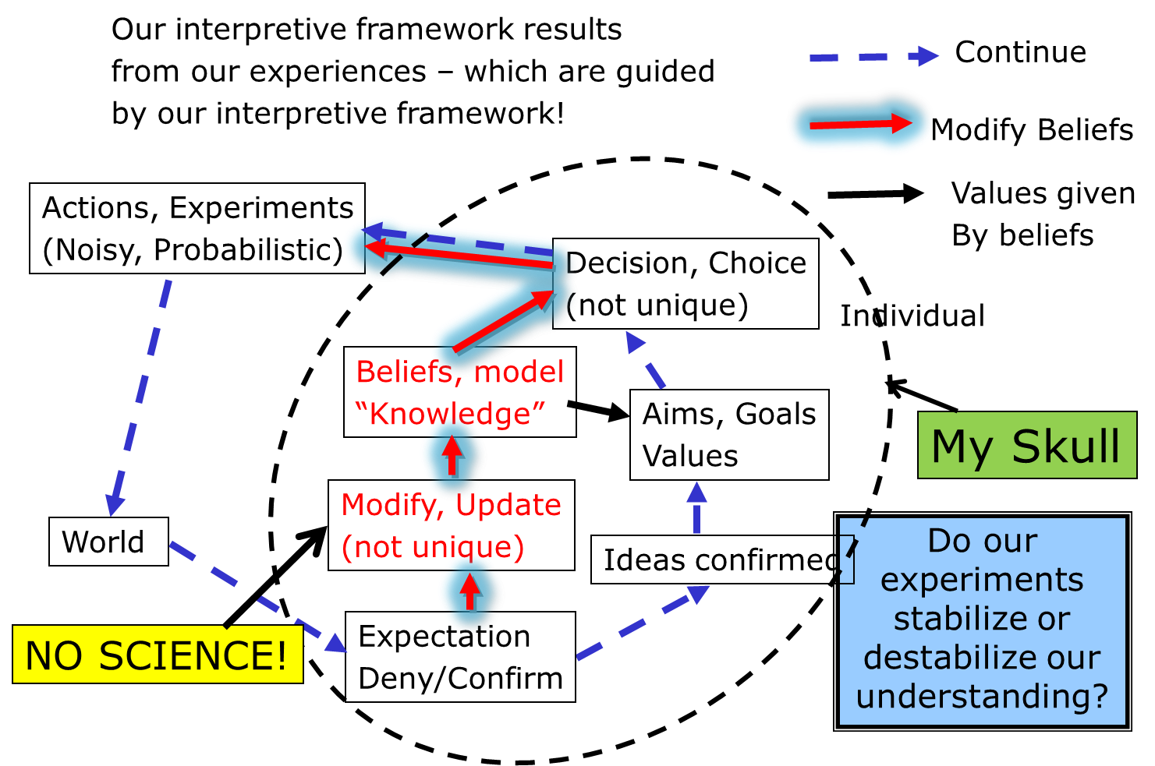
But what is my aim? Good for me or COMMUMITY?
Are we honest scientists? In denial? Or hierarchical sheep?
I was not wrong:
Loss of face, insecurity,
pig-headed…..
The Honest Scientist
What do you think, Master?

Slide 36
But the “world” is also others:
Incoherence can only end in coherence
Open exchange can lead to emergent collective capabilities
Framing Competitions
Negotiating the ‘others’
Getting a collective view

Slide 37
But there are groups, and networks….
Schumpeterians…
Pragmatists
Flat Earthers
NeoClassical
Economomists
Collective performance will
Lead to retention of ‘successful’
Group identities and ethical behaviour

Slide 38
Conclusions: Models are for Learning not Prediction
For better Governance - Develop Models to explore possible Futures. Models can help explore possible Actions and changing circumstances in order to imagine possible futures.
These Models are not just describing past statistics and events, but with noise, randomness and interactions can tell us things that we didn’t know and weren’t in the data!
Reflexivity: when agents see the outcomes predicted by the model, they may modify their behaviour. This makes the MODEL part of reality, which INVALIDATES it in normal terms. But this is agents and Governors ‘learning’, and might be the aim of such modelling. We could make a Machiavellian version….
The model could also help develop empathy and understanding across a community. It could help a region forge its own sustainability.

Slide 39
Conclusions 2: Complexity is Life
Each region has its particular history, characteristics and situation. Models can help us understand its past, and may reveal choices and dangers and thereby change the future. In a Complex World - Everything is an experiment!! And we shall need to continue experimenting!
Models (interpretive frameworks) do not make predictions. They are instruments of reflection. Increased “credibility” may make evasive action more likely(e.g. climate change, limits to growth). Models are part of ‘politics’. But politics needs to frame the models in an integrated way.
Enhanced understanding and clearer views of possible futures are just part of the Evolving Complex World.

Slide 40
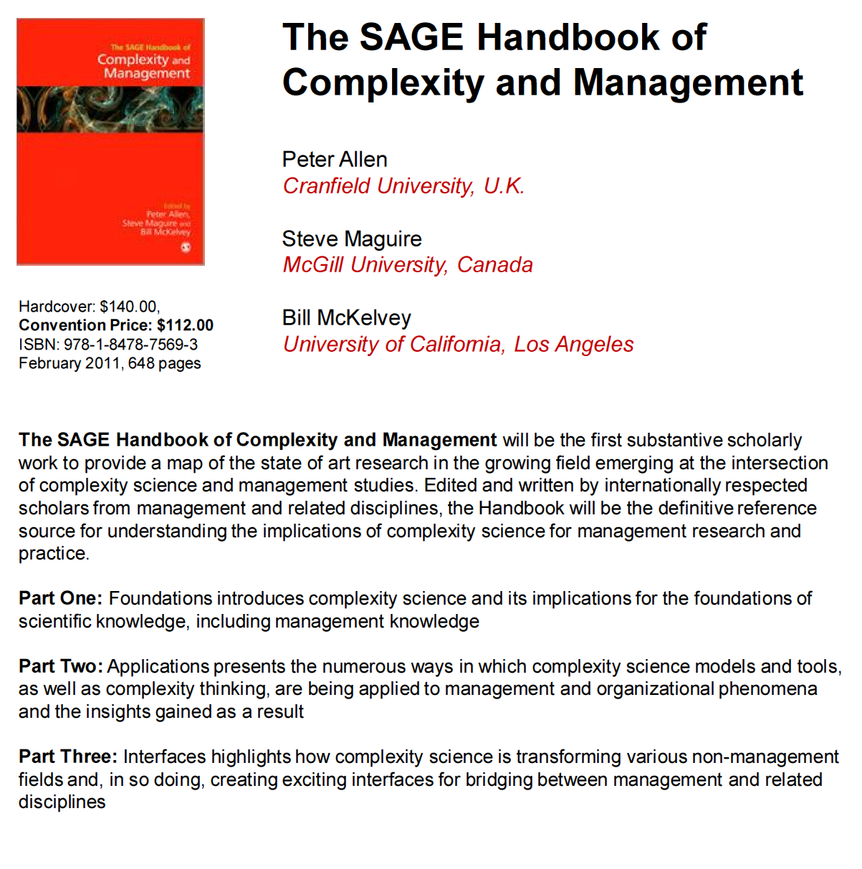

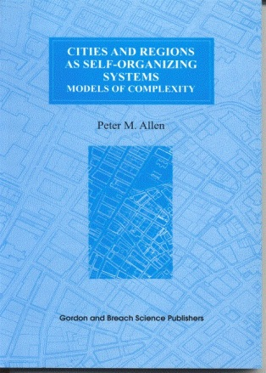
Some Great Books!!!
Emergence: Complexity
and Organization
ISBN : 0-203-99001-3
ISBN 90-5699-071-3 Great Read!

Slide 41


Recent Books:
And Now!!!!
Embracing Complexity: OUP,
Jean Boulton, Peter Allen and Cliff Bowman
Emergent Publications
ISBN 978-1-938158-13-1
An interesting collection of very diverse papers written by some of the friends who have worked with me over the years.
http://www.amazon.com/The-Social-Face-Complexity-Science/dp/193815813X

