Slide 1
eSyn2030
A Metaphorum Online Experiment

Slide 2
Welcome to eSyn 2030
Dec 21st, 2020, 4 PM (GMT)
- Welcome (AL)
- Info set intros Name, location, #keywords
- Overview of the experiment (AE/JW)
- Process (JW)
- Schedule (PT)
- Technology (SV)
- Research (DB)
- Q& A
- Later in the bar

Slide 3
eSyn 2030 Organising & Researching Team
Design & Logistics
Allenna Leonard
Jon Walker
Stephan Verveen
Peter Tuddenham
David Beatty
Angela Espinosa
Facilitators
Allenna Leonard
Angela Espinosa
Maya Vachkova
Pedro Pablo Cardoso
Andrea Martinez
Lukas Ritcher

Slide 4
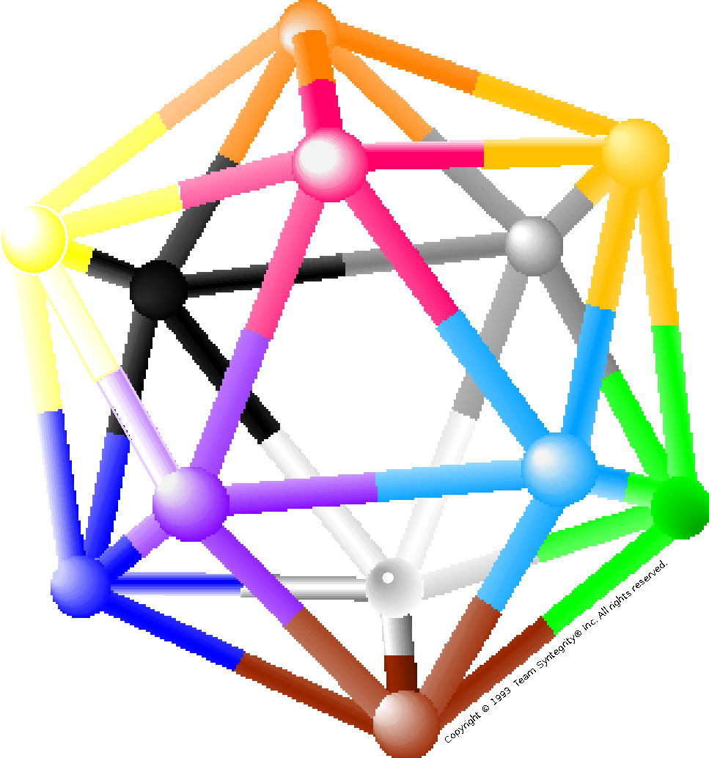
E -Syn 2030
Design and development of an experimental online event inspired in Beer’s Team Syntegrity (Beyond Dispute)
Learning experiment to find out how the methodology may work in our designed online context to enable effective collaboration
Experiencing E Syn 2030 protocol for creating a collective answer to the Opening Question:
“How can Metaphorum and its members capture the learning from the current crisis, and best contribute in radical shifts that society have to make fast?”

Slide 5
Icosahedron
Tensegrity (tension & compression) - B Fuller
S Beer - Team Syntegrity (synergy & integrity) (Beyond Dispute)
TS International ( MoM)
30 people (struts)
12 topics (nodes)
Each participant is:
Member of 2 teams (e.g. green yellow, pink-purple)
Critic of 2 teams (e.g. black-purple; white-silver)
Notes:
Notes:
This slide is provided to enable you to talk about some of the features of the model that underlies the TS architecture and methodology. For example, you may want to reference the platonic solids, of which this is the largest, how Bucky Fuller used the icosahedron as the basis for his invention of the geodesic dome, and how Stafford borrowed on this idea. If referencing Bucky, you can talk about the concept of tension and compression - which led him to use the term “tensegrity”. You may also want to point out that the icosahedron is found in nature - that many viruses take this form, etc.
This is also a good opportunity to introduce how the model works - that the nodes represent “ideas” or topics, and the struts represent people or positions. You can point out that the model demonstrates how 5 people come together around each of the 12 coloured nodes, and are therefore accountable for the ideas that are generated. You can reference aspects like “closure” - how the model is fully connected and “closed”. You can also talk about how Stafford came up with the term “syntegrity” - composed of the two terms “synergy” and “integrity”. You may also want to introduce the term “infoset” at this stage, to support its use later in the presentation.

Slide 6
Reverberation Effect
The way the shared knowledge of the infoset permeates the whole team to produce reverberation of the key ideas
This is our main challenge for an online experience!

Slide 7
eSyn 2030
A Syntegration type of Online Experiment
Introduction
Infoset Meetings
Problem Jostle
Discussion of 18 topics
Iterations (3)
Choosing the 12 topics
Closing
Allocating people to struts (lottery)
Jan 11th, 12th, 13th
Jan 6th, 7th, 8th

Slide 8
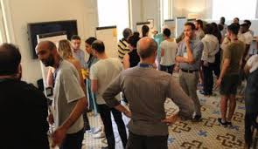
E Syn 2030 challenges
Problem Jostle

Slide 9
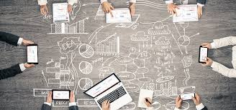
E Syn 2030 challenges:
II. Agreeing on the 12 topics
Managing explosive variety online
Producing a collective mental model of the desirable topics
(developing skills on the suggested tools)
Dramatically reducing variety by pre-clustering and clustering to 18 a then 12 tematic teams

Slide 10
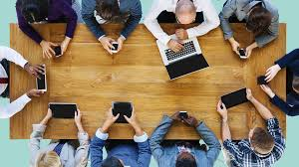
E Syn 2030 challenges:
III. Facilitating an effective infosets work
Zooms (meetings)
Miro (Problem jostle)
S

Slide 11
E Syn 2030 challenges:
III. Sharing information online
Google Forms,
Google Slides
Audio recordings
Sched (participants profiles, agenda)
Participants’
Log Book
Metahorum Web page

Slide 12
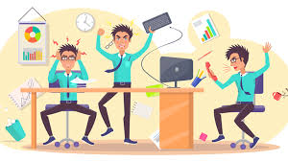
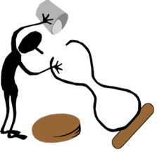
E Syn 2030 challenges:
IV. Preventing Oscillations &
Maintaining Cohesion
Technology?
(SV)
Facilitation (Facilitators)
Counselling? (DB)
Recording, sharing (PT)

Slide 13
E Syn 2030 challenges.
V. Developing an online learning community
Action Research:
How did I/we do?
What did I /we learn?
How can we develop further the E Syn 2030 experiment?
Improving communications & supporting technology
Research focus 2021

Slide 14
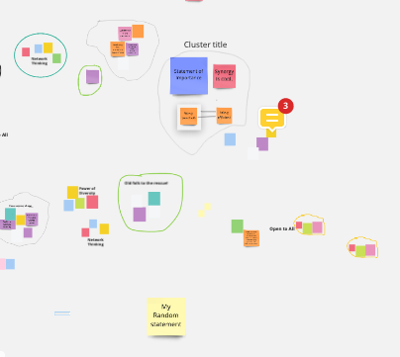
Problem Jostle
Generating Statements or Importance
PHASE 1
A Syntegrations begin with no pre-defined agenda, but focused on the Opening Question. Participants create the agenda.
How to replicate the face-to-face experience ?
Participants prepare and post their Statements of Importance (SIs) on Miro over 18 hours.
You can put your SI next to similar SIs, and begin grouping.
We begin Day 2 by clustering, drawing boundaries, giving the cluster a title and becoming a Host.
Concludes with dozens of clusters.
You are encouraged to be creative, challenging and thought-provoking
Notes:
Notes:
This slide is used to describe the

Slide 15
Selection of the 12 Topics
PHASE 2
From the Miro board we then select the 18 most popular clusters by voting.
To ensure preliminary discussions we run 18 Zoom meetings of 20 minutes each in 3 streams. This concludes with 18 Consolidated SIs and a clearer Topic title.
We then hold a second vote for the most popular 12 Topics.
The 12 Topics are given a colour, and thus a location as a node on the icosahedron.

Slide 16
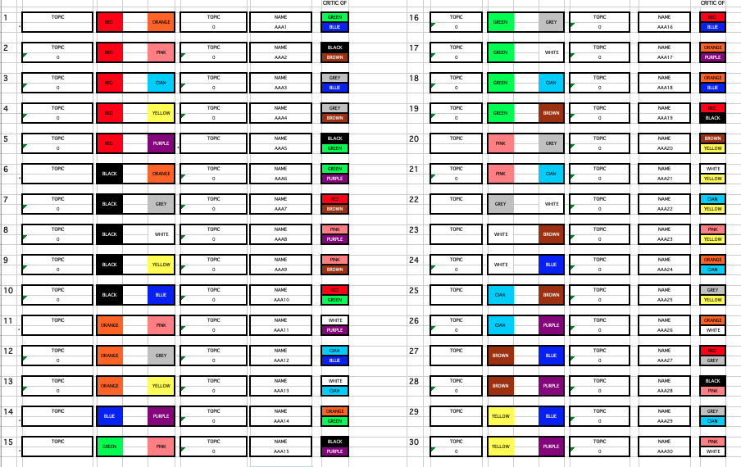
Allocation of people to Topics.
The Lottery.
PHASE 3
All participants now know about the Topics and the colours which have been allocated.
All participants are given a number between 1 and 30.
We then pull numbers out of a hat ( with a random number generator) and the person with that number gets to choose the strut which gives them membership of the groups discussing the Topics in which they are most interested.
We generate another number and that participant gets to choose. And so on until every strut has been allocated.

Slide 17
Jan 11th - 13th
Infoset Meetings
PHASE 4
Zoom Room 1
Zoom Room 2
Notes:
Notes:
Before describing what happens in an Outcome Resolve team meeting, it is best to describe the meeting schedules, and how the 12 teams meet, two teams at a time, in nearby rooms. The coloured “stars” shown above reflect the 5 team members who connect to each coloured node, and therefore come together to discuss and explore the topic. You can explain here that in addition to the 5 team members shown here, 5 critics will also attend the meeting. With a total of 10 people engaged in each of the two simultaneous meetings, or 20 in all, there are another 10 people who are not and who play the role of observer. Observers are free to visit either of the two meetings, and can come and go at will, or take a break from the formal activities for the purpose of relaxation and reflection.
You should also explain here that there are three iterations - which means that after all 12 teams have met the first time, they will meet a second and a third time in the same meeting sequence. At the end of each iteration, 12 statements are produced by the 12 teams, and the final statements at the end of Iteration 3 represent the content outcomes of the event.
It may be helpful to introduce the concept of polar opposites here (e.g. Red and White), and demonstrate this using a real icosa model. You can also point out how the critic positions are “2-away-from” and where the observers come from.

Slide 18
Infoset (online) Meetings
5 Members, 5 Critics & 1 (or more) Observer
Facilitator: Allocate speaking time, keep track of time; scribe for the team, ensure quality of team output; reporting it to the whole group
Team Member: 5 people
to explore and discuss the topic,
- to generate a written statement
Team critic: 5 people to bring in other perspectives.
Observer: not included in the discussion.
3 Iterations
Concludes with
Final Statement of Importance

Slide 19
Closing Meeting
Each Topic Group presents their conclusions.
Each Participant talks about their experience.
Final open discussion.
Later in the bar . . . . .

Slide 20
PROJECT OVERVIEW Jan 6th- 8th 2021
Jan 6th, 5-6 pm Opening Plenary. Describe SIs and process.
Asynchronous All info-set members place SIs on Miro + Initial grouping
Thurs, 4 pm Clustering.
Jan 7th 4.30 pm Boundaries, Hosts, Titles
3 hrs 5 pm Vote 1 . Select 18 SIs
5.30 pm Organisers timetable 18 Zoom meetings
6 – 7 pm First 9 Zoom meetings. 3 streams. 20 mins each.
Friday, 4 pm Plenary.
Jan 8th 4.15 pm Last 9 Zoom meetings. 3 streams. 20 mins each.
4 hrs 5.15 pm Hosts upload CSIs and Titles on Miro
5.30 pm Vote 2 . Select final 12 SIs
5.45 pm Organisers allocate colours to Topics.
6.15pm Lottery
7.30 Trading struts
8 pm. Closing
Weekend Organisers publish Topic group details , members and critics, and timetable for the following week.

Slide 21
PROJECT OVERVIEW Jan 11th-13th, 2021
Monday, 1.45 pm Plenary.
Jan 11th 2 pm Meetings 1 and 2 ( 50 mins + 10 min changeover)
6 hrs 3 pm Meetings 3 and 4
4 pm Meetings 5 and 6
5 pm Meetings 7 and 8
6 pm Meetings 9 and 10
7 - 8 pm Meetings 11 and 12
Jan 12th 2pm - 8 pm Iteration 2 as Monday
Jan 13th 2pm - 6pm Iteration 3. (40 mins + 5 min c/over)
6.30 pm Preparation for presentations
7 pm 12 x 5 minute presentations
8 pm 30 1 minute reflections
8.30 Closing

