Slide 1


Anarchist cybernetics in and against the institutions
Thomas Swann
Loughborough University – Leverhulme Early Career Fellow
T.Swann@lboro.ac.uk @thomasswann1

Slide 2
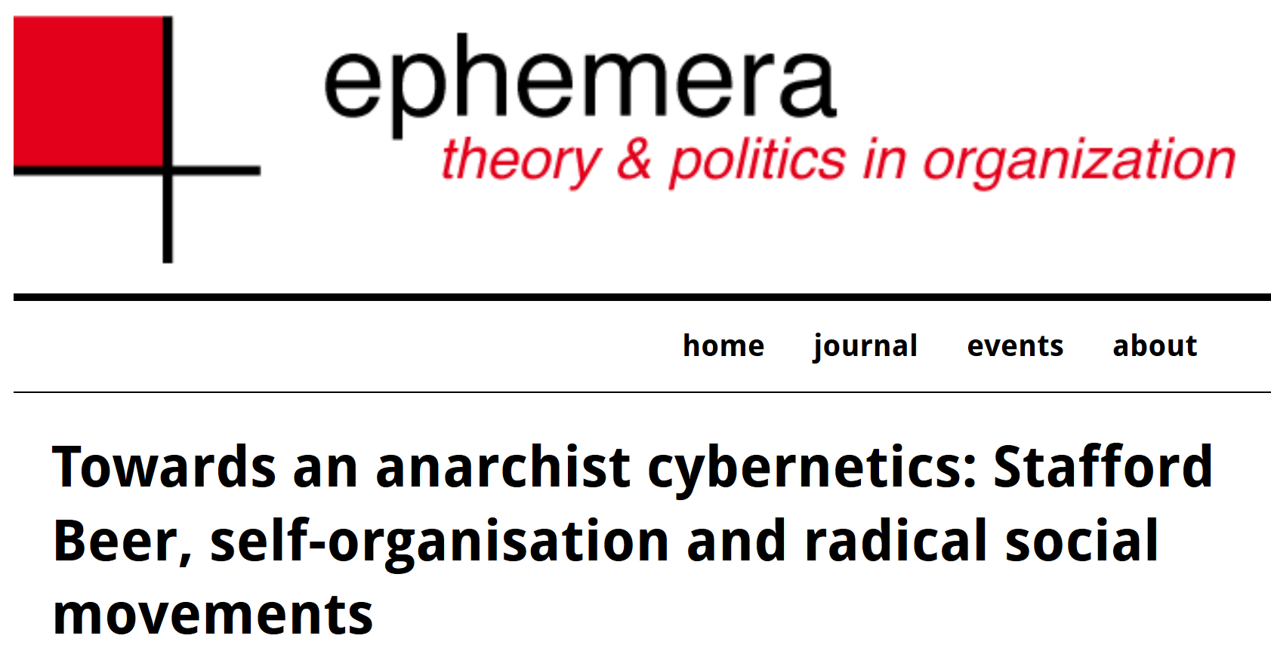
Anarchist Cybernetics
Very brief overview based on the work I conducted for my PhD at the University of Leicester School of Business (then called the School of Management)
Published in an article in the journal ephemera: theory & politics in organization and in a forthcoming book with Bristol University Press due for publication towards the end of 2020

Slide 3
Anarchist Cybernetics
Using Occupy as a model of anarchist organisation
Working groups and caucuses making up system one units (tactics)
General assemblies and later spokescouncils performing system three through five functions (strategy and grand strategy)

Slide 4
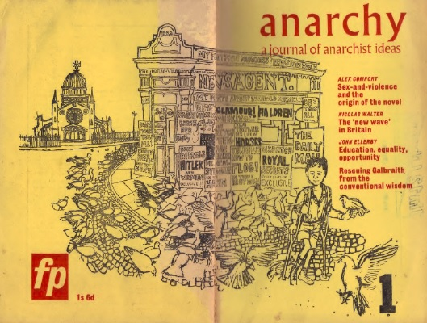
Anarchist Cybernetics
Publications in the journal Anarchy by William Grey Walter and John D. McEwan in 1963
Other connections over the years in work by Colin Ward, Roel van Duijn, Marius de Geus
Some of the broader connections with the science of self-organisation explored by John Duda in a 2013 article in the journal Anarchist Studies

Slide 5
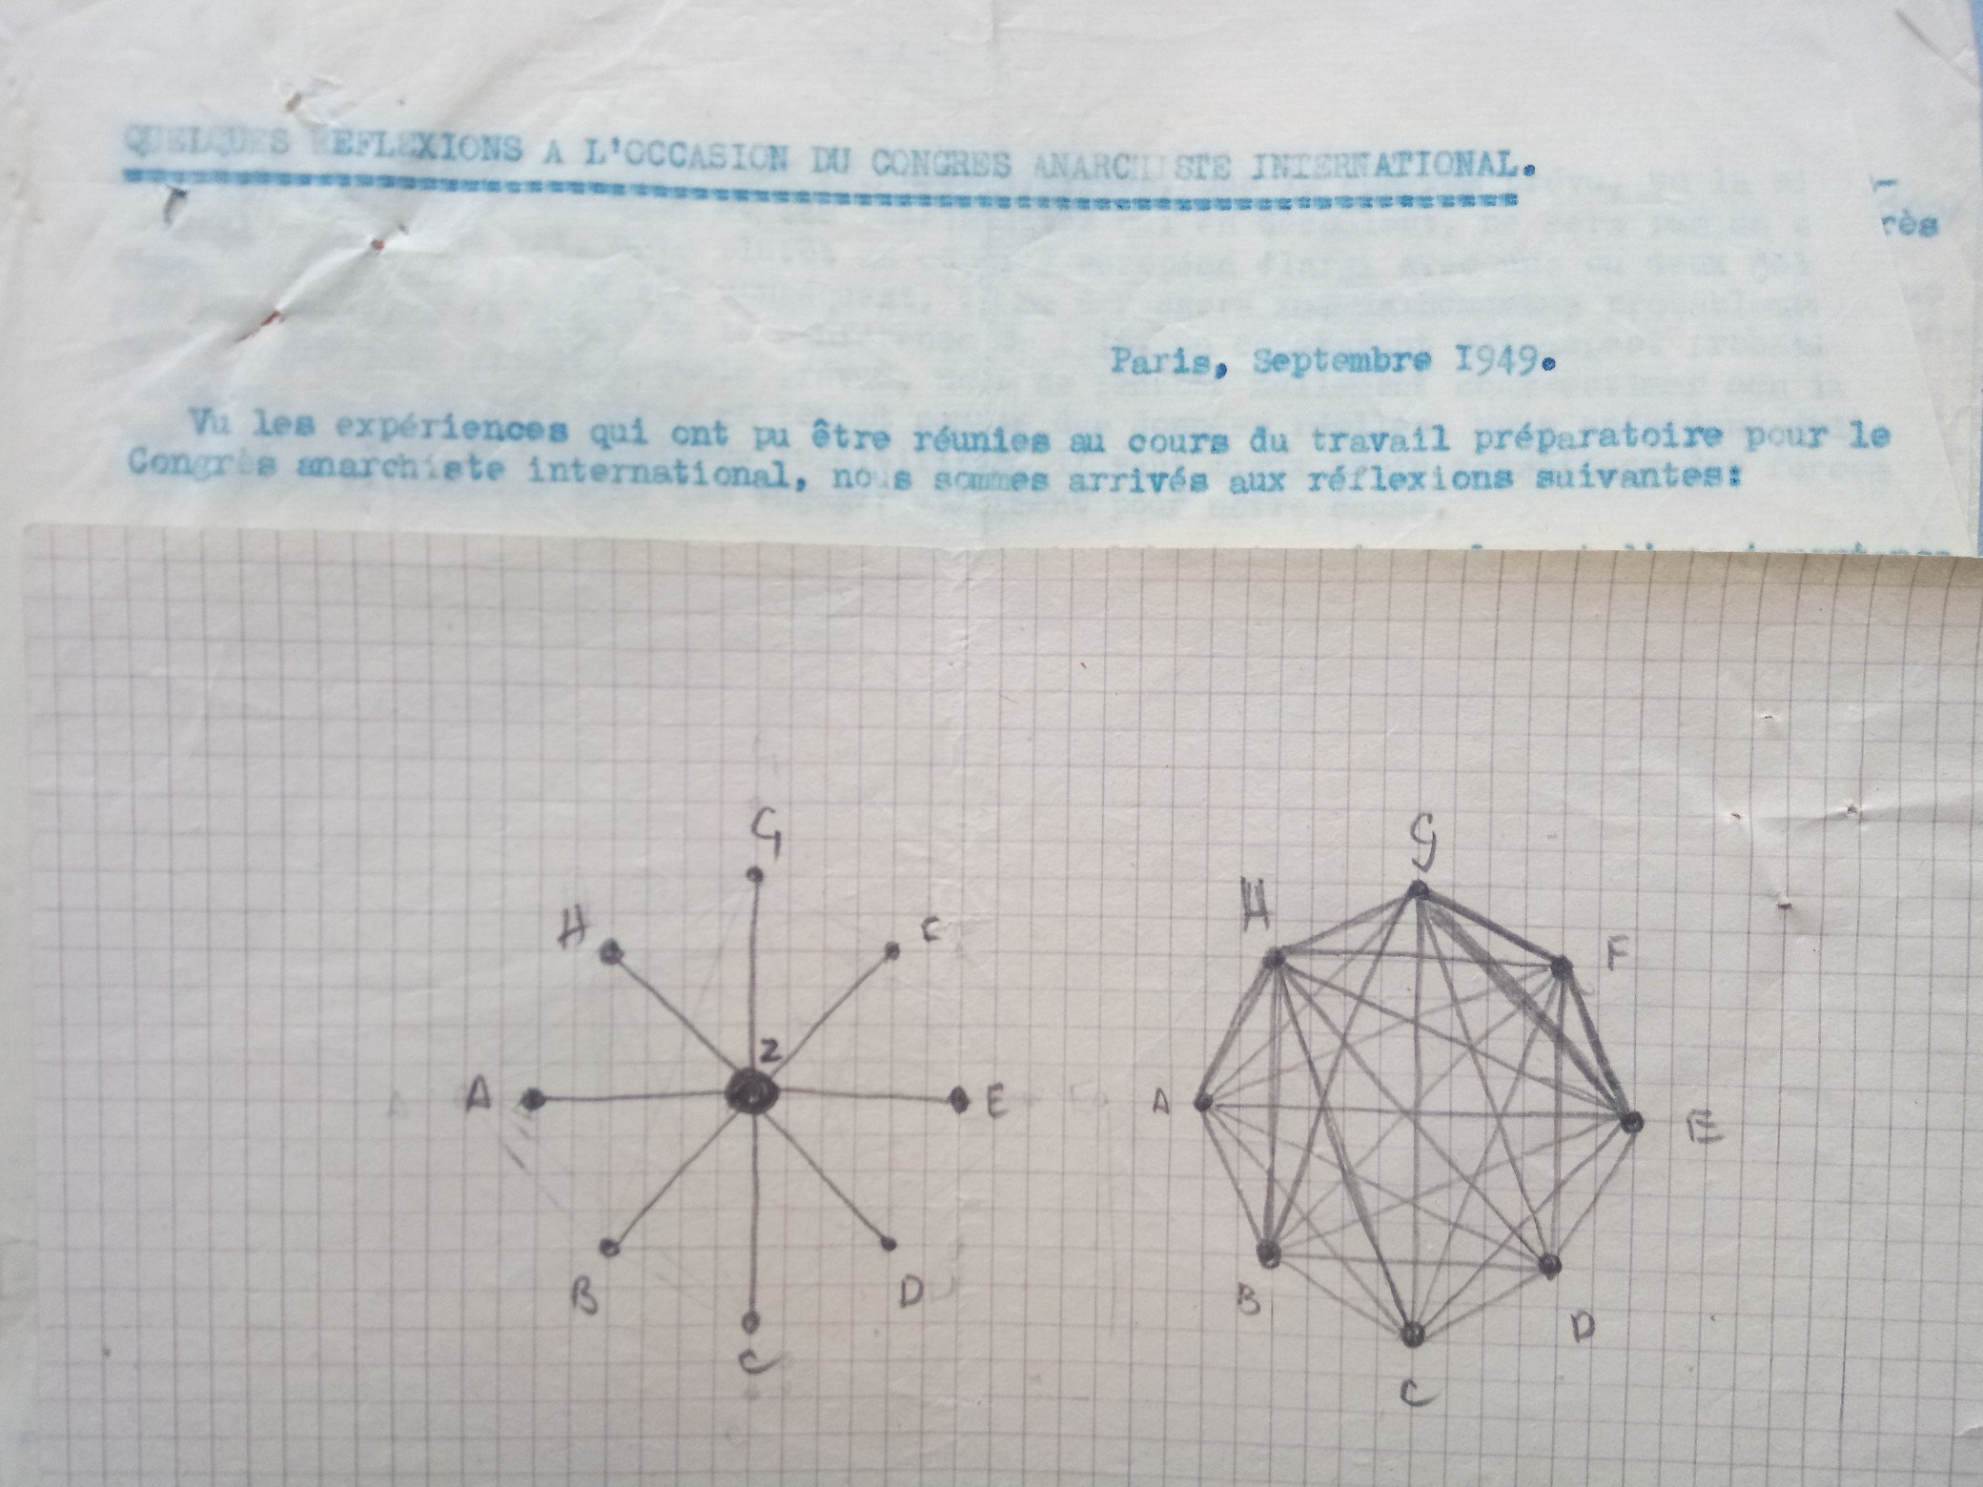
Anarchist Cybernetics
Ugo Fedeli’s depiction of anarchist organisation in his notes from the 1949 International Anarchist Congress in Paris
Striking similarity here with the visual representation of Team Syntegrity
Only recently uncovered almost by accident by Ole Birk Laursen
The text reads something like “in view of the experiences that have been gathered during the preparatory work for the International Anarchist Congress, we have arrived at the following reflections”

Slide 6

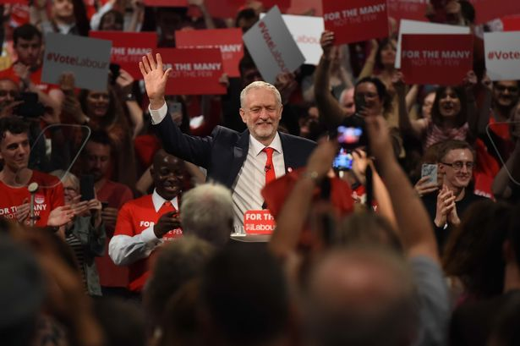
Radical Politics In and Against the State
Since the 2011 uprisings, of which Occupy was one important part, there has been a shift towards electoral politics
Initially with Syriza in Greece and Podemos in Spain but also seen in the surge in membership and support for the Scottish National Party after the 2014 independence referendum and currently in the grassroots mobilisations in the US and the UK around Bernie Sanders and Jeremy Corbyn respectively

Slide 7
Radical politics In and Against the State
This electoral turn does not necessarily equate to an abandonment of the participatory democratic spirit of the 2011 uprisings
As John McDonnell puts it, this involves a strategy of working in and against the state
Anarchist critique of the state, according to Dupuis-Déri (2016):
  “a system of domination (macro), a constellation of institutions (meso), and a mass of individual agents and social relationships (micro)”
  “a non-egalitarian division of political work involving two classes, the governors and the governed”

Slide 8
Radical Politics In and Against the State
Milburn and Russel (2018):
  Institutions train “us to adopt a particular subjectivity, a particular mode of thinking and acting. […] Through repetition we internalise this institutional logic and come to anticipate it and act accordingly, until it eventually it comes to structure the common-sense view of human possibility.”
The question for radical politics is how to shape this so that institutions facilitate and reinforce participatory democracy

Slide 9
Radical Politics In and Against the State
Gunn (2014):
  “Institutions have a built-in, hierarchical dynamic: they obey an iron law of oligarchy that generates role definitions – role definitions which claim authority and cluster together at the top. By contrast, interaction which follows its own inner logic is unrestricted and in principle free.”
Gunn, Smith and Wilding (2015):
  “An analogy may be drawn with conversation: a “good” discussion follows its subject-matter wherever it leads. It gives its law to itself. So it is, we suggest, with interaction. Interaction which is truly interaction has an unstructured character. That is to say, it is not confined to previously-established channels. It decides its own patterns and consults itself.”
Interaction and conversation counterposed with the logic of institutions

Slide 10
Radical Politics In and Against the State
Milburn and Russell (2018):
  “New forms of institutions are needed that can provide each of us with the opportunity – and perhaps obligation – to learn what it actually means for us to take collective decisions over our common future.”

Slide 11
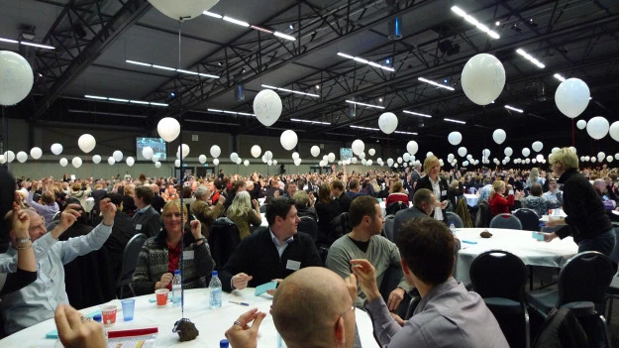
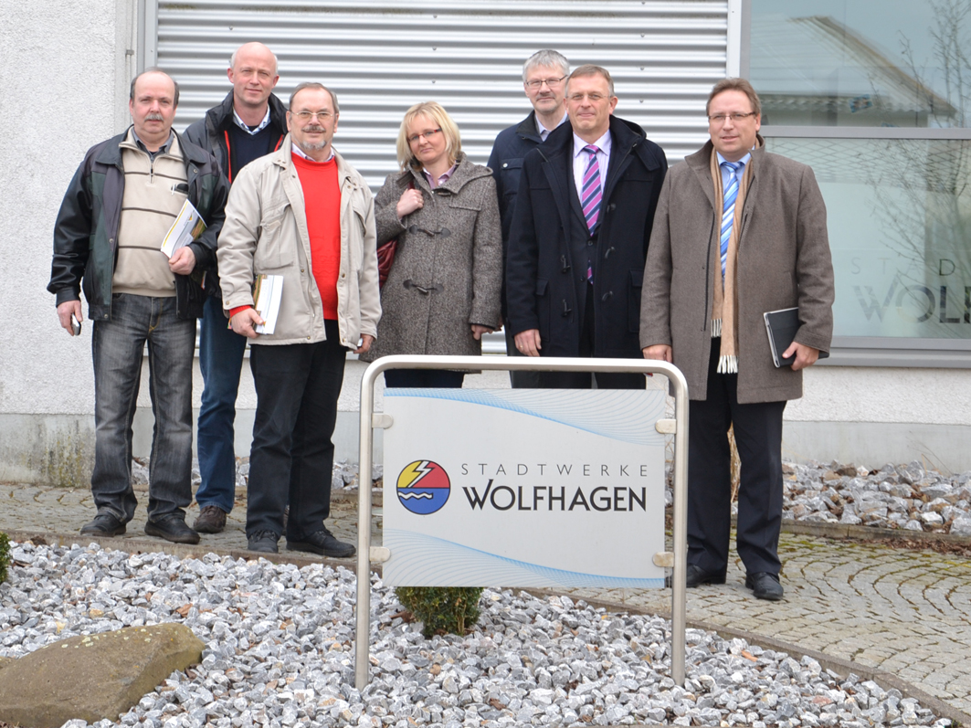
Models of Participatory Democracy
Two examples of how the participatory democracy of anarchist politics can be realised in institutional settings:
  Public-Commons Partnerships
  Iceland’s Participatory Constitutionalising

Slide 12
Models of Participatory Democracy
Public-Commons Partnership in Stadtwerke Wolfhagen
Director of Stadtwerke Wolfhagen Martin Rühl:
  “Through the cooperative participation we want to make the citizens not only co-owners and co-earners, but through the form of a direct participation in the Stadtwerke also co-decision-makers. For future projects, citizens and electricity customers will be at the table from the very beginning.”
Milburn and Russell (2018):
  “… the distributed model of governance means that power – understood here as the capacity to shape the collective conditions under which we live our lives – is less concentrated in the state apparatus. Rather than a centralised and paternalistic state making decisions on behalf of consumers and the electorate, we instead see the possibility for distributed forms of governance that incubate and promote new forms of relationships between citizens.”

Slide 13
Models of Participatory Democracy
Iceland
After financial crash, new government begins a process of revising the national constitution
  National Assembly of 1000 randomly selected citizens decides on the core principles of the community
  Elected Constitutional Council drafts the new constitution
  Subject to a referendum
Landemore (2015):
  “(i) direct popular participation at various stages of the process, (ii) elements of descriptive representativeness where direct participation wasn’t possible, and (iii) transparency”

Slide 14
Models of Participatory Democracy
Constitutionalising (determining the principles, rules, institutions and decision-making practces that govern a community) in participatory democratic ways that reject the need for the state
Kinna, Prichard and Swann (2019):
  “a grass-roots, post-statist constitutional politics”
  “Anarchist constitutional practices point to a new language of constitutionalism that moves from the sovereign ‘I’, in order to develop multiple and overlapping constitutional process for articulating plural ‘we’s’.”

Slide 15
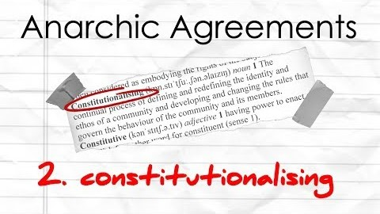

Slide 16
Mapping Participatory Democracy onto the VSM
Systems 1 and 2 functions particularly well realised in the Occupy model of democracy
Systems 3, 4 and 5 better realised in the Icelandic example and in the Public-Commons Partnership structure
How do we bring these together to provide a vision of anarchist cybernetics that applies to the higher-level functions in context larger and often more complex than the protest camp?

Slide 17
Mapping Participatory Democracy onto the VSM
Iceland
  Participation facilitated through random selection, voting and social media
Public-Common Partnership
  Representatives on boards
Is this enough?
What structures can we create that enable both the kind of participation seen in Occupy and the strategic and grand strategic functionality of examples of participatory democracy, and – if we’re anarchists – that fulfil the functions of the VSM without reproducing or reinforcing the state?

