Slide 1
Managing complexity with VSM: New developments in theory, methodologies and applications
Dr. A Espinosa
Hull University Business School &
Los Andes University Business School

Slide 2
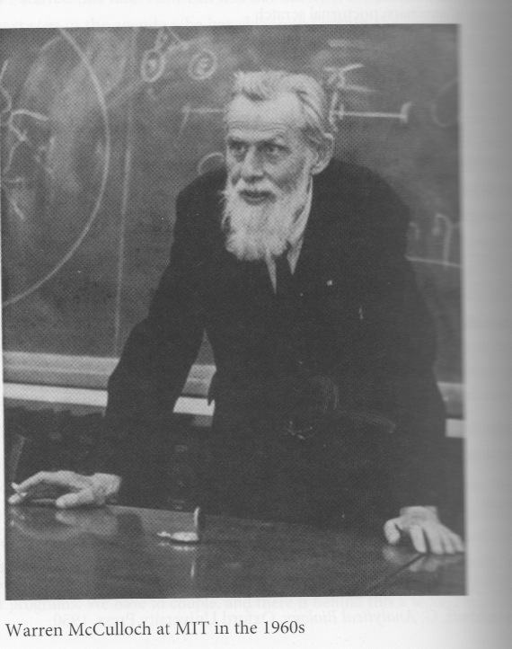
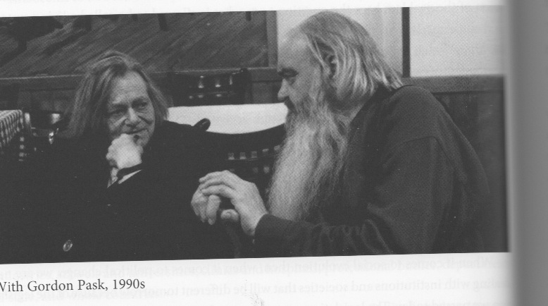
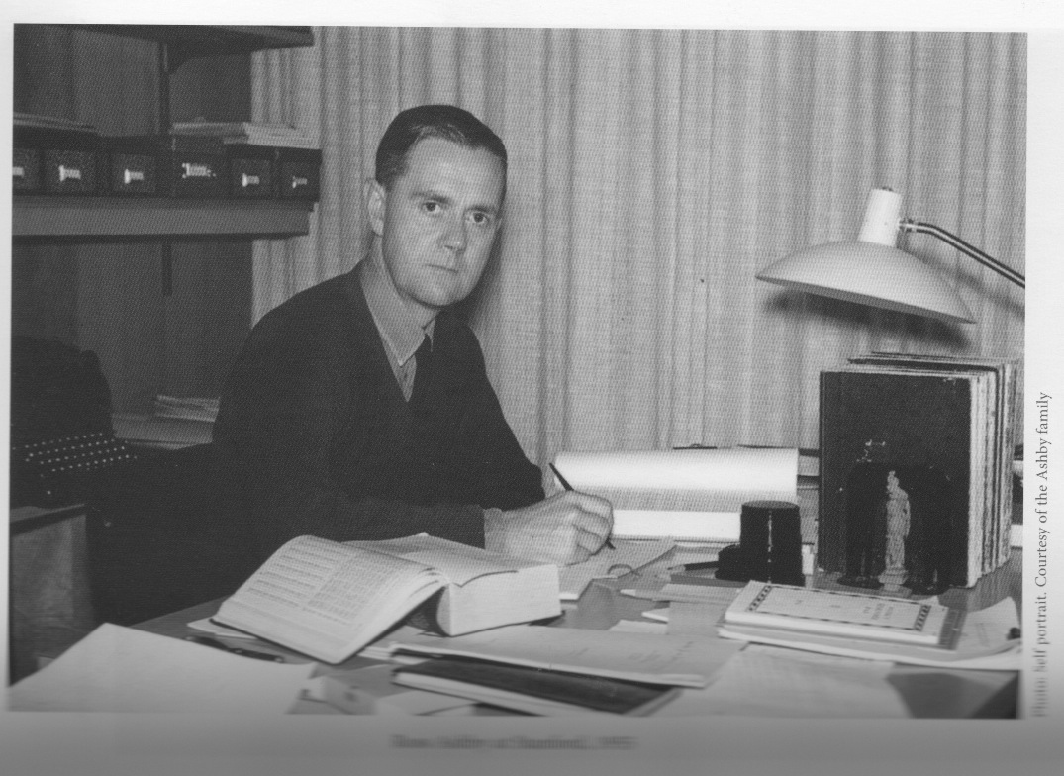
Stafford Beer
1926-2002
1966 – Published Decision and Control- Lancester Prize of the OR for America
1970 Waren Mc Culloch Plaque - ASC
1950: Reads Wiener’s Cybernetics
1956 Founds Department of Operational Research and Cybernetics – United Steel
1960; meets USA cybernetitians
1961 – SIGMA – 1st OR – Cybernetics consultancy in UK

Slide 3
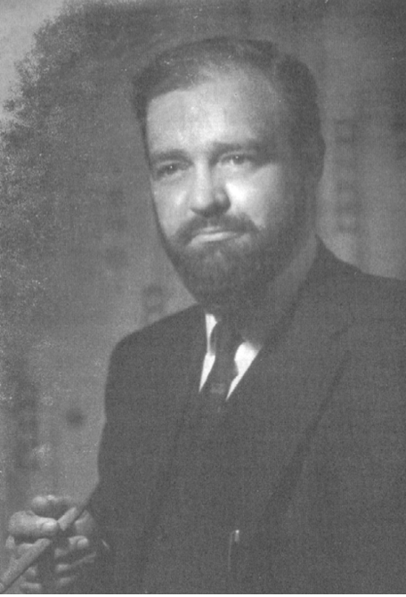
British Steel & VSM: 1950’s
Developed the VSM during the 1950’s while he was a manager in the UK steel industry.
It was a response to his dissatisfaction with traditional approaches to management.
His theories resulted in significant increases in productivity.

Slide 4
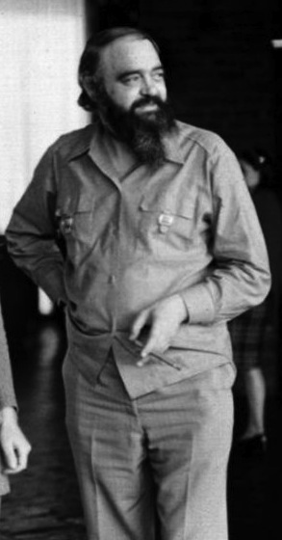
Chile 1971 - 1973
Invited by Allende to create a decentralised, participative economy.
In 18 months they created a network linking all the nationalised factories, simulations and real-time information systems to control the economy.
After Allende
Stafford comes back to UK
writes the VSM books…

Slide 5
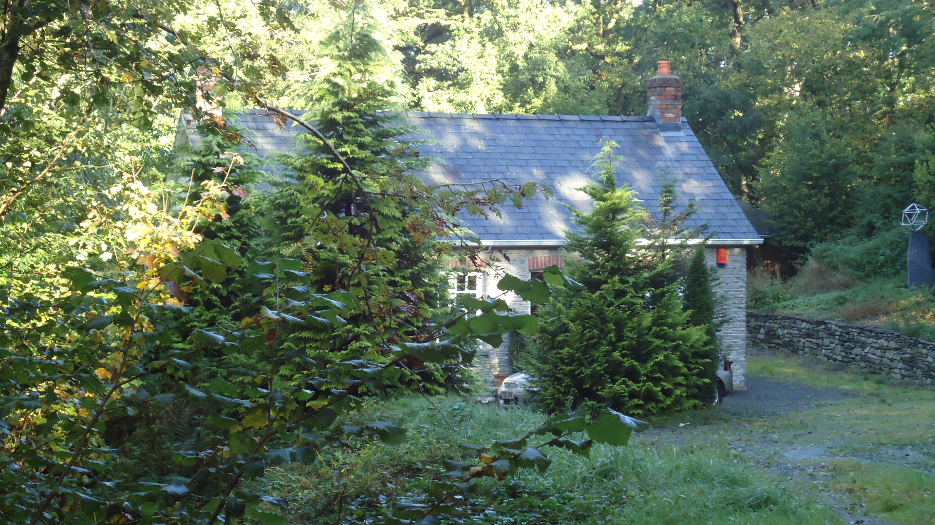
Chile & Afterwards
1971-1974 Cybersyn project. Allende’s Chile
1972: Brain of the Firm
1974: Designing Freedom
1975: Platform for Change
1979 – Publishes Heart of the Enterprise
1981 – Publishes Brain of the firm . 2nd ed
1983 – Works with the Mexican Government; publishes Transit
1985 – Publishes Diagnosing the System for Organisations
1990s – supports four major VSM projects in Colombia
- 1994- Develops Team Syntegrity, publishes Beyond Dispute
1990s Malik on Management buys copyrights
Team Syntegrity Inc created

Slide 6
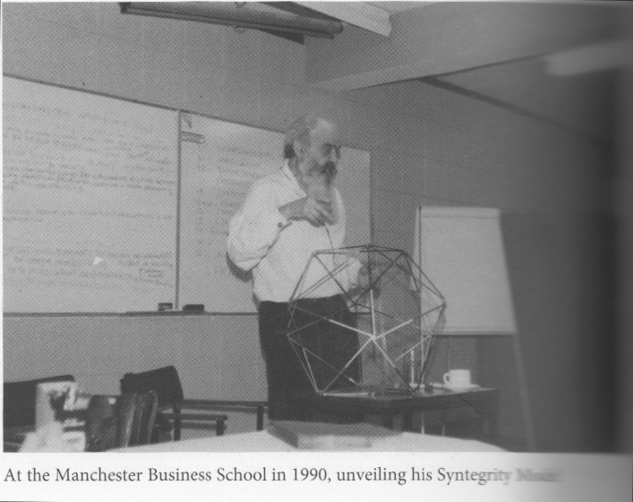
Team Syntegrity (1990s)

Slide 7
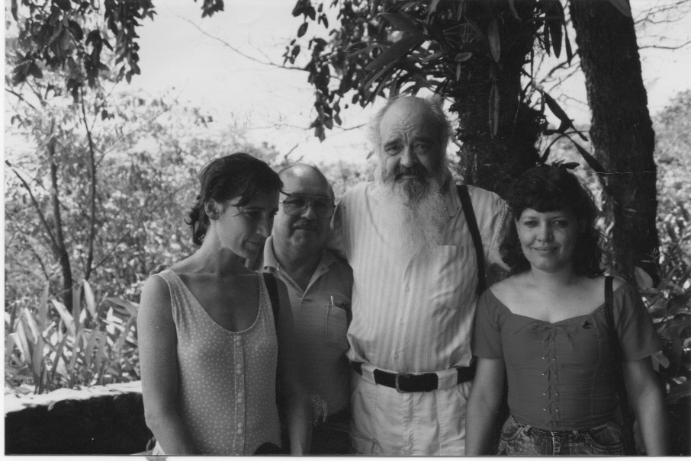
Other latin-american projects (1988-1990s)
Colombia (1990s)
A cybernetic methodology to support strategic
information systems planning – case study at
the Colombian’s President Ofiice (1990-1992)
Reunirse: a monitoring system for the Social
Solidarity Network (1994-1998)
Reengineering the National Audit Office (1994-1998)
Redesigning the Colombian School System (1998-2000)
Designing the National Environmental Information System (1999-2001)

Slide 8
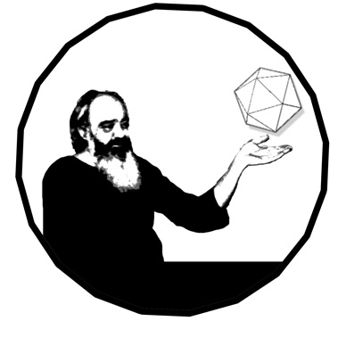
The Metaphorum Group
(2002…)
Staffordian Syntegration – Scarborough (2002)
  Creation of the NGO – Metaphorum
  Agreement on its constitution & membership
7 Conferences organised (Scarborough, Sunderland, London, Liverpool, Dublin, St Gallen, Scarborough)
2 special issues produced (Kybernetes 2006; Organisational Transformation and Social Change 2007)
Listserve active since 2005 (P Stokes, R Harnden leading)
Wikispaces (L Hoebeck leading)
New webpage (drupal based) 2010

Slide 9
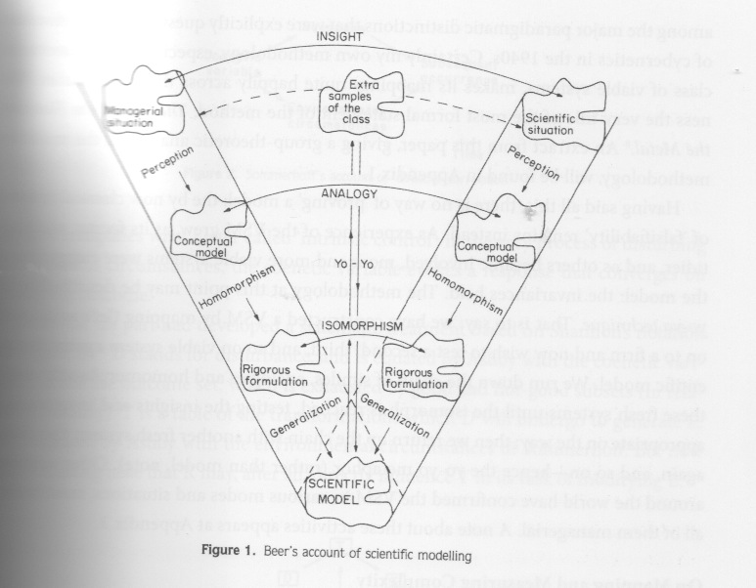
The theory of viability: Origins

Slide 10
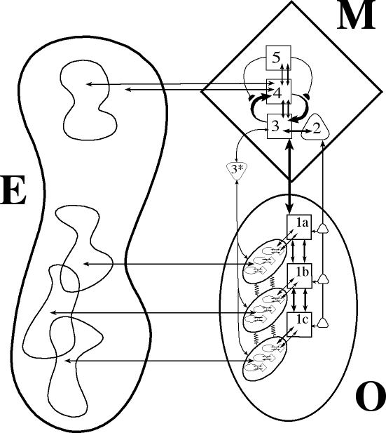

The VSM: An Overview.
Meta-system provides a service - to hold the Operational parts together.
Recursive systems within systems.
5 Necessary and Sufficient Systems:
S1 - Operation
S2 - Harmonization & Conflict Resolution
S3 - Self Regulation & Synergy
S4 - Adaptation
S5 - Identity and Closure
Autonomy and cohesion.
Co-evolution with the environment
All 5 systems need to be both fit for purpose and properly connected.
Dynamic Balance

Slide 11
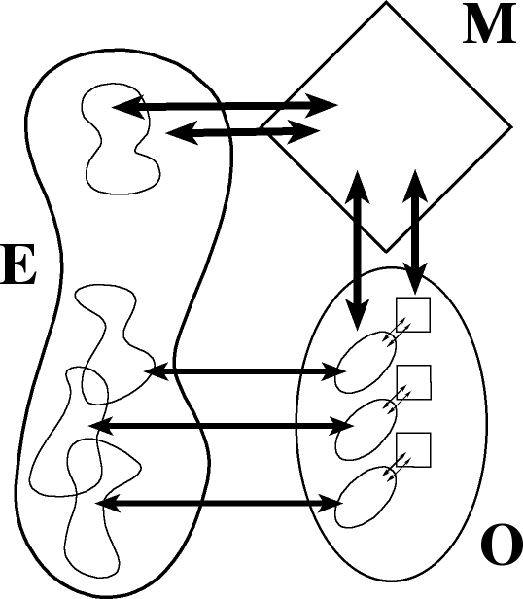
In summary: The VSM theory
Nested, recursive systems within systems within systems . . .
A Meta-system which enables the Operational elements to come together to form a new, larger, whole system.
Operational autonomy limited only be system cohesion.
Continuous, dynamic, co-evolving interactions, based on real-time information.
This is the basic unit of analysis: a whole system co-evolving with its environment
Not hierarchical !!
Not mechanistic !!

Slide 12
Developing the VSM Theory and Methodology
(after 2002)
Theoretical & Methodological developments
  Schwaninger, M. (2007) – Intelligent Organisations (The Systemic Management Framework)
  Hoversdadt, P. (2009) – the Fractal Organisation (applications)
  Cristopher, P. (2007) – Holistic Management
  Malik, F. (2002-2015) – Malik’s ‘VSM’ (applications)
  Espejo, R. & Reyes, A. (2011) – Organisational Systems: managing complexity with the VSM (Viplan method + applications)
  Espinosa, A. & Walker, J. (2011) – A complexity approach to sustainability: theory and applications (Methodology for self-transformation + framework for sustainable governance + applications)
  Pérez-Ríos, J. (2012). Design and Diagnosis for Sustainable Organizations: The Viable System Method. (methodology + applications)

Slide 13
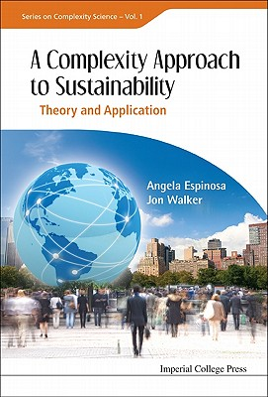
Need for new approaches to manage complexity
‘Sustainability is the wickedest social problem’
Global environmental crisis → a holistic, trans-disciplinary view, (inspired in the VSM) able to integrate, social, economic and environmental aspects of the different related complex situations
Understanding human social systems and networks as complex systems, then a complex systems approach would be desirable to understand sustainability

Slide 14
A viable (and sustainable) system
A viable (and sustainable) system must:
  Be financially viable
  Be in balance with its ecological environment
  Enhance the well being of the people it employs and the communities in which it functions
The VSM provides us with a model of the structural conditions for viability – which is a pre-requisite for sustainability.
  Resilience in a complex organisational network can be be studied using insights from the theory of viability and sustainability;
  This needs of new theoretical and methodological developments
Sustainable governance:
  Involves the design of recursive decision-making spaces
    including participation of stakeholders at each level,
    responsible for designing and implementing sustainable strategies and actions.

Slide 15
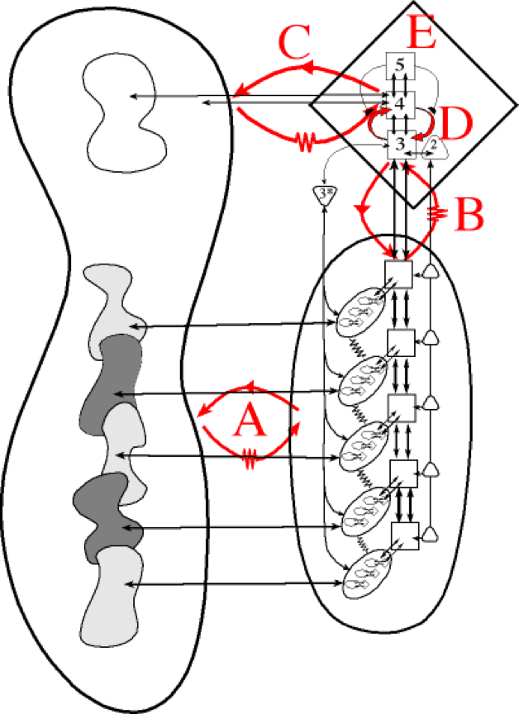
Key issues for organisational viability
Self –organisation (self- regulation)
Co-evolution with the environment
Innovation: continuous learning and adaptation
  Adaptive Policies and Strategies
  Continuous Learning – Closing feedback loops.
Optimum information & knowledge management systems
Recursive Governance: Sustainability Indexes on Critical Processes for Sustainability

Slide 16

‘Self governance’
At all levels, (from the local, regional, national to the global levels)
  Each one must observe and measure – in as close to real time as possible - the dynamics of those variables that are essential for the viability of the socio-ecological system.
  if we manage to learn more about the essential variables for sustainability and self-govern our societies accordingly to keep them within their physiological limits, then the possibilities for our long-term survival increases.

Slide 17


Self governance in a social group
Self governance in an
individual

Slide 18
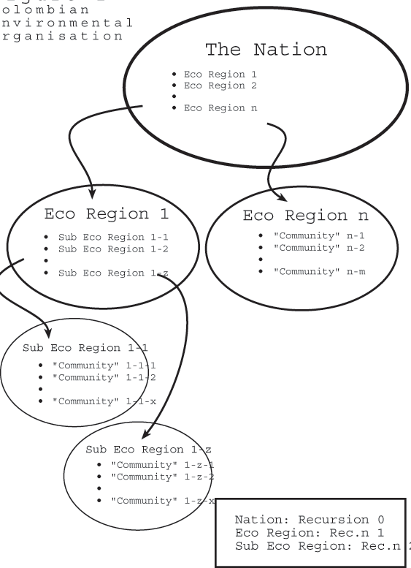
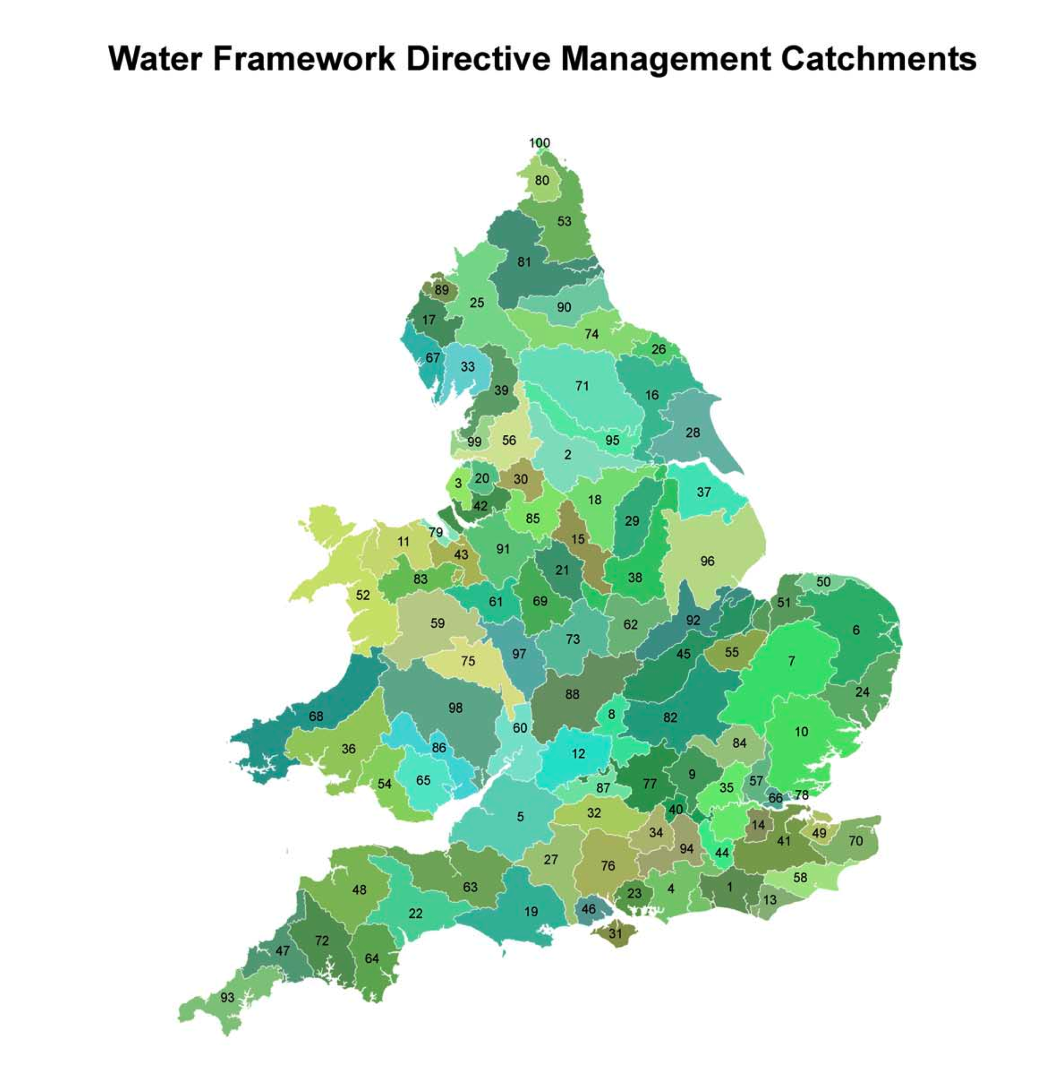
Governance by Bio-regions ?
(Espinosa & Walker, 2005)

Slide 19
Recursive Governance
Clusters of whole-systems: cohering into larger whole-systems at higher levels of recursion
Sustainable governance:
  if we achieve long-term sustainability at the local and the global level
  mapping the society: nested systems from the individual to the planetary level
  Self-governance within each recursive level of organisation → capacity to co-evolve with its socio-ecological niche
Enabling sustainable governance
    a parallel, bottom up strategy, which nurtures self-consciousness and change at all levels.
    Implementing a structure with recursive, distributed control requires effective decision making at each recursive level
    in these decision-making spaces that collective consciousness may or may not emerge

Slide 20
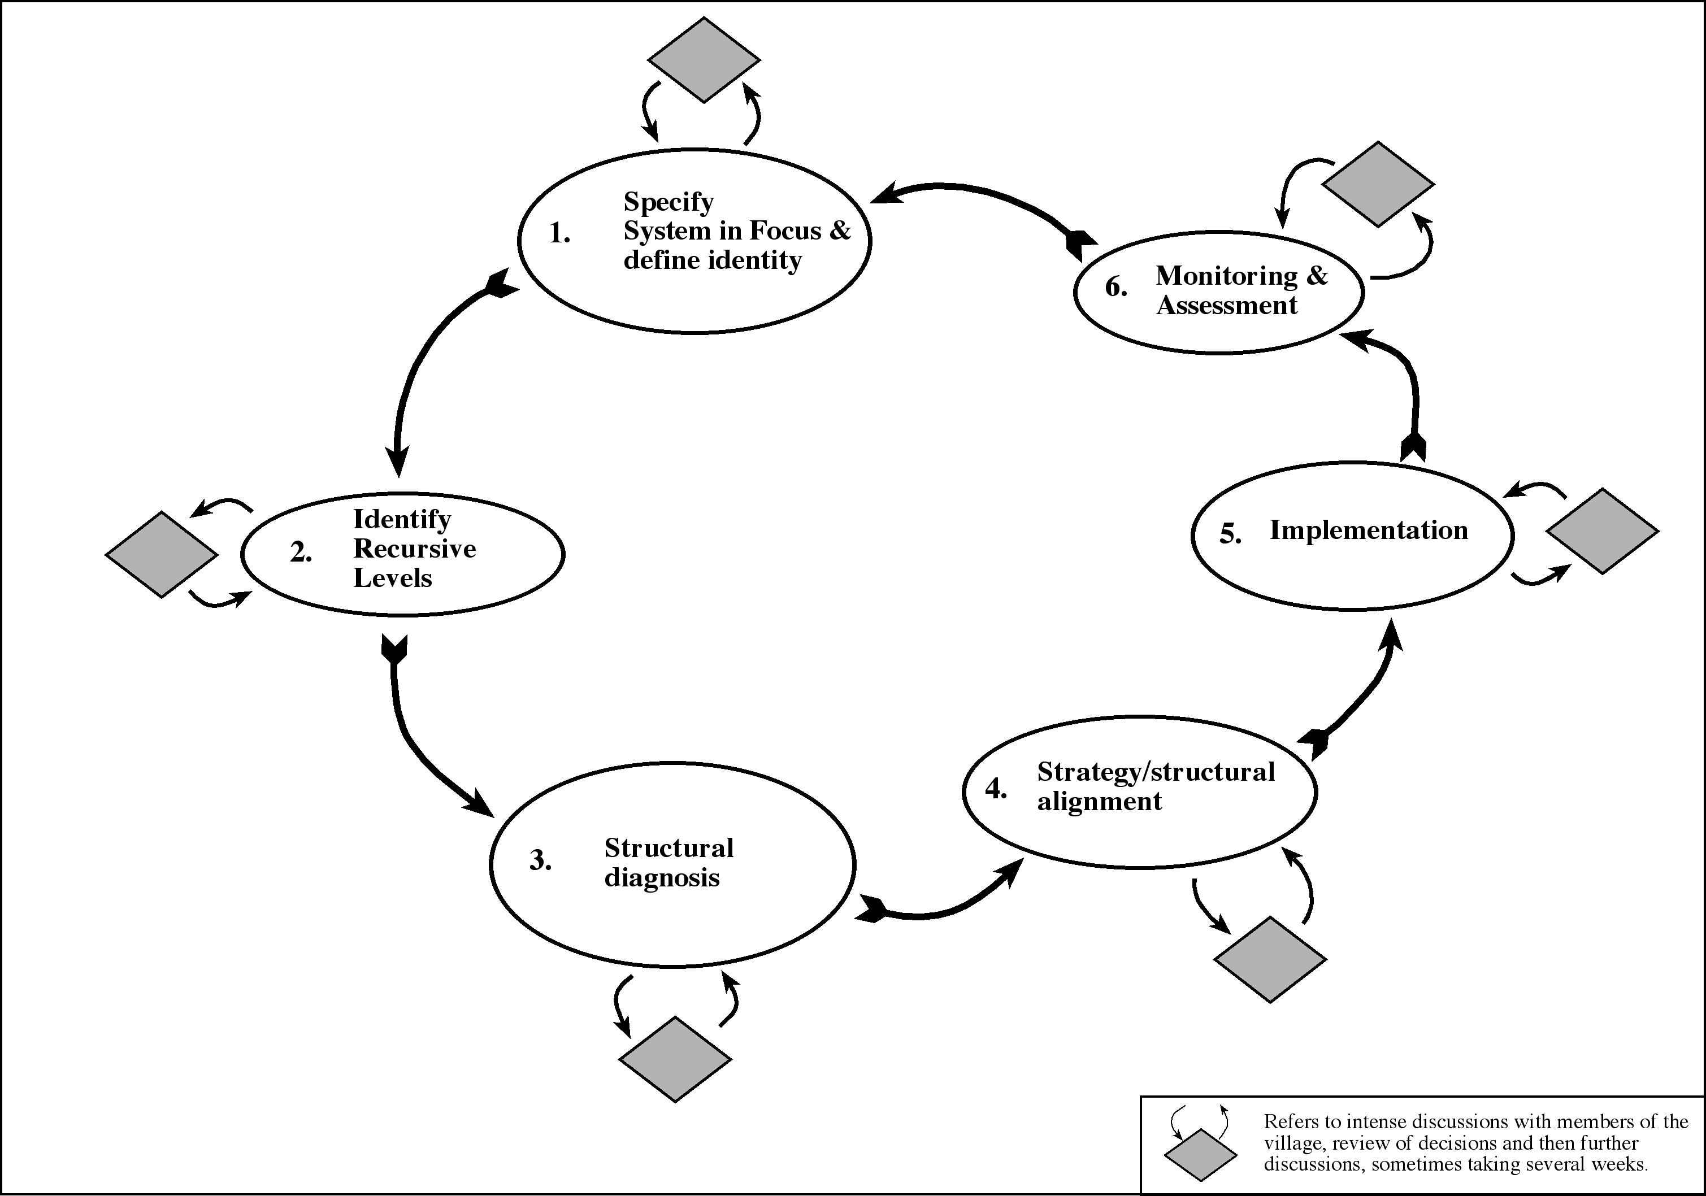
VSM Diagnosis Methodology
(Espinosa & Walker, 2011a, 2011b)

Slide 21
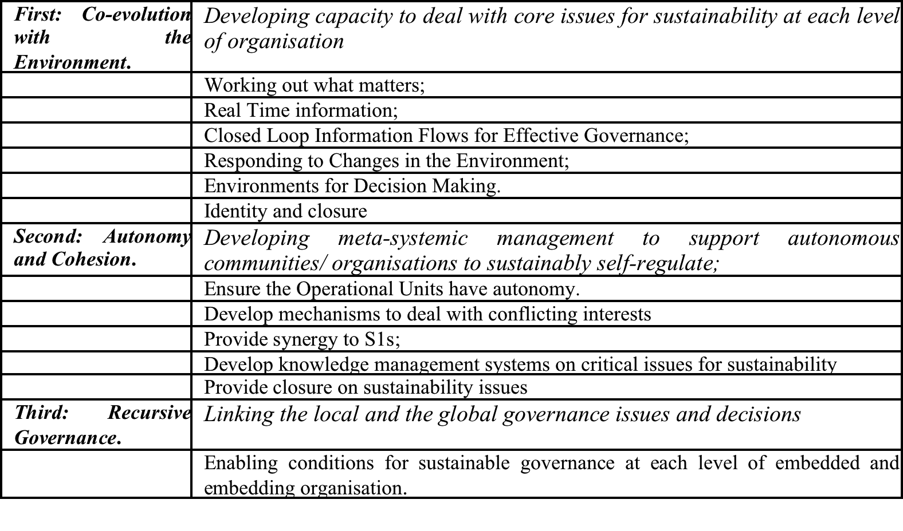
Framework for assessing sustainable governance

Slide 22
New developments
- research topics and projects-

Slide 23
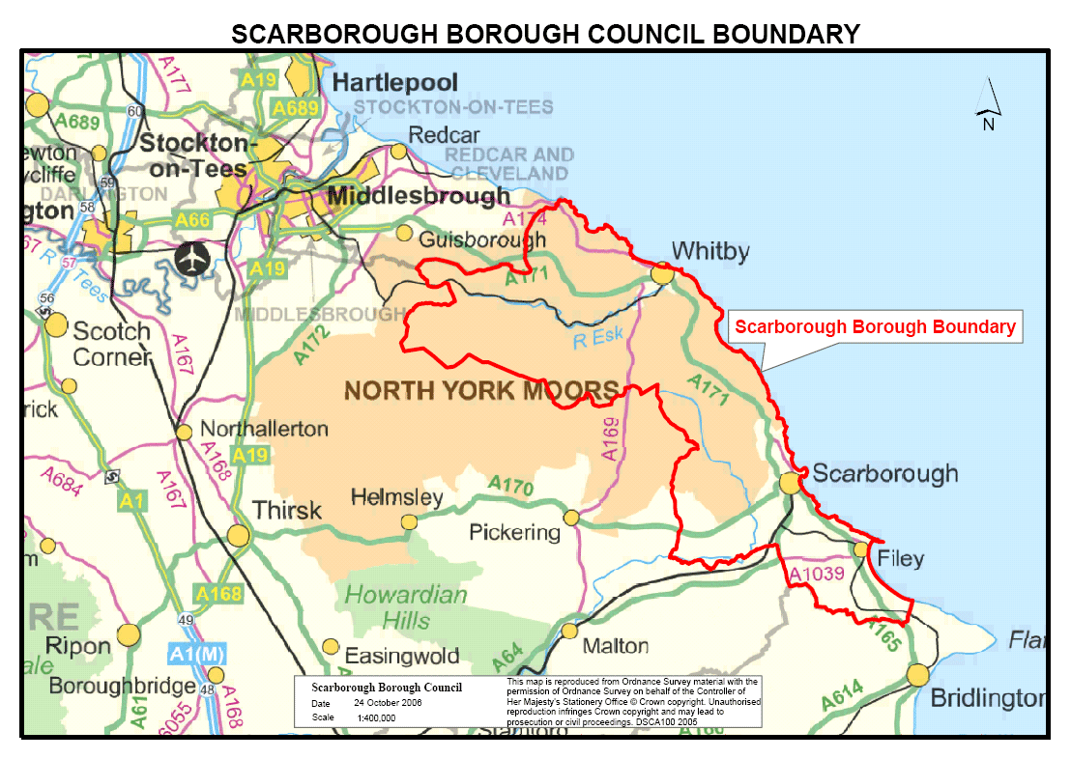
The Systemic Policy Implementation Framework
M Watts (2008) – exploring VSM vs network collaboration (I)
(+ combining VSM +SNA)
Defining System in Focus | Diagnosis | Design | Assessment | Action | Reflection
Appreciation | Analysis
Rich Picture Cybernetic Methodology Transformation Actor Suppliers Customer Owners Interveners Identity Statements Modelling levels of complexity | Viable System Model (VSM) Social Network Analysis (SNA) | Viable System Model Social Network Analysis | Feasibility Testing | Design Implementation (Who, What, When, Where, How). | Reflective Practice

Slide 25
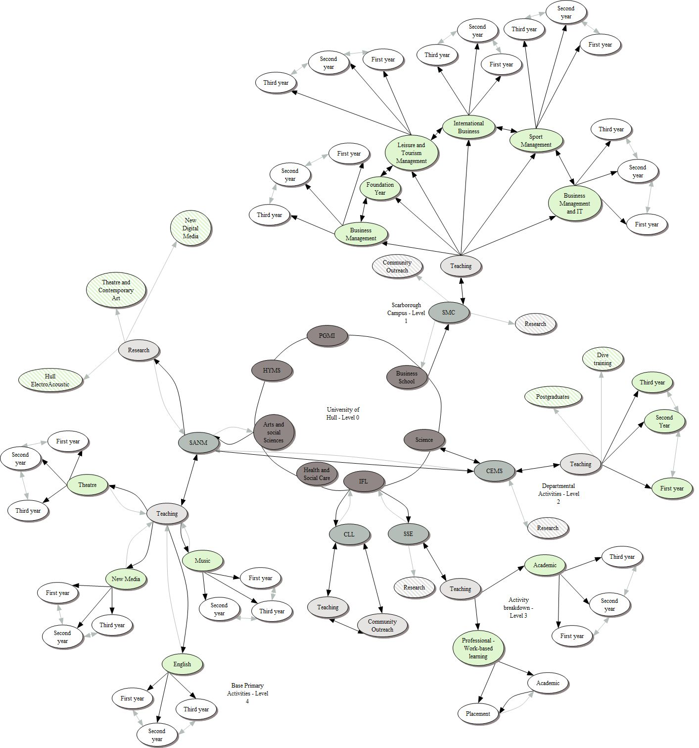
A systemic methodology for environmental
Management (K Knowles, 2010)
Identifying meta-norms
Mapping informal networks
Social Network Analysis (SNA)
Agreeing the environmental
Strategy (TSI)
VSM Diagnosis
Implementing & monitoring
environmental strategy

Slide 26
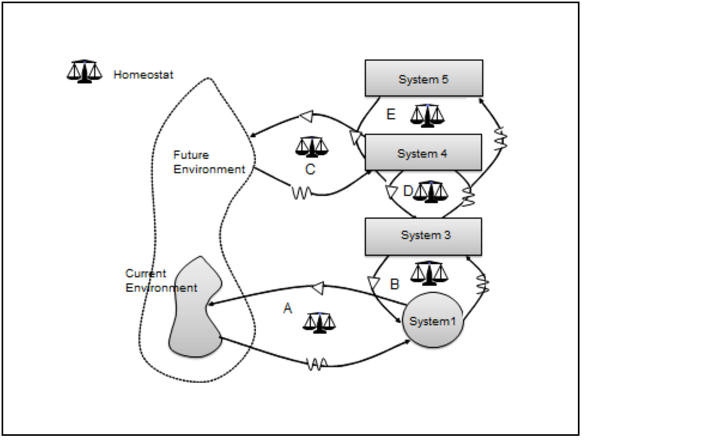
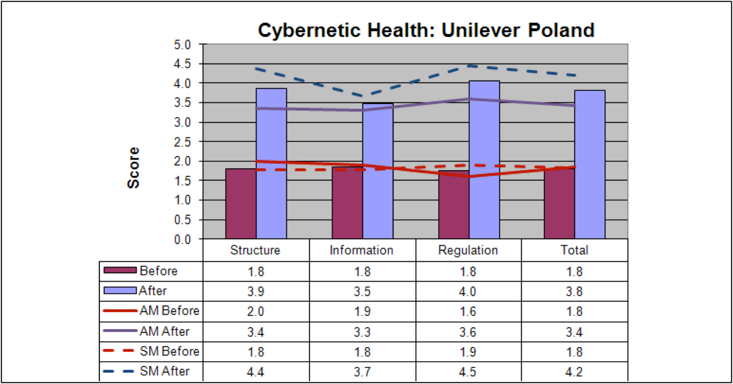
The Application of Organisational Cybernetics to the Design and Diagnosis of Financial Performance Management Systems (S Morlidge)
The VSM as a set of interlocking homeostats
The ‘cybernetic soundness’ of PMS

Slide 27
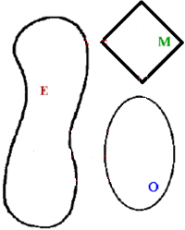
A Holistic Emotions Measurement Model: Using the Viable System Model to Diagnose Workforce Emotions
(Iffat Sabir)
MANAGEMENT
ORGANIZATIONAL DIMENSION
(Relational View)
OPERATIONS
ENVIRONMENT

Slide 28
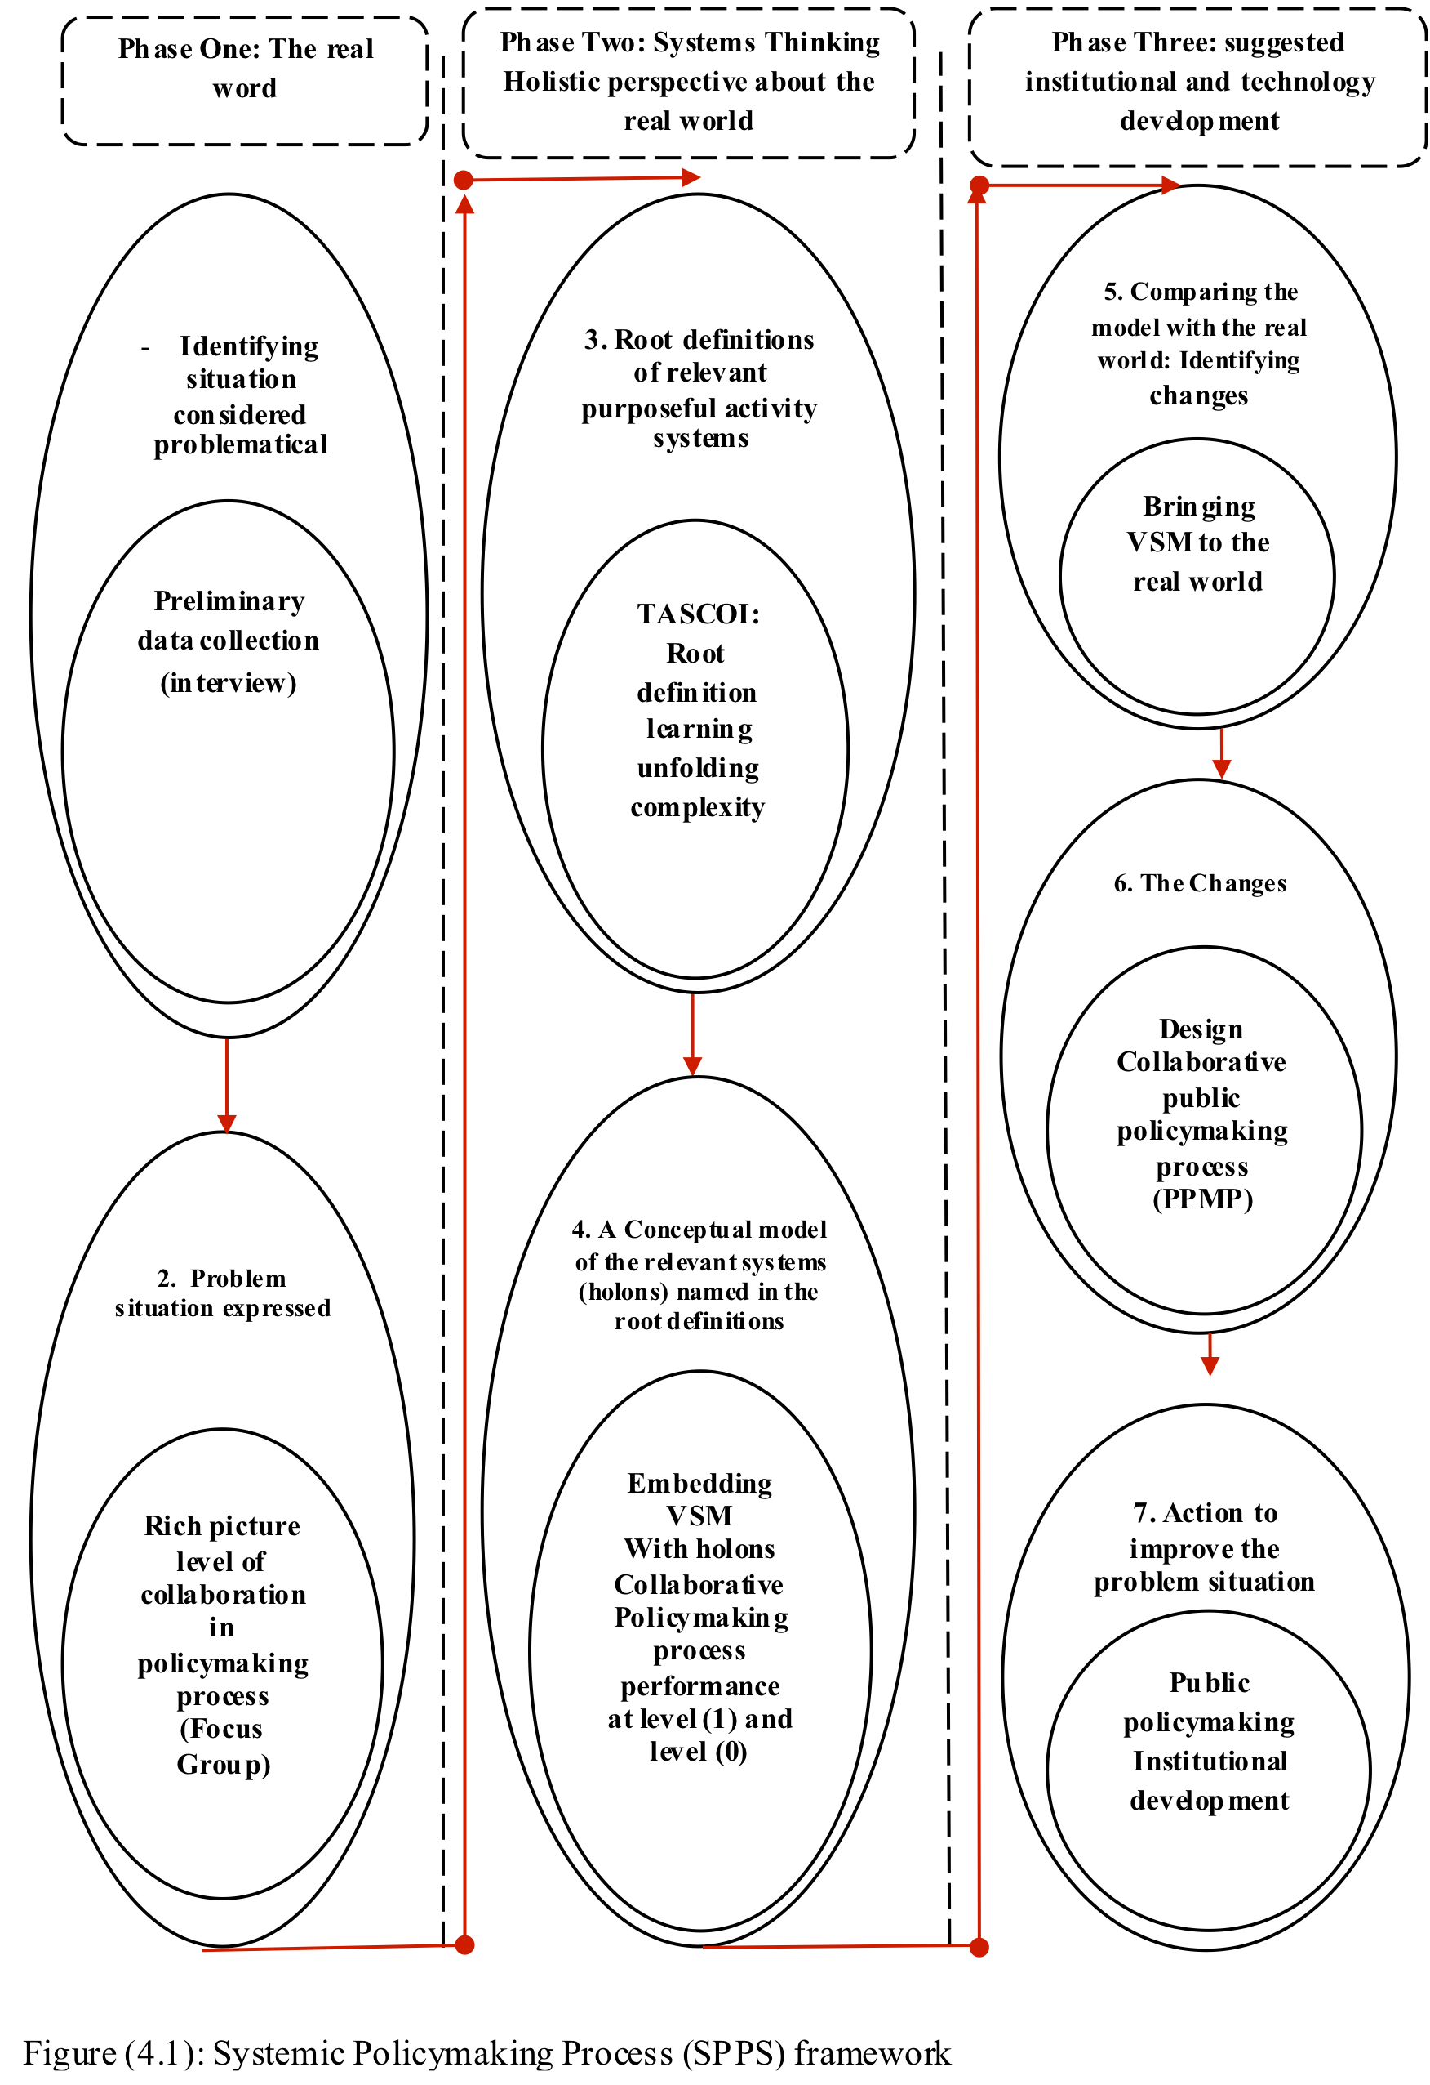
An institutional development policy framework for growth in the non- hydrocarbon sectors of Oman: A systems approach
A Al Maimaini

Slide 29
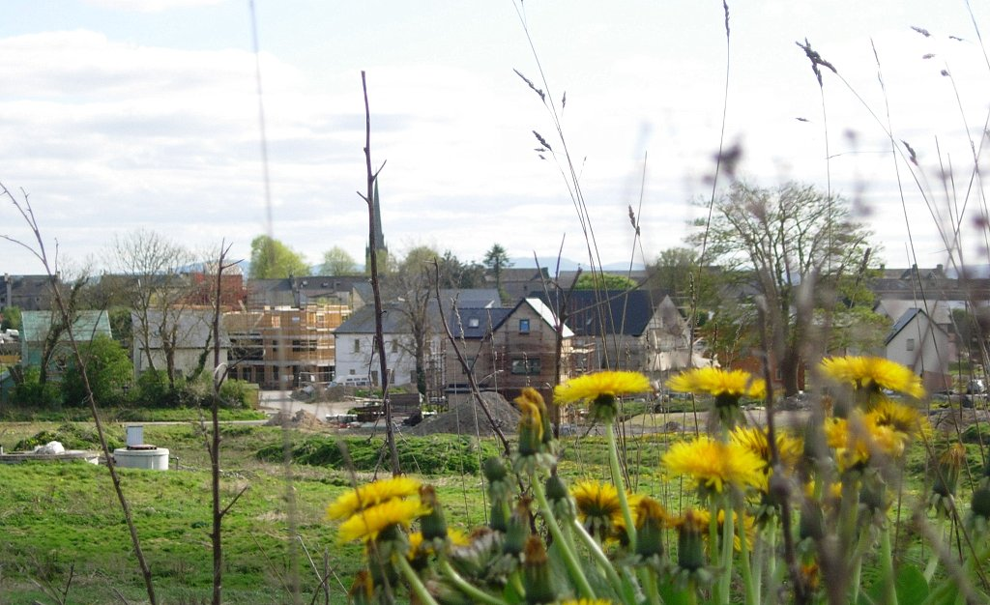
Self Organisation and complexity management: application in an eco-community (2007-2011)
The self-transformation process – The Village – Cloughjordan – Ireland
(Espinosa & Walker, 2013)

Slide 30
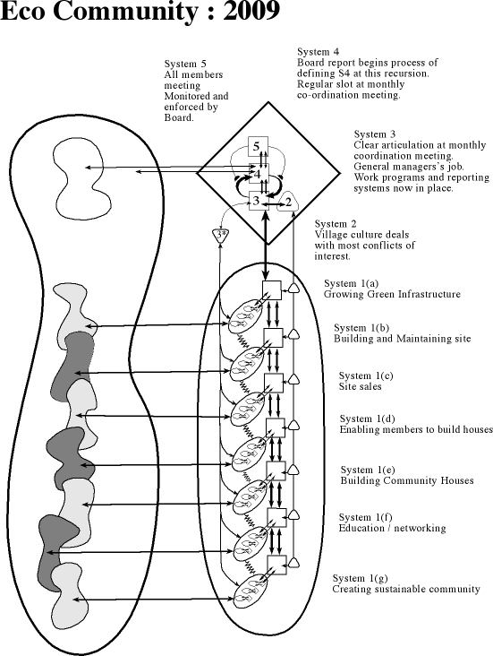
Doing the Diagnosis
Far too many systems 1 (22) Needs clear primary activities.
Board involved in everything. Needs to be focussed
Weak, unfocussed System 3. Needs re-design.
Unfocussed System 4. Needs re-design

Slide 31
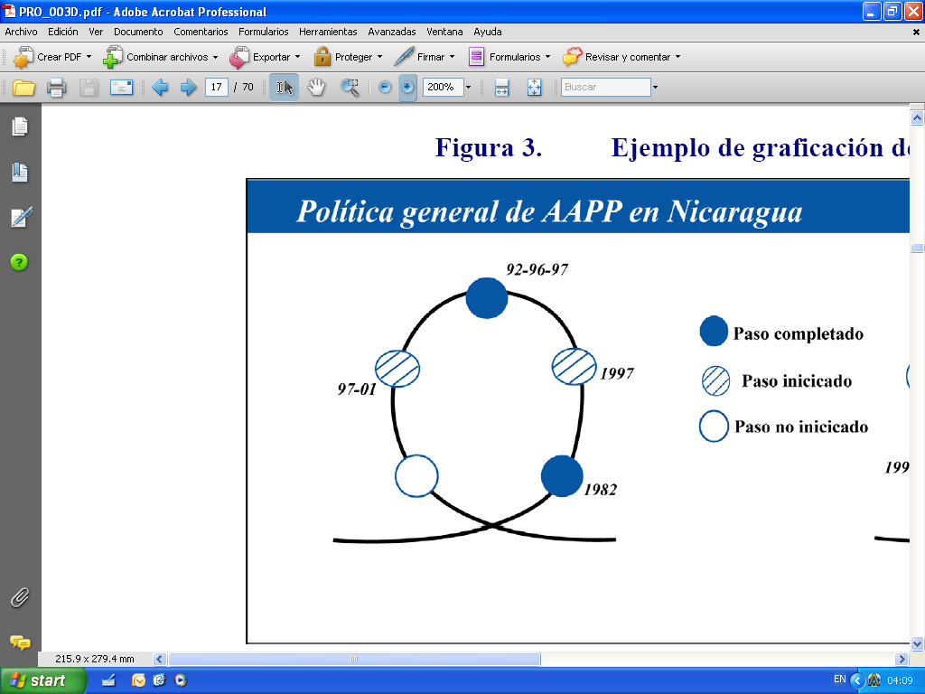
Facilitating Self-Organization in non-hierarchical communities.
The Visualization – Planning Toolset (V-P)
- P.P. Cardoso
The Visualization Loop
Stages
3
Workshops / Instruction: Presentation of the suggested language (VSM handbook and the FCC)
Visualizing the organization: VSM Diagnostic Interview/Questionnaire
Visualizing connectivity: Questionnaire, Follow-up connectivity chart (FCC, Annex 13)
Recognizing the history: Collection of Narratives: interviews
Visualizing the operations: Interviews – process analysis
4
2
5
1

Slide 32
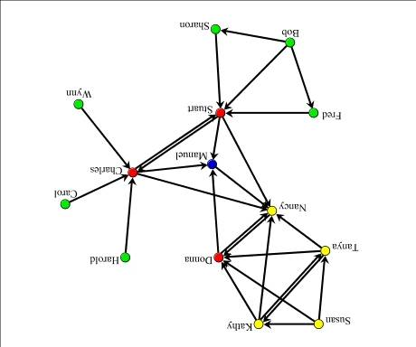

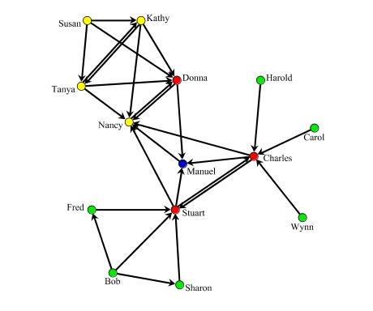

Slide 33
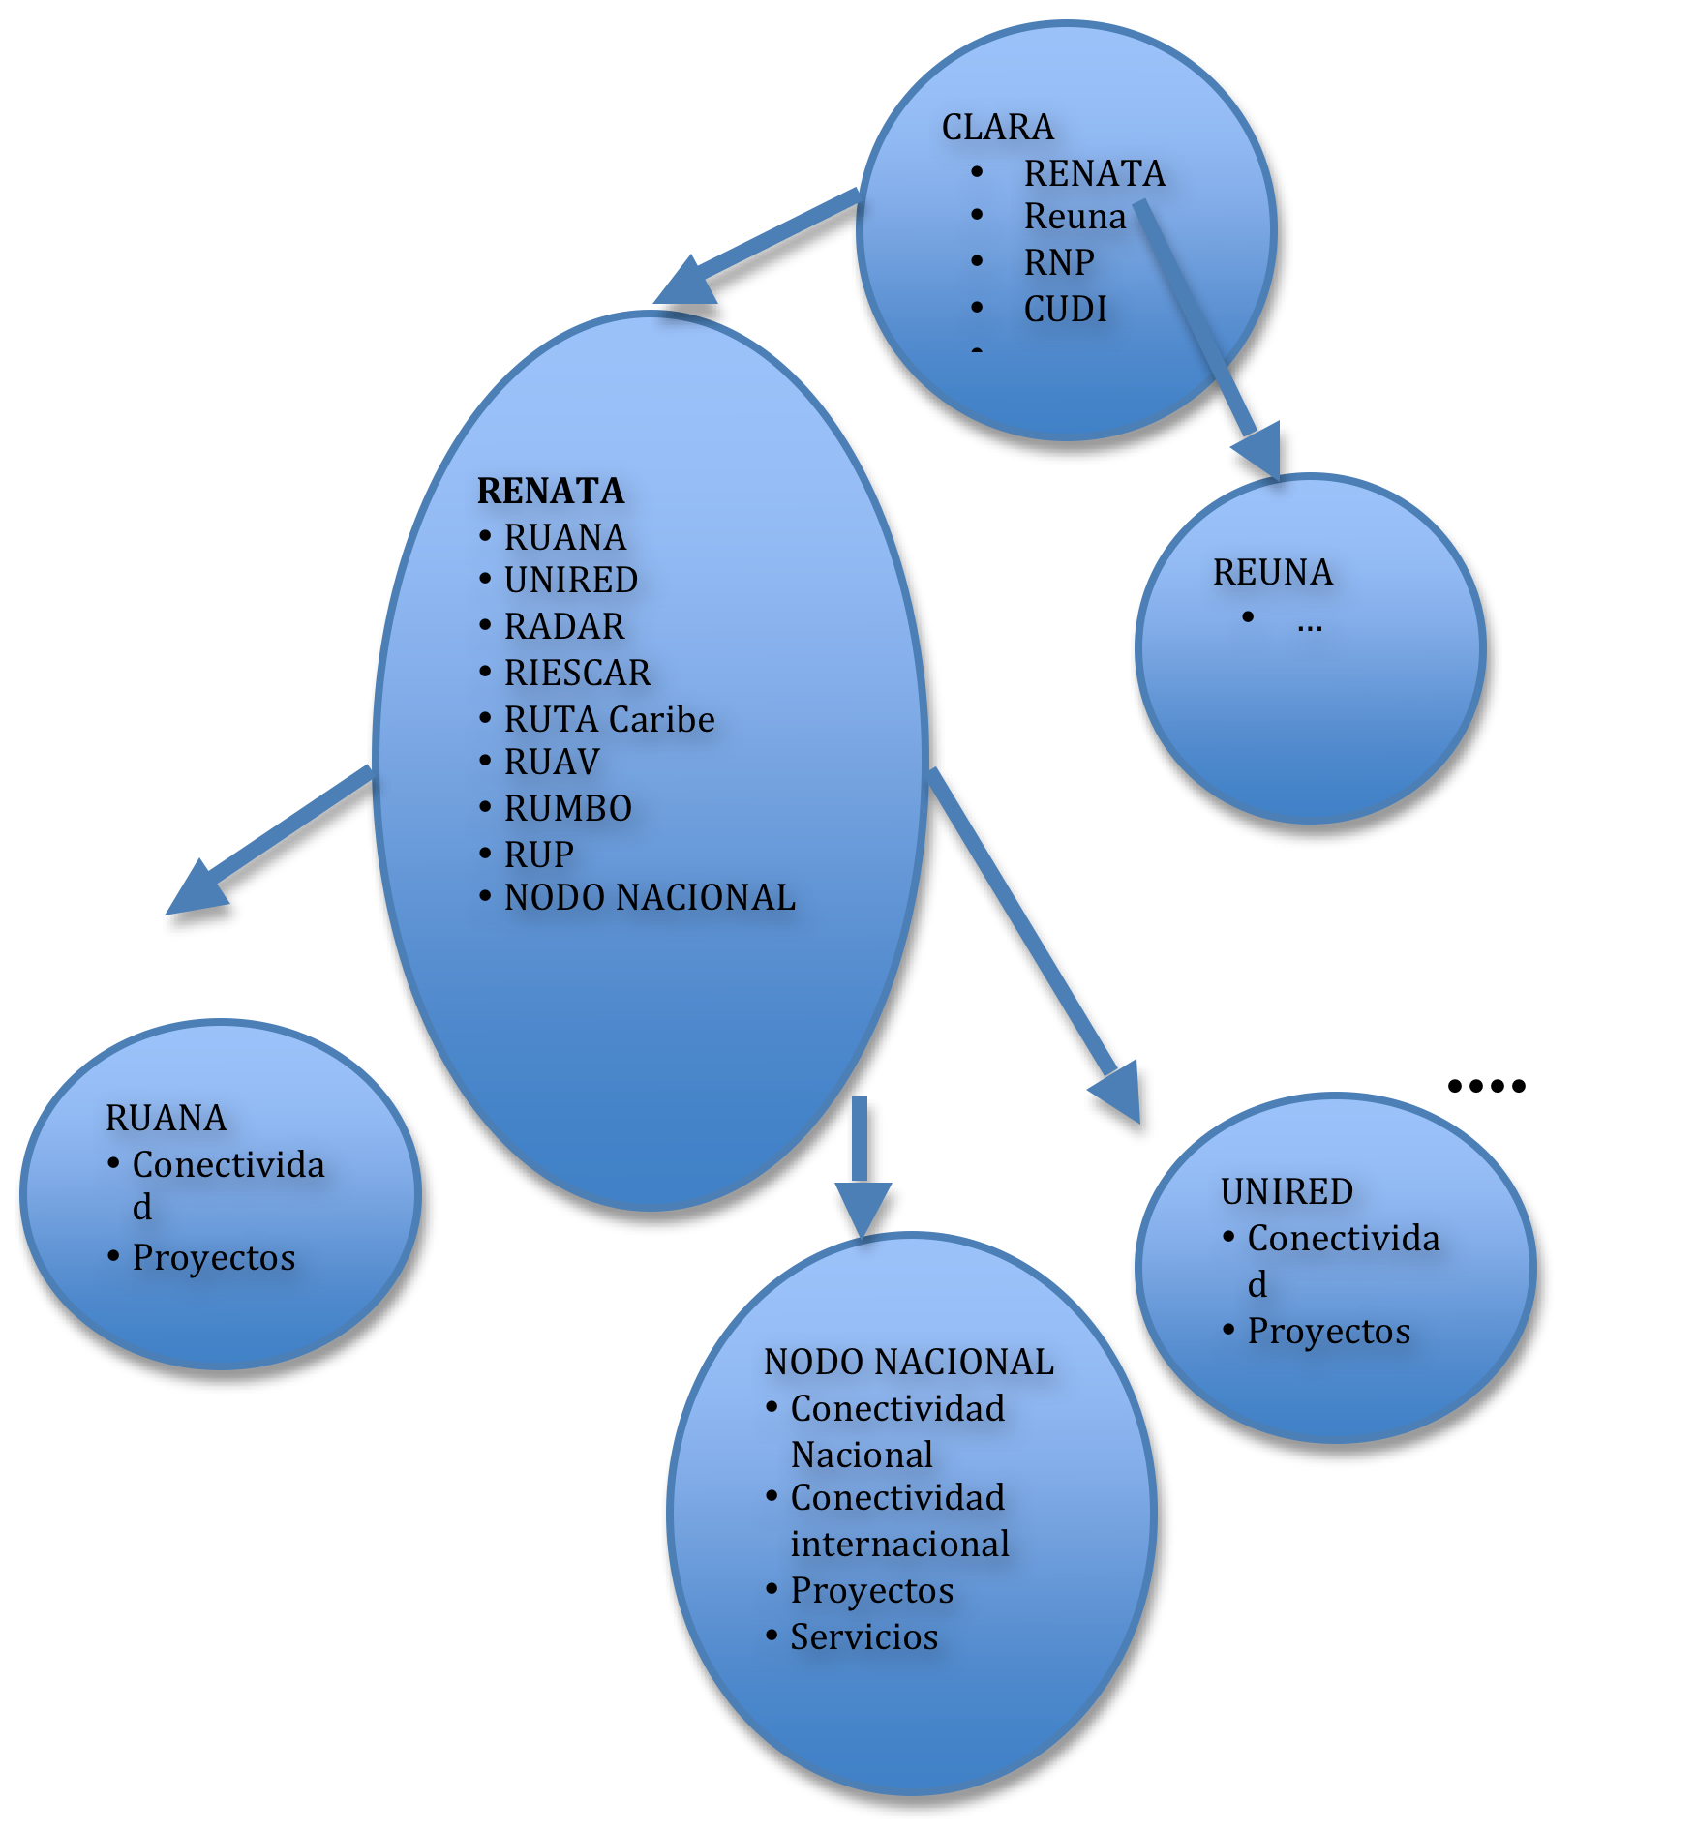
Redesigning a national broadband network (Colombia, 2011)

Slide 34
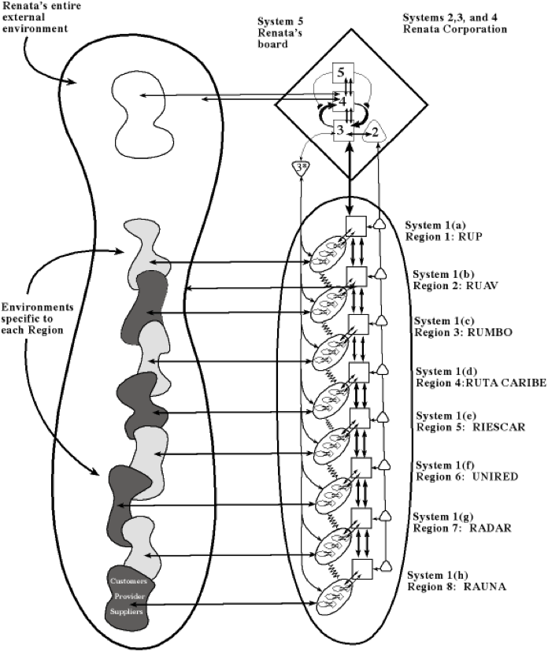
TS – inspiration for vision agreement +
VSM -
Redesign criteria

Slide 35
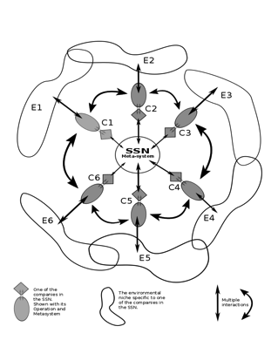
Beyond Collaboration:
Viability of Industrial Systems
(Van Hoof, Espinosa, Walker, in progress)

Slide 36
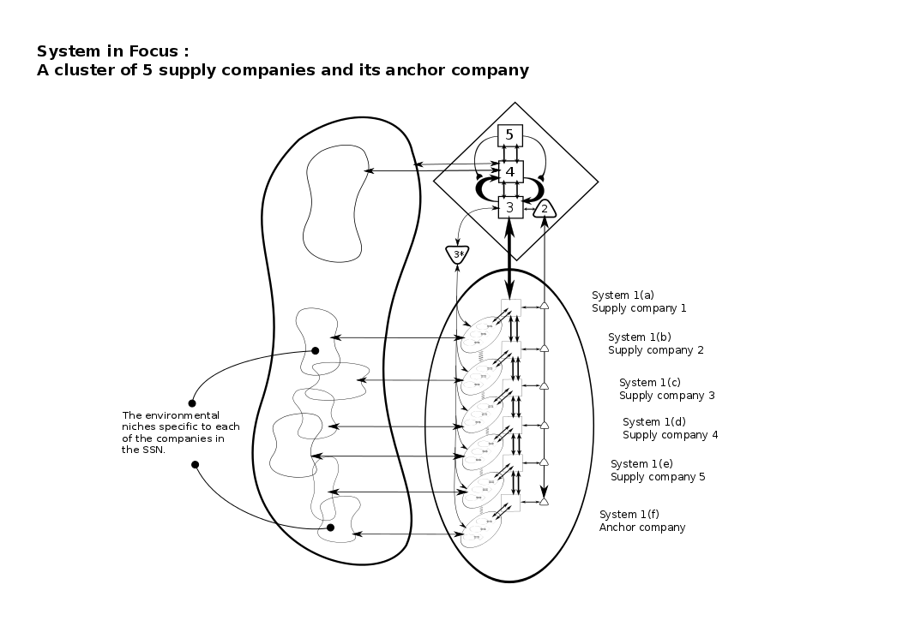
VSM diagnosis of SNG
S5
Cleaner Production ethos
+ Public, combined with private interest
+ Leadership anchor company
+ After 5/10 workshop identity started to rise.
MSSP values
+ Voluntary participation
+ Network collaboration for a better environment
+ Appropriate improvements
+ Transparent communication of tangle benefits
S2
S3
Training method in CP
+ 10 workshops,, learning by doing
+ Active interplay among participants
+ Social rules
Invitation by anchor company
+ Previous commercial “rules
+ Voluntary invitation
+ Letter of agreement
  Presence of an independent expert
+ References point
+ Solving conflicts – facilitation
interaction
Learning by doing approach
+ Empowerment
+ Collaborative learning
+ Decision makers were involved in S1
Common interest in cleaner Production
+ Autonomous operations with a common interest
Collaboration on 2 levels
+ Exchange of information
+ Development of collaborative actions
S4
S1
Training tool
+ Case analysis as part of training method
+ Internet platform
Participation of external expert
+ New information about CP
+ Dissemination of best practices
Development of cleaner production
+ critical points, CP alternatives
Operational outcomes
+ 75% implementation rate
+ 13 collaborative action (recycling

Slide 37
Self governance in SESs
(Espinosa & Guzman, 2015)
VSM- as a metalanguage to reflect on key issues of sustainability, resilience and symbiosis within the organisational networks and systems constituting the SESs through recurrent interactions
Based on the literature review, we suggest a few analytical tools to compare resilience capabilities in two complex socio-ecological systems.
  Recursive mapping to identify the SESs and embedded organisational networks
  A Framework to assess sustainable self-governance
  A tool to observe the dynamic relationships between core actors in the SSE
Using an exploratory research approach, we suggest the design of a research agenda to continue this research initiative

Slide 38
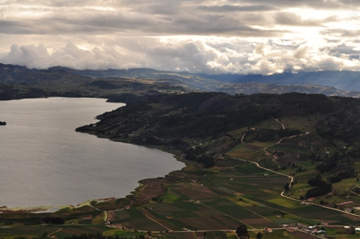
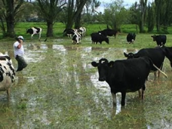
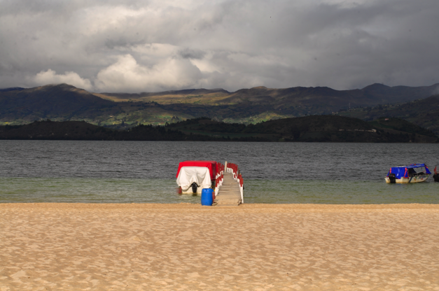
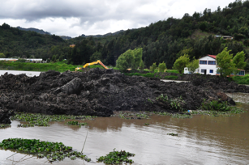
Guzman, 2014
Self organisation in SES for climate change management

Slide 39
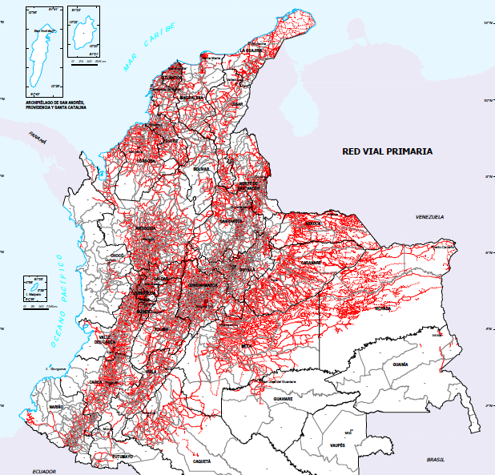

Complexity management and entrepreneurial action:
Outsourcing of distribution in complex environments:
A case in Colombia
.. C. Velez
Primary roads: SIG-OT
Source: Ministry of Transportation, 2007

Slide 40
VSM Analysis of company before outsourcing
Centralized structure
No discussion between production lines and distribution
All system 1’s report to the same meta-system, no intermediaries
Strong system 3 and 5 (with limitations→ interests of owners)
Weak system 2, 3* and 4
Poor information systems
Distribution demanded too much time from systems 3 and 5 in aspects that did not benefit the company
Notes:
No information systems for dealing with distribution

Slide 41
On going PhD research (1)
VSM inspired Methodologies to support organisational transformations
  R Gonzalez – A methodology to support SMEs learning on their management of complexity (Mexico)
  A Martinez – A methodology for sustainability strategy implementation (Colombia/Mexico)
  P Sydelko – a multi-method systemic intervention to design a multi-agency network (USA)
  A Al Hinai – multi-methodological support for designing a startup (Oman)
  W Mettanont – a framework to support knowledge management and viability for community enterprises (Thailand)
  A Al Maimaini – a systemic framework to support institutional development in the public .vs. private sector interactions (Oman)
  Complexity management vs complexity economics – Asset transfer pricing models (S. Wasiwleski)
  VSM working in Natural Disasters (P Munday)

Slide 42
In summary
Vibrant research context
Innovative applications
Opening boundaries of traditional VSM research
  Multi-methodology
  Complementing theories
    SES
    Industrial symbiosis
    Collaboration theory
    NIE
    Complexity economics
Need to strengthening existing community!!!

