Slide 1
The ultimate criteria of viability
must indeed be the capability to survive.
This is both a physiological and ecological criterion
- and certainly not a logical one.
Stafford Beer
Many think of sustainability in terms of water, land, fossil fuels.
Yet there is a socio-economic dimension which deserves attention too.

Slide 2
EXPLORING THE SUSTAINABILITY OF MINOR LANGUAGES
Dr Leonie Solomons
Executive Director,
Language Matters, Sri Lanka
& Consulting Systems, Australia

Slide 3
Yesterday …
Regional exclusivity - Hans Losscher
Robyn Ashby – UK … England
Sri Lanka – Peace Secretariat,
Russell Clements – let its evolution reveal itself, Geordie accent
Prof Peter Allen – Models (finding out about the system, …)

Slide 4
Language Matters in SL …
Developed the OCR for Sinhala (4 years - proprietary algorithm, open source with proprietary software to overcome gaps in standardized computing)
Introduced Telephone Based Translation Centre for Citizen-Police dialogue
Ecopolicy translated into Sinhala and Tamil
Evaluation of SL draft constitution (when proposed … 2017 + statutes & regulatory instruments)
Sustainability of Minor Languages – modelling to find out about the system

Slide 5
Relevance of language as part of
Identity (groups of people) and what it takes for minor languages, particularly its written script and vocabulary, to be viable.
Functionality in terms of communication – spoken & written (words, grammar and script)
Today with computers becoming the equivalent of pen/pencil, scripts which don't reach computers are taking the path to museums!
At times it is facets of their alphabet rather than the whole script, that is being obsoleted by the world of computing

Slide 6
Intuitive Concern - International Languages are dominating communication
Medium of instruction for professional education (e.g. Doctors, Engineers, Surveyors, etc. is done in English.)
Sending SMS via telephones means youngsters are using the English alphabet to send messages using words in the vernacular.
*************************
Longer Term …. Bi-lingual or Monolingual
Language of Administration (Public Service)
Medium of Instruction (Government schools)
Handle the language transition with older generation

Slide 7
Modelling Language Sustainability
Cybernetic Inference Diagrams (stocks & flows … Systems Dynamics)
Sensitivity Modelling
Bayesian Belief Networks (Probability)
VSM

Slide 8
Two-fold objective … Boundary Critique
Sustainability of Minor Languages – Sinhala
What is revealed by different modelling techniques

Slide 9
Problem Statement | ∞ The question is whether the on-going viability of the Sinhala language is sustainable in the longer term, given the emphasis of English as used in ICT and English as the medium of instruction for Professional Qualifications. It is the inroads made by the English alphabetic script (also known as Latin or Roman alphabetic script) as used in its written and read state that is of major concern. ∞ What keeps a language in use (as distinct from becoming an ornamental antique) is its ability to deliver functional value in everyday use. This use is primarily for personal conversations, for conducting business transations (products/service), education, deliver public service. This is called the demand for language. The supply side of language thus refers to the number of users of that language, their competence in that language (both written and verbal) and the language keeping abreast of new words as they appear in other languages and thus creating its equivalent in its own language and having it used by is users (both on the demand and supply side)
Variable/ Nodes/ Concepts | Description of the variable
Sinhala Language (alphabetic script - read&write) | ∞ Sinhala is the official language of administration in the public sector and the medium of instruction in urban and rural schools. ∞ Sinhala in formal writing is expressed using refined and sophisticated words and grammar. ∞ SLS 1134 (Standards for Sinhala computing) caters for what is known as Level 1 (everyday sinhala), Level 2 (touching and conjuct letters) Level 3 (disused ancient letters). SLS 1134 specifies Level 1 as mandatory. ∞ Sinhala is the native language of the Sinhala people who comprise 70% of the Sri Lankan population. About 80% of these Sinhala speaking people are monolingual and literate (read/write). Thus 20% of the Sinhala people are multilingual. Of these 5% are Sinhala-Tamil competent, 94% are Sinhala-English competent and who competent in Sinhala-English-Tamil are 1% . Of the 30% of the non-Sinhala Sri Lankan people, about 10% of them can competently read & write Sinhala. Another 30% of the non-Sinhala people can read and write Sinhala but with poor comprehension and grammar. Thus 18% o f the total population of Sri Lanka cannot read or write Sinhala.
Sinhala Language (spoken word - listen & speak) | ∞ Conversational Sinhala for our purposes is categorised into 3 levels - sophiticated, hybrid and colloquial. ∞ Broadcast in Sinhala (TV, Poilitical, trade union and management speeches) use sophisticated Sinhala words and grammar. The medium of instruction in governament schools does likewise. ∞ Conversation in the public service within itself and with citizens uses hybrid Sinhala. ∞ Sinhala people in their day to day communication use a hybrid Sinhala (something between Sophisticated and colloquial) ∞ Non-Sinhala people in their day to day communication use colloquial Sinhala
International Finance (imported sense) | Sri Lanka, having an open economy has the ability to engage in trade and service activities with other countires. The government foreign policies pave the way for the country to be involved in trade policies, Capital, loans, trade agreements, Exchange rate, Cash flow
Export (generates income for SL) - service sector | This sector comprises: ∞ Tourism - bulk of staff ∞ software in-sourcing, ∞ phone call centres, ∞ foreign employment for professionally qualified
Export (generates income for SL) - products | Garments, Tea, Rubber (Agriculture)
Import (generates expenditure for SL) products & services | Products & software (labeling ingrediants, instruction manuals)
Rural & urban living in Sinhala dominated areas | Communication is predominately in Sinhala
City living in national capital | Communication is in English and Sinhala (excluded Tamil language as city living has little relationship to Sinhala language sustainability)
City living in Sinhala dominated provincial capital | Communication is predominately in Sinhala
Top Administration in Public Sector use Sinhala-English | Career Senior Public servants (e.g those eligible for Car Permits) employed at National, provincial or Local govt use Sinhala as their prefered mode of communication, althought written English is the preferred choice for professionally qualified public servants - example, judges, lecturers, Secretary, Doctors, Accountants. English, being the link language, is used when Tamil is the other party's language. In the 1950's the language of administration was English. From the 70's, elected politicians increasingly were more competent in Sinhala than in English . Consequently, parliamentary dialogue has become predominately exchanged in Sinhala and this language migration is reflected in the top echelons of the public service too.
Public Sector - Administration | This catergory includes up to middle management and first line management staff. Sinhala is the medium of communication within these ranks whereas English can be the language when communicating upwards, particularly in Ministries like Foreign Affairs, Finance.
English-Sinhala Language of all Administration in Private Sector | English is the primary written language (with Sinhala being the primary spoken language amongst the middle to lower personnel)
Employment of Professionally qualified | Doctors, Accountants, Engineers, Lawyers, Computer programmers, Surveyors, Marketers, Bankers, Teachers, Chefs, Managers - English language
Employment of semi-skilled/clerical staff | Clerks, Pions, Mechanics, technicians, machinists - Schooled in Sinhala medium with English as second language
Employment of labouring staff | Sweepers, drivers, farmers, domestics, carpenters, bricklayers, cooks - schooled in Sinhala medium
Rural-Urban Sinhala Govt School Education - Sinhala for Sinhala children/parents | where Grade 1 - Grade 13 medium of instruction is Sinhala for children with both parents being Sinhala
Leading Govt, Semi-Private & International School Education - English | where Grade 1 - Grade 13 medium of instruction is English
Higher & Professional Education/Qualifications - English | where university and professional qualifications are taught in English (conversations, group discussions amongst students and lecturerer or amongst students may be spoken in Sinhala Language.)
Trade Qualifications - Sinhala | where trades (brick-layer, driver, car mechanic) are taught in vernacular (eg. Sinhala)
ICT work | Computer programme development, Applications and platform, Internet and E- mail (Panel dicussion, local programmers clubs and forum mostly Sinhala driven)
Local products & services | Made in SL - food, machinery, repairs, implements (mammooty, brooms)
Sinhala Media, Literature, Arts & Entertainment | News papers, television, radio, Music, Drama, Dance, Cinema (in sinhala)
non-sinhala Media, Literature, Arts & Entertainment | News papers, television, radio Music, Drama, Dance, Cinema (in English)
Sinhala Culture | Sinhala race Traditions, food, rituals, dress
Religion - Buddhist, Christian (B&C) | Importance given to Sinhala language by Buddhist and Christians
Religion - non Buddhist, non Christian (non-B&C) | Hindu, Islam, etc
Sinhala social identity/status | Social esteem (accorded to knowing Sinhala) within the Sinhala community
Other Social identity/statis | Social esteem (accorded to knowing Sinhala) outside the Sinhala community
Sinhala-Sinhala race harmony | relationships within the Sinhala community
Sinhala-other race harmony | relationships with non-Sinhala community (eg. Tamils, Muslims)
Digital Social Media | using English alphabetic character set (using English and/or Sinhala words) - Facebook, tweeter, whatsapp, viber, sms
Clubbing ??? | English (western, latino, african, bollywood music & dance & dress) clubbing
Judiciary-citizen Sinhala communication | Language of Judiciary-citizen communication is written and spoken in Sinhala (Judiciary - Supreme court, High court, District court, Tribunals)
Lower courts-Legal communication in Sinhala | Communication between magistrates (lower courts) and lawyers is in Sinhala
Higher courts-Legal communication in English | Communication between judges (higher courts) and lawyers is in English
Primary language of President's communication | Sinhala Language as generally used by President (pre-1990,s the President/Governor General communicated in English)
Primary language of parliament's communication | Sinhala Language as generally used in parliament (pre-1970's the parliament conducted its discourse in English)
Sinhala Notice Boards | Bus destination boards, Direction boards in hospitals, offices, posters (public & Private sector)

Slide 10
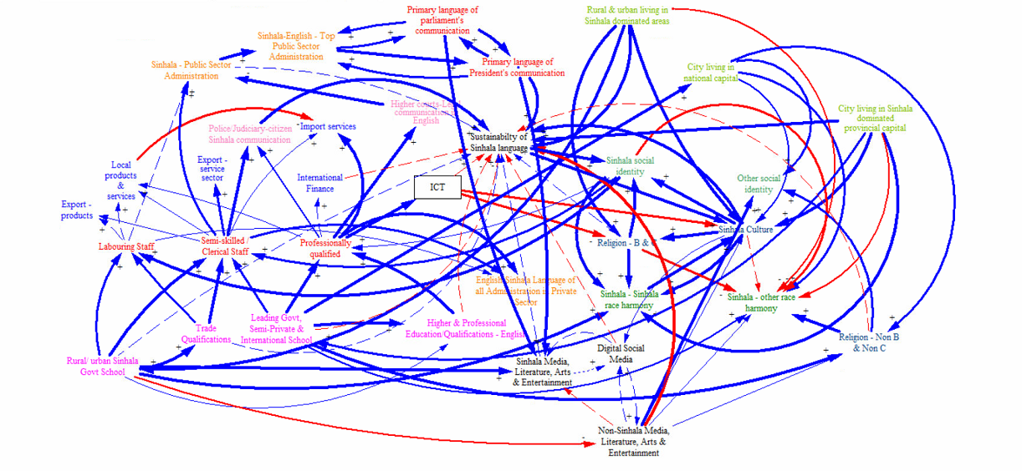
Cybernetic Influence Diagram – minor language sustainability

Slide 11
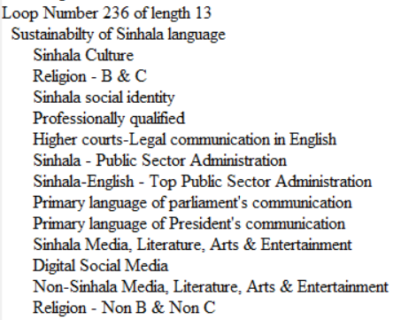
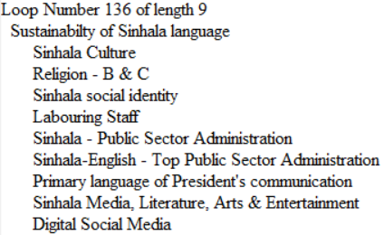
Loops – Sustainability of Sinhala Language

Slide 12
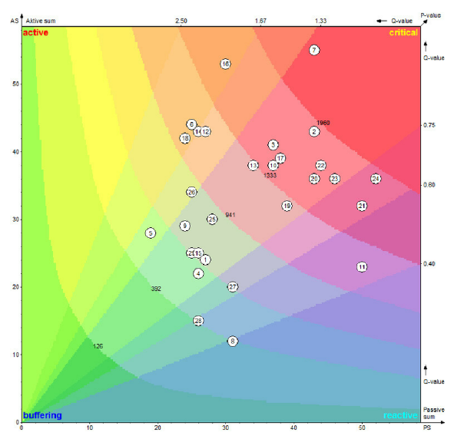
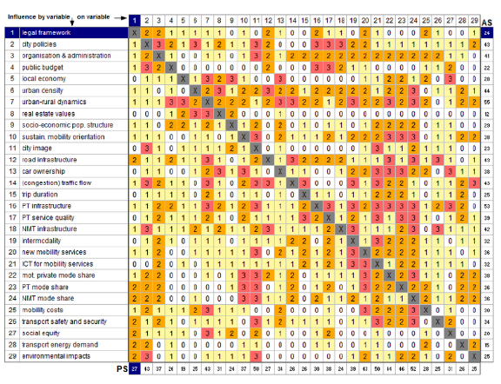
Sensitivity Modelling – Matrix of Criteria Matrix / Influence

Slide 13
VSM
System in Focus
S1? – demand & Supply (per language) (per context)
Homeostats (18 by Javier)
Demand and supply
Environment

