Slide 1
Thank you!

Slide 2
Neo-confusciantist perspective
  To know and not act is yet not to know
(…to accumulate knowledge for the sake of it disregarded what they considered to be the true purpose of learning: construction of the moral self.. ‘in service to the world and those in it’)

Slide 3
See what you make of this?
My invitation to you - bring your VSM lenses
  WHAT you notice is present/ absent in terms of System 1-5
  Killer VSM informed question based on your sense-making
After sharing - leave your notes + Question with me to digest

Slide 4

Why this? Why now? Why me?
Global concerns
Professional concerns
Personal concerns

Slide 5

What? Concerns
Global
  Escalating conflicts, divisions, fragmentation
  Environmental disasters
Professional
  Corruption, institutional and personal abuse
  Linear thinking dominates my professional fields and does not match my practice
  Systemic approaches prioritise working with groups
Personal
  Nature, scale and scope of concerns appears to exceed an individual’s ability to respond
  What does the above mean for me as a systemic practitioner?
  What does it mean to ‘be the change’?
Notes:
Escalating conflicts, divisions, fragmentation
Ukraine/ Russia
EU (Greece)
Britain (Scotland referendum; BNP/UKIP)
Religious Fundamentalism (Islamic, Evangelical Christian)
Environmental disasters
Katrina (US)
Tsunami (Asia pacific)
Nepal earthquake
Corruption, institutional and personal abuse
Politics e.g. Lord Sewell over drugs abuse and prostitution
Corporations e.g RBS (‘Fred the shred’), BBC (Jimmy Saville et al)
Tianjin, China chemicals explosion
Tax avoidance schemes in Luxembourg facilitated by PWC e.g. Amazon, Accenture, AIG, Heinz, DeutschBank, Burberry, FedEx et al
Linear thinking dominating my professional fields
Corporate tendering processes and contracting
Focus on goal-setting, planning and control
Can measure and manage change and prove causal impact of interventions
Coaching/ Coaching Supervision industry
Preoccupation with trying to prove ROI
Assumptions that competency frameworks assure best practice
‘Systemic’ means working with the interpersonal not intrapersonal

Slide 6
Stacey Diagram (2002): Manifesting concerns…
Unorganised
Global concerns
Unstable
Chaos
Unpredictable
Random
Surprising
Creative sparks
Self-Organising
Emergent
Adapting
Patterns
Anticipate
Influence
Personal concerns
Organised
Stable, manage
Plan, control
Predictable
Procedural
Professional concerns
Notes:
What interventions?

Slide 7
What? Interventions + System responses
Linear causality = Do X to fix Y (organised)
  Humanitarian aid
    campaigns, crisis management, mobilising ‘armies of support’
  Political-corporate
    Public inquiries, Codes of Conduct, military response
    Dominance of conventional change management interventions
    Performance management; SMART goals; Performance Coaching
Nonlinear = Emergence (unorganised, self-organising)
  Chaos and conflict
    Global economic crash – ripples continue - Greece
    Arab Spring – one man in Tunisia sets himself alight… ripples continue - Syria
  ‘Change for Good’
    Occupy movement – emerges then fades away??
    Initiatives of Change (IofC) started by an individual – continues 80+ years on??
    Why has my practice arrived at working with individuals as a locus for change??
Notes:
Linear = Do X to fix Y (yet still persist)
Humanitarian aid
Public donation campaigns
Crisis management
Political-corporate
Public inquiries, policy + practice reviews, law reform
Codes of Conduct e.g. Financial industry
Conventional change management interventions
Nonlinear = Emergence (unpredictable, self-organising)
Conflict and chaos
Arab Spring (19 Dec 2010>>) leading to chaos, revolution
Al Qaeda (11 Sept 2001 Twin towers attacks; ISIS (1999/2003>>)
Change for Good
Occupy (17 Sept 2011, petered out) Why did this fail?
Initiatives of Change (IofC) - 80+ years and still

Slide 8
Interventions not matching system responses…
Unorganised
Unstable
Chaos
Unpredictable
Random
Surprising
Creative sparks
Self-Organising
Emergent
Adapting
Patterns
Anticipate
Influence
Organised
Stable, manage
Plan, control
Predictable
Procedural
Notes:
What interventions?

Slide 9
Intervening for good. Yes but how
Unorganised
Unstable
Chaos
Unpredictable
Random
Surprising
Creative sparks
Self-Organising
Emergent
Adapting
Patterns
Anticipate
Influence
How can we work better with nonlinear dynamics to amplify ‘change for good’?
Organised
Stable, manage
Plan, control
Predictable
Procedural
Notes:
What interventions?

Slide 10
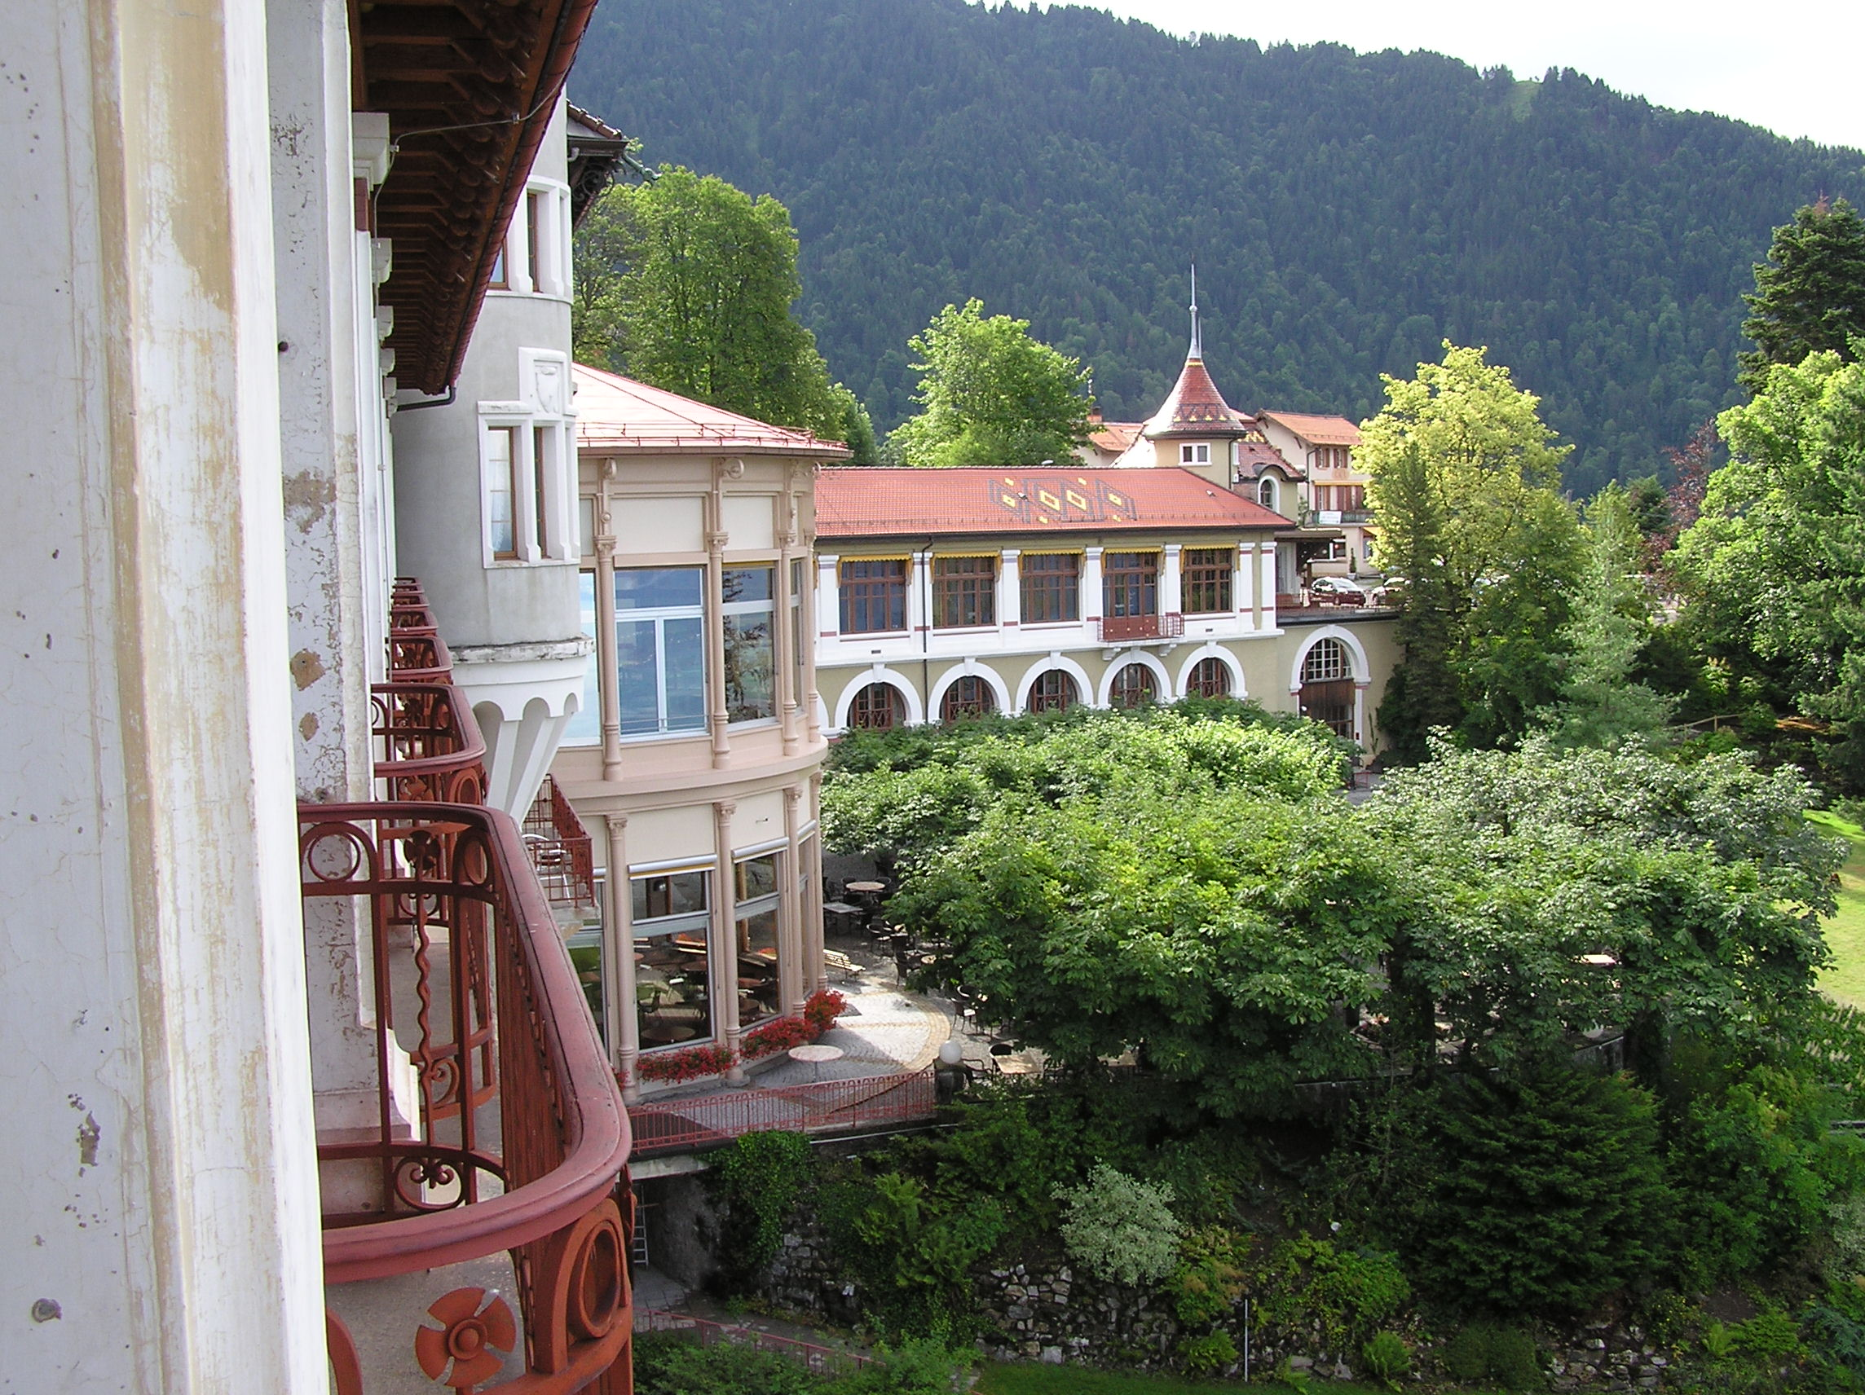
In 2010, I was invited to contribute to a conference at the Mountain House, in Caux…

Slide 11

…high up in the mountains above Montreux, overlooking Lac Leman…

Slide 12
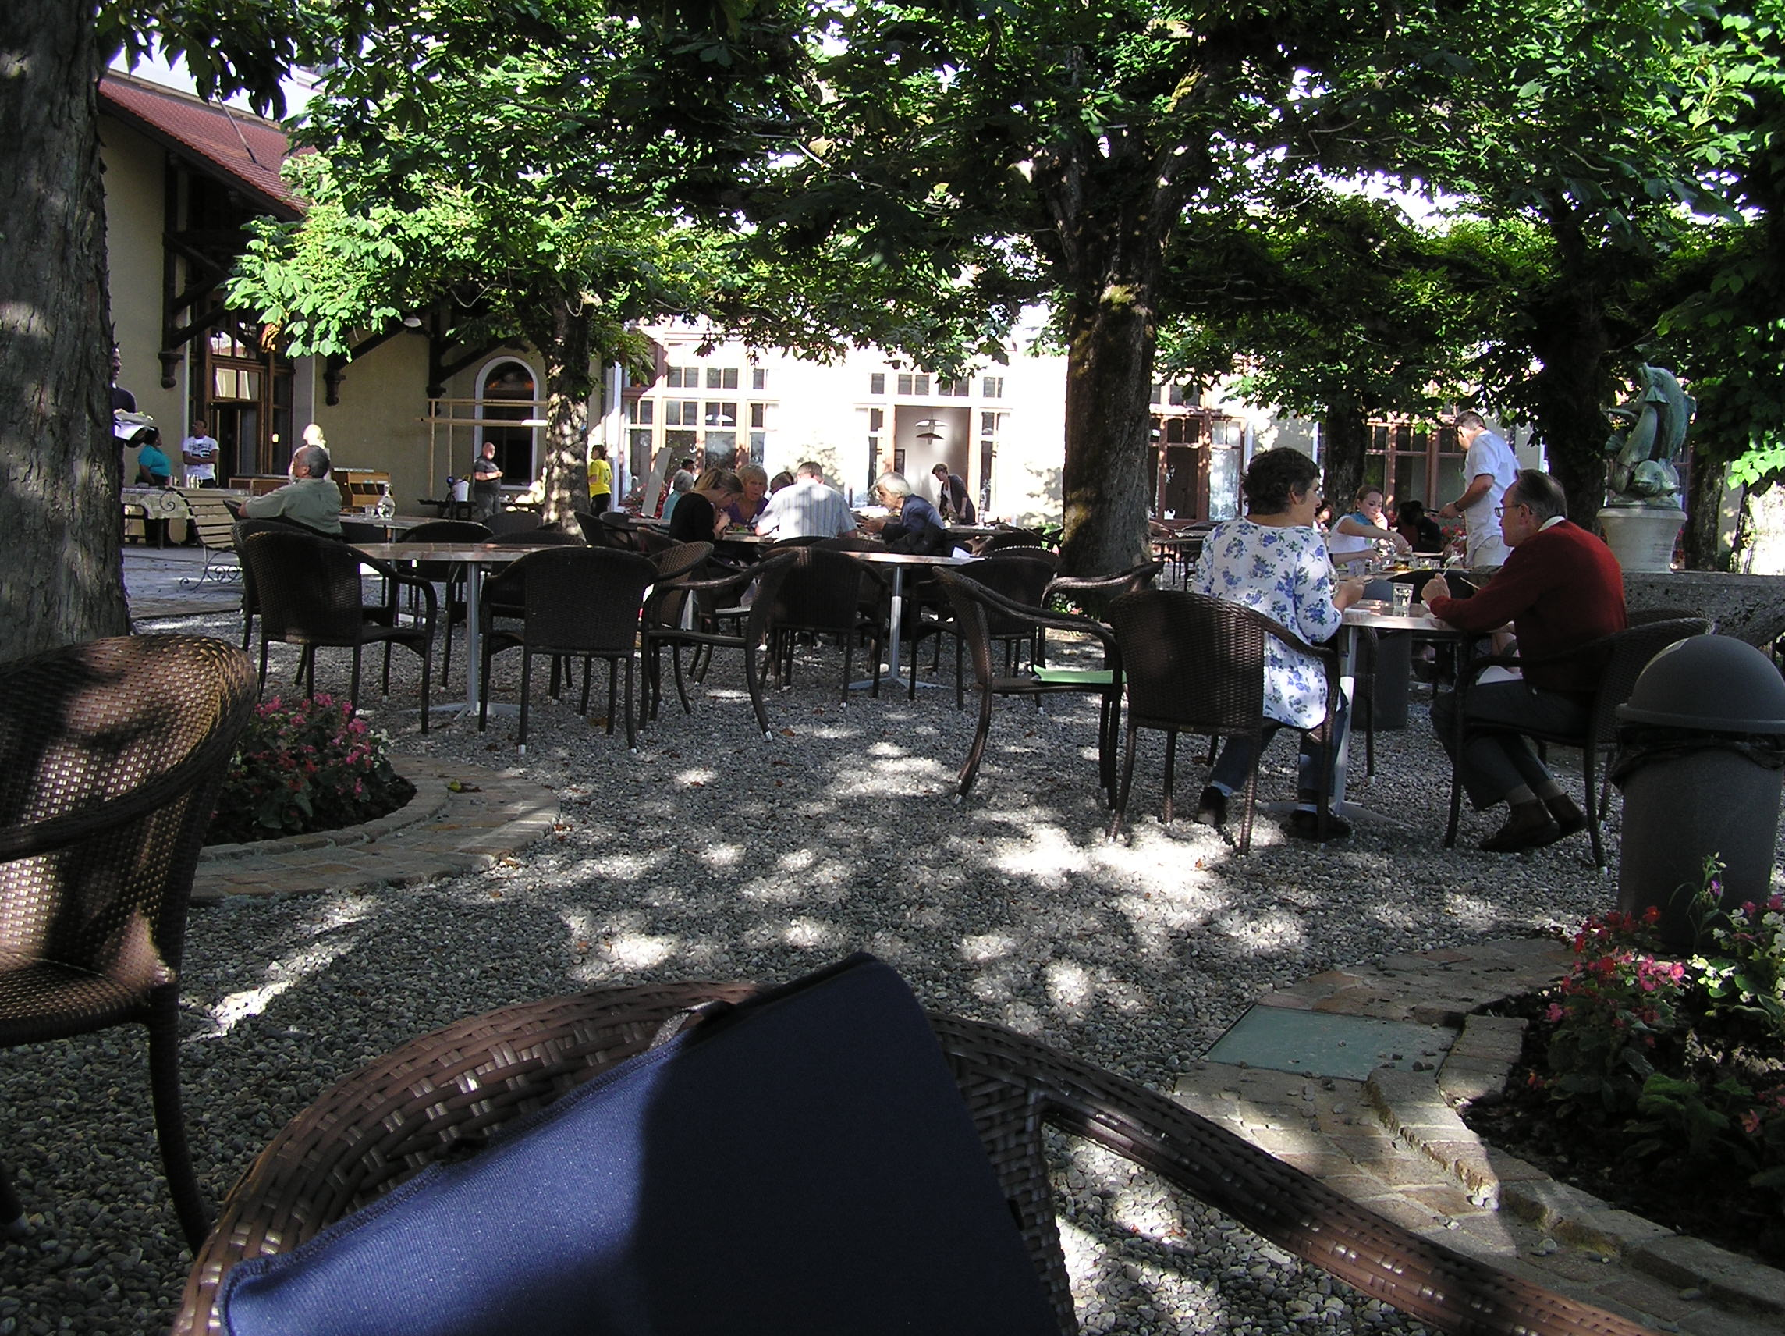
…in 2012, on the terrace, I knew it was time to do a PhD in support of IofC… but what?

Slide 13
Literature review: The Gap – an intrapersonal focus?
Systemic assumptions ➔ with interactions between people
  Systems Thinking + Complexity sciences
    Approaches focus on interpersonal/ group interventions (Burns, 2009, Eoyang 2001, Williams & Hummelbrunner, 2009)
    Complexity – mathematical, agent-based modelling
    ‘Black Box’ (Watzlawick, 2011) assumes we cannot work with ‘interactions’ because cannot see the ‘parts’ internal to individuals
  Psycho-therapeutic realms
    Family Therapy focus on interactions between family members (Boscolo & Bertando 1996;
    Tavistock Institute psychodynamic systems perspectives across scales
    Some Systemic Therapists work with individuals but focus is still on client’s interpersonal interactions with others (Hedges 2005)
  Coaching and Coach Supervision
    Systemic Coaching Constellations derived from Family Therapy (Whittington 2012)
    7-eyed model for Practitioner supervision framed in therapeutic constructs – (Hawkins & Shohet, 2012)
  GAP: Working systemically with individuals at the intrapersonal level
    Grow ‘Systemic Agency’ focusing on intrapersonal domain – scale-able, systemic methods innovation

Slide 14
Liberating scale-free learning in self-organising systems, starting with myself:
Case study with Initiatives of Change
What could VSM bring that CAS and Semantic Field Theory may not?

Slide 15
Can working systemically with individuals bring about scale-free learning?
from Systemic Intervention to ‘Systemic Agency’

Slide 16
What do I mean by scale-free learning?
Systems that are viable… sustainable… generative
Generative Adaptive Capacity (not Heifetz, 2003; Eoyang 2013)
  Sensitive enough to notice
  Robust enough to withstand challenges when needed
  Adaptive enough to change
  Courageous enough to ‘let go’ of needing to know – to surrender to what will become (LG)
Embodied ‘Being-Doing-Becoming’ that scales beyond initial system boundaries to anyone, anywhere

Slide 17
Setting the Scene
Abductive research: Systemic Intervention; adopting a complexity worldview; subjective-empirical approach
Commitment to engaging ‘for the good of the whole, part and greater whole’

Slide 18
My Philosophical stance
4 Truths (Eoyang 2013) | 3 Fs (part of P6C) (Gardiner, 2001)
Objective | Facts, my Feelings
Subjective | My Fiction, your Feelings
Normative | Our Fiction, our Feelings
Complex (all truths are true) | All 3 in relationship, interacting within me producing patterns that manifest through me
My worldview
Notes:
Temporal dimension (Past and Future) is embedded in and bursts through Fiction portal (Purpose-Outcomes)
I conclude it makes no sense to pick one perspective eg. Realist (objective) or Interpretivist (subjective)
Assumption – e.g. to take only Realist or only Objectivist ➔ reductionist is to disrupt coherence of the whole….throws it off-balance

Slide 19
A Case: IofC
Mission: ‘Change the world, starting with oneself’
Action initiated by individuals ‘following their Call’
An example of ‘change for good’ enduring for 80+ yrs
Distributed leadership in 60+ countries
Consists of individuals, informal groups and formal bodies
No formal universal, membership process or records
No centralised control mechanisms
Formal bodies called into being by local-national-international demands
2002 - International Association for member nations
No singular focus, destination, vision, activity or function
Core Practice appears systemic – deep embodied knowing but they do not know WHAT they know – and are in danger of letting it go in favour of modernist approaches!

Slide 20
More about IofC
Began from Christian foundations
Now ‘space’ in which vast differences co-exist e.g. peoples of all faiths and none, cultures, interests, ethnicities, generations, life-contexts
Spiritual and ‘moral’ stance guides personal practice
‘Spirit’ of IofC:
  Quiet Time
  Guided by 4 Absolute Standards (Honesty, Unselfishness, Love, Purity)
  Service + sharing in community

Slide 21
Questions newcomers to IofC ask
  What is it?
  How can I take the spirit of Caux down the mountain?
  How do I get in?
  Who is the leader/ decides/ is in charge?
  5 years in process thus far

Slide 22
My sense-making of issues in IofC
The fellowship seems to be waning
  Size appears to be shrinking- number involved in IofC is unknown - no centrally maintained records. People may be on newsletter circulations; size is irrelevant to IofC – impact + individuals matter
  Spread diminishing?
  State/ coherence - unaware, fuzzy, unconfident. Clarity, competence, connection within & beyond IofC needs rejuvenating
  Impact in scale and reach – engagement from people operating in global leadership scales has diminished; reputation of IofC threatened; scale of projects mostly very small, with few exceptions of scaling up; global presence & stature in question
Those engaged in REAL will be changed in ways we trust will support others & the system to change
If there is recognition and resonance of some/ all these issues, in IofC people will sign up to the research

Slide 23
Now what…?
Would you do…?
Could I do…?
Should I do…?
Should I avoid…?
Could I explore more…?

Slide 24
Useful Complexity Theories: CAS
  Human beings in and as Complex Adaptive Systems (CAS): (Dooley and Van de Ven, 1999)
  ‘A group of semi-autonomous agents who interact in interdependent ways to produce system-wide patterns, such that those patterns then influence behaviour of the agents’
The power of ‘Littles’ and ‘Ones’

Slide 25
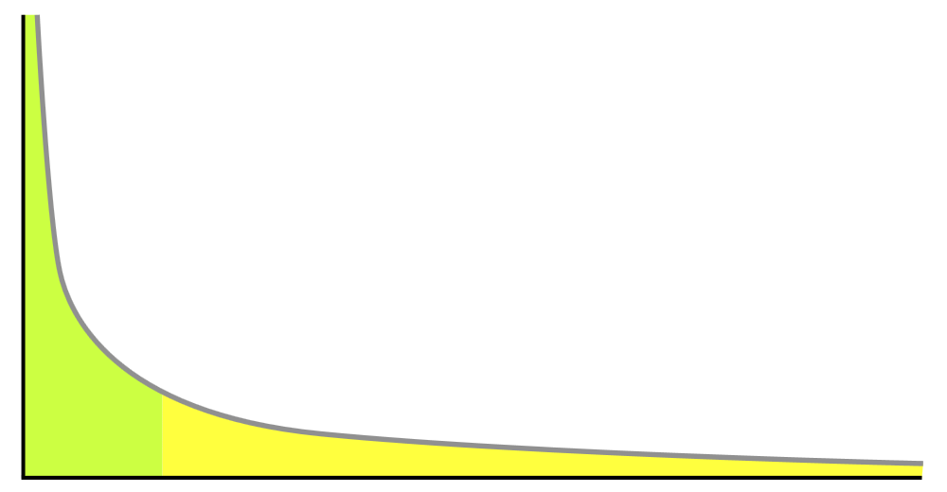
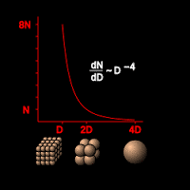
The Power of ‘Littles and Ones’
Number = frequency
Self-organised criticality follows Power Law (Per Bak, 1997)
  ‘Littles’, seed ‘Mediums’, seed ‘Bigs’, eventually
  Swarm behaviour (Craig Reynolds, 1986)
  Local to local interactions (Simple Sules) generate system-wide patterns https://www.youtube.com/watch?v=eakKfY5aHmY
  Individuals follow Simple Rules until they don’t
Autopoiesis (Maturana & Varela, 1974, 1975, 1980)
  Change is determined from within
D = Size

Slide 26
Freeman
‘the world is infinitely complex and the self can only know and incorporate what the brain has created within itself’
Freeman Ch2 in Craig Piers et al 2007
‘Self-organising Complexity in Psychological Systems’

Slide 27
Semantic Fields Theory, Hardy (1998)
Multi-level web networks
Semantic lattice
  Semantic Constellations (SeCos)
Potent 6 Constellation –
  Framework derived through abductive process 1999/2000-2013/14
  a way to reveal activated SeCos
  ‘illuminate, connect and liberate flow’
    Tipping point – Power Law at play

Slide 28
Objectives of the Research
What is meant by ‘scale-free learning’?
What does it mean to ‘work systemically with individuals’?
Can working systemically – and intrapersonally - with individuals liberate scale-free learning?
As a Systemic Researcher embracing complexity realities, how can I assure my practice addresses academic concerns regarding coherence, quality, rigour, relevance & contribution?
What can Systems Thinking learn from IofC?
Notes:
What, within and about IofC core practice, sources and resources change for good?
What can IofC learn from related fields of theory and practice?
What can be learned that will translate across scales and contexts?

Slide 29
Making the systemic shift…
FROM Systematic | TO Systemic
Linear causality one-way cause and effect | Nonlinear causality multiple interdependencies, many unknown and unknowable; every part impacting and being impacted by each other
Closed | Open ‘there is no outside’ - infinite ways of bounding systems eg. physical, perceptual; purpose(s)); context & agent dependent
Low dimension | High dimension infinite differences, changing & not all relevant in any moment
Take apart reductionist | Systemic agency - Work within… for good of ‘whole, parts & greater whole’ as RELATIVE not absolute construct
Snapshot | Continually changing
Root cause | Patterns arise from initial conditions
Predict + control | Anticipate and influence
Mandate + manage | Attend and respond

Slide 30
What am I doing?
On ‘natural philosophers’ – Boulton et al (2015, p55)
  ‘they immersed themselves in the experience of the world and sought understanding from that immersion… It is also interesting to ask what role such enquiry methods might have in exploring the complex world empirically in our own times’
What term do you prefer:
  ‘Immersive, emergent abductive’ – ‘self as instrument’
  Subjective empiricism (Crook 2003)
  ‘Emergent Grounded Theory’ (LouieG 2015)
  From ‘Systemic Intervention ’ to ‘???’
  ‘Adaptive Action Research’ (LG 2015)
    Adaptive Action (Borton, 1973; Eoyang, 2013)

Slide 31
Adaptive Action Research Methodology

Slide 32
IofC Scale-frames: Boundary management
Scale | Parts | Whole | Greater whole
One | Internal ‘agents’ | Individuals | REAL programme
Two | Individuals | REAL programme | IofC-UK
Three | Groups within IofC-UK | IofC-UK | IofC-Global
Action focus
Observe, Sense + Respond

Slide 33
IofC Simple Rules – in a state of becoming
What do people see us do or hear us say when we are
  At our worst?
  At our best?

Slide 34
Patterns

Slide 35
IofC at our best

Slide 36
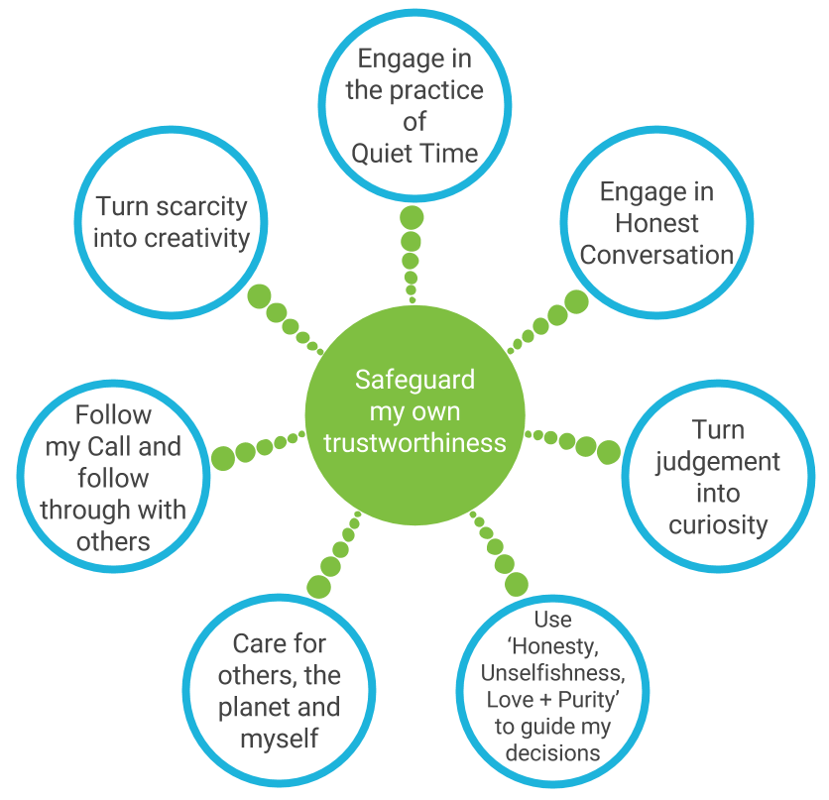
IofC Seed Behaviours

Slide 37
My Claims: Potent 6 Constellation
Emergent patterns manifesting through nonlinear causality between ‘agents’ in portals
Embodies principles of CAS, Autopoiesis & Semantic Fields Theory
  Does it map to VSM?
Reveals & transforms activated SeCos
Facilitates self-organized criticality (tension tips; Power Law in e-motion)
Is recursive – within, between, beyond
Deploys Adaptive Action
Develops Body-Mine-Psyche ‘muscles’ for systemic thinking & practice
Nurtures reflective & reflexive capacity
Grows adaptive capacity

Slide 38
Recursive across scales

Slide 39




Conventional Systemic interventions: prioritise interactions between people & groups of people...
Who is present and…
… what happens between them?

Slide 40


An intrapersonal systemic inquiry?
What is present within…
?!?!
… and what patterns manifest
within…
…and beyond the individual?

Slide 41
Systemic Scoping
Point Attractor Inquiry ➔Scoping and focusing research
Participation compass ➔Discerning stakeholder engagement approaches and methods
Fit-for-purpose AND coherent with context and ‘community’

Slide 42
PAI reveals coherent collaborative Purpose(s) by delivering answers to these questions… recognising that meaning is an emergent property ie. It cannot be ‘forced’ into view

Slide 43
Positioning PAI

Slide 44
PAI +
Participation Compass

Slide 45
Participation Compass

Slide 46
Methodology and Methods
Testing Methodologies and Models for ‘FIT’ ● - Yes (●) - Partially | Simple | Recursive | Scale-able: W/P/GW | IINTRA-personal | Pattern spotting/ building | Emergence-in-action | FIT: to Context | FIT: to Purpose | FIT: to Focus
VSM |  | ● | ●
SSM
Action Research + derivatives: CAR, PAR, SAR etc | (●) | (●) |  |  |  | ●
Action Inquiry |  |  | ● | ● |  | ●
Causal loop diagrams
System Dynamics
Social Network analysis
Outcome mapping
Process monitoring of impacts
Strategic assumption surfacing and testing
CDE | ● | ● | ● |  | ● | ● |  | ●
Adaptive Action | ● | ● | ● | ● | ● | ● | ● | ● | ●
Potent 6 Constellation | ● | ● | ● | ● | ● | ● | ● | ● | ●
Simple Rules | ● | ● | ● | ● | ● | ● | ● | ● | ●

Slide 47
Assumptions about Evidence
‘CAS share a variety of characteristics that make standard research and data analysis methods ineffective….. [there are] six of these….nonlinearity; high dimensionality, dependence on context, sensitive dependence on initial conditions, discontinuity, massively entangled levels’ (Eoyang, 2001:50)
If the best we can do is ‘anticipate and influence’, then
  How best can we do this? and
  How best can we know how we are doing?

Slide 48
System-sensing & Data collection
Methods for doing AND tracking the research
  Adaptive Action + CDE
  Potent 6 Constellation
  Simple Rules (Systemic Researcher SRs + IofC Seed Behaviours)
Pattern-spotting; ethnographic and auto-ethnographic data
  1-1 session recordings
  Participant reflections
  Visuals, poems, journal reflections, emails, documents
  Adaptive Action Adjustments
  Potent 6 Constellation tracking
  Simple Rule reflections

Slide 49
Contribution: Innovation & Impact
Fields of Research + Practice
  Anticipated: Extend the accessibility, reach and influence of systemic practice in established and emerging fields, through the introduction of a rigorously tested systemic method that scales from intrapersonal to interpersonal realms
  Unanticipated outcome: A pioneering CAS-coherent research methodology and protocol for working emergently across system scales and contexts
Global impact/ change-makers
  Anticipated: Revitalise connections, confidence and coherence of IofC - safeguarding its local to global reputation as a trustworthy partner enabling ‘change for good’
  Anticipated: Pass on ‘change for good’ systemic knowhow to change-makers (beyond IofC) working in complex, unpredictable contexts

