Slide 1
Designing Meta-organizations for Addressing Wicked Problems
By: Pamela Sydelko
PhD Student: Centre for Systems Studies
Prepared for:
CSS Metaphorum Workshop
Managing Complexity with the Viable Systems Model: Theory, Applications and Innovative Research
11-13 November, 2015

Slide 2




Introduction
Systemic Intervention
Stove-piped Government
Meets
The Wicked Problem
Notes:
Governments are increasingly faced with challenges that present themselves as “wicked problems” (also called messy problems)

Slide 3
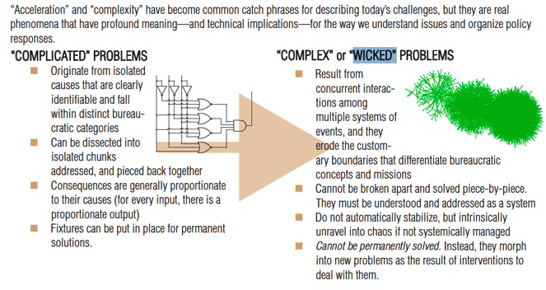
Wicked Problems Rittel and Webber (1973)
Fuerth and Faber (2012)

Slide 4



Hard and Soft Systems Approaches
Hard Systems (Quantitative)
Soft Systems (Qualitative)
Critics found hard systems too deterministic and reliant of the judgment of “experts” (West Churchman, 1970; Ackoff, 1979; Richardson and Midgley, 2007)
Problem Structuring Methods (PSM):
  Common understanding (not consensus)
  Acceptance of differences (Checkland & Scholes, 1990; Checkland & Poulter, 2010)
Systemic Problem Structuring:
  Holistic, bigger-picture and diversity of perspectives (Midgley et al., 2013)
  Explores the boundaries of inclusion and exclusion (Ulrich, 1983)
DIVIDE
Example Hard System Approaches:
System dynamics (Forrester, 1961)
Systems analysis (Quade et al., 1968)
Systems engineering (Blanchard, Fabrycky, & Fabrycky, 1990)
Example PSMs:
Cognitive mapping / Strategic Options Development and Analysis (SODA) (Eden & Ackermann, 2013)
Strategic Choice (Friend & Hickling, 2005)
Strategic Assumption Surfacing and Testing (Mason & Mitroff, 1981).
Notes:
West Churchman (1970):
Too deterministic
No researcher can adequately embody the decision maker and all stakeholders, boundaries set are too conservative.
Ackoff (1979):
Practitioners with making immoral value judgments by not taking stakeholders perspectives into account.
Analytical optimization approaches aimed at finding a single solution do not provide for organizational learning and adaptation.
On-going learning and change become important
Richardson and Midgley critique hard systems thinking for inadequately dealing with:
“conflicting values, viewpoints, policy preferences, ideologies, power relations, etc., the limitations of some of the ‘engineering’, ‘rational’ and ‘optimization’ approaches [begin] to show through.” ---(Richardson and Midgley, 2007, p. 169)
Strongly interpretive because they are based upon the belief that the “environment” is interpreted differently among those observing a system (Jackson, 2006)

Slide 5

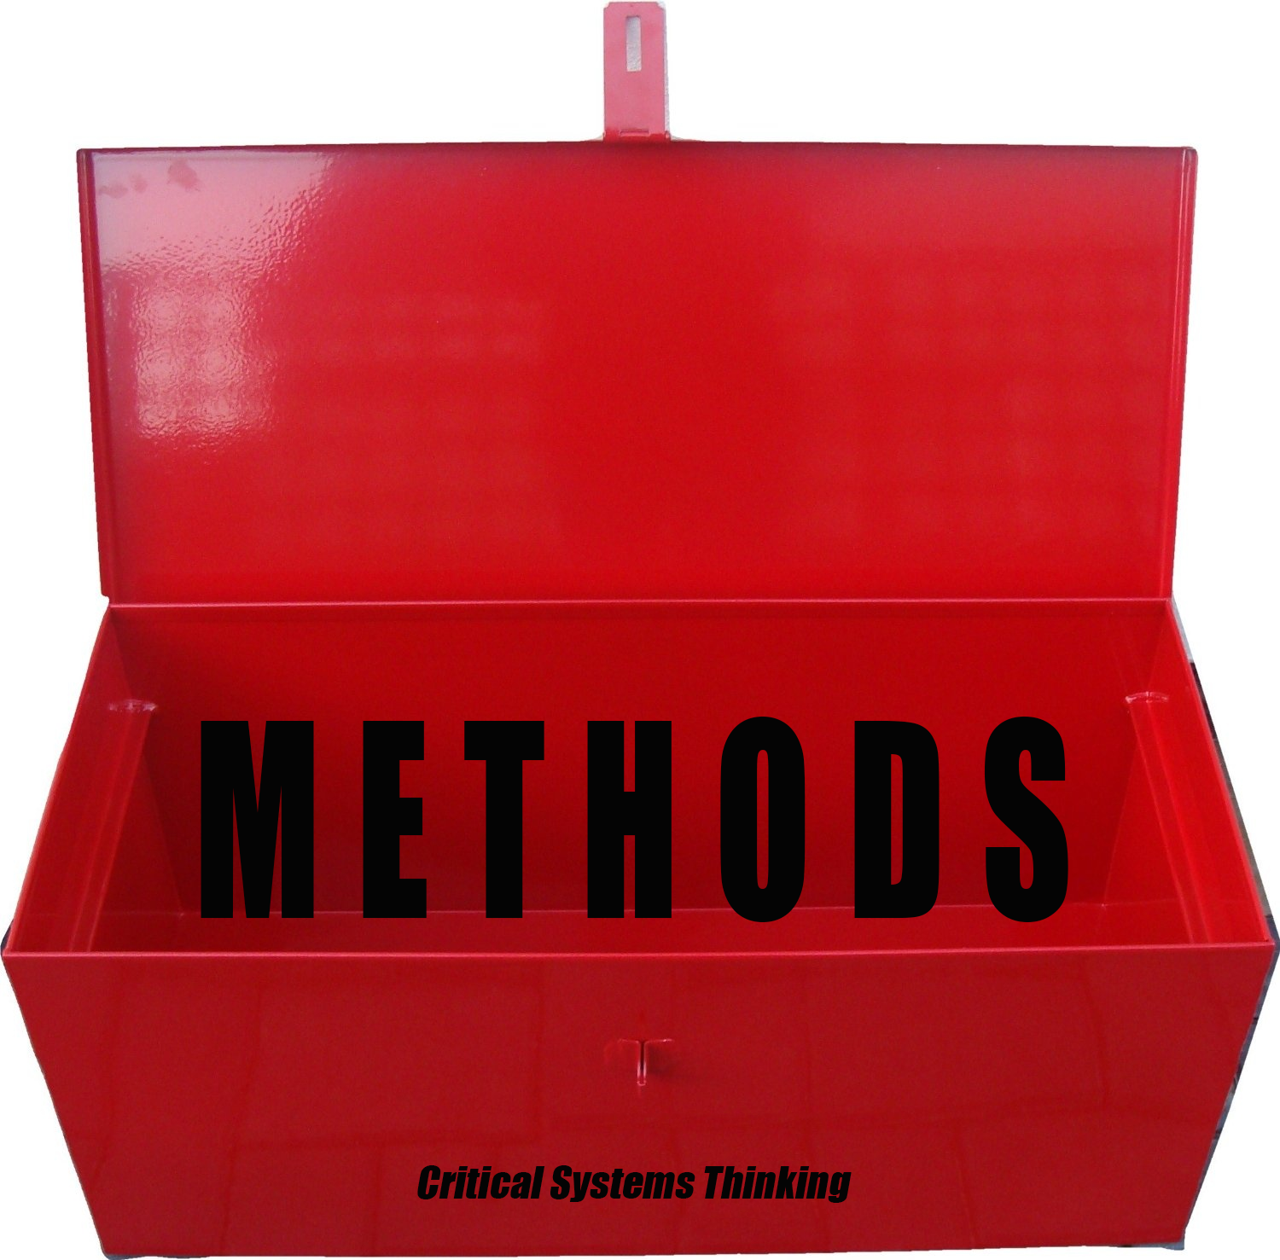
Critical Systems Thinking
Criticizes both hard systems (focused on optimization) and soft systems (focused on dialogue) for isolationism
  View the two approaches as mutually exclusive and incompatible, instead of complementary (Flood & Jackson, 1991; Mingers, 2011)
Critical systems thinking (CST) (Jackson & Keys, 1984; Jackson & Keys, 1987; Flood & Jackson, 1991; Jackson, 1991; Ulrich, 1993; Gregory, 1996; Midgley, 2000) :
  Sophisticated in its understandings of power and how to address it through intervention
Rests upon “commitments” (Midgley, 1996 [reduced from Jackson’s seven commitments (Jackson, 1991]
  Critical Awareness
  Emancipation/Improvement
  Complementarism or (Methodological Pluralism)
POWER

Slide 6
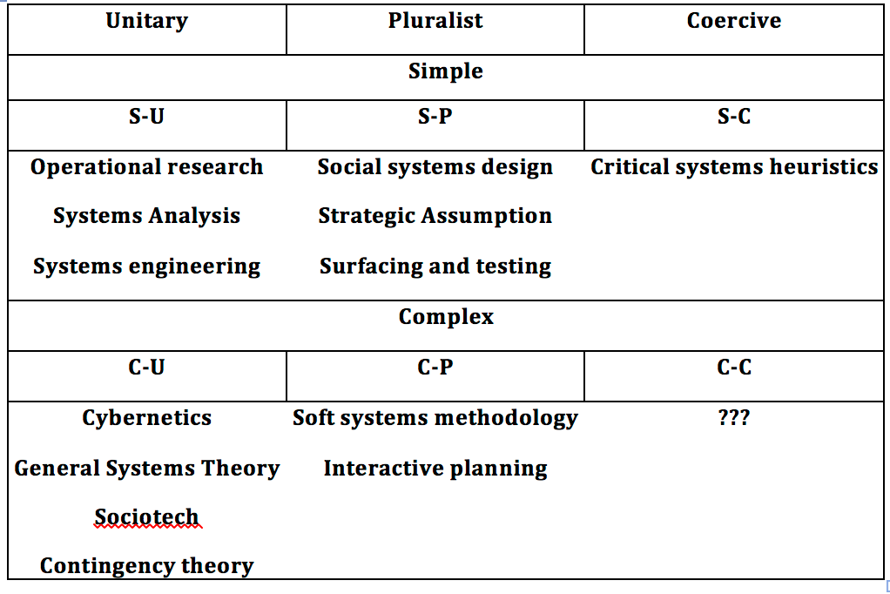
Methodological Pluralism
System-of-systems methodologies (SOSM) (Jackson and Keys, 1984):
  Choosing a methodology requires first identifying the problem context
  Includes the set of decision makers and their objectives
  Unitary: decision makers agree on a common set of goals
  Pluralist: decision makers do not agree on a common set of goals
  Coercive: power and domination of a few achieve cohesion
  Simple systems: relatively easily solved (mechanical)
  Complex systems: more difficult to solve (systemic)
(Flood & Jackson, 1991, p. 7)

Slide 7

Boundary Critique
  Boundary Critique: subjecting boundary judgments to scrutiny in reflections and dialogues (Ulrich, 1996)
  concerns with the exercise of power is when ‘experts’ make unilateral decisions
Built on the seminal writings of Churchman (1970):
  Boundaries determined by the values of decision makers
  “unfolding process”, which includes the "sweeping-in" of as many factors as possible into the system of concern
Ulrich (1988) suggests that ‘unfolding’ refers to understanding the nature of different stakeholder boundary judgments and their implications for those who may be affected by a decision
  Boundary critique is necessary for all interventions -- way to get deep enough understanding of the problem context to choose the right methodology (Ulrich, 1993)
  Subsume Ulrich’s approach and make it into a methodology that is only of use in simple-coercive contexts (Jackson, 1987)
Jackson and colleagues focused on methodological pluralism.
Ulrich: Critical System Thinking focused on power relations and dialogue

Slide 8
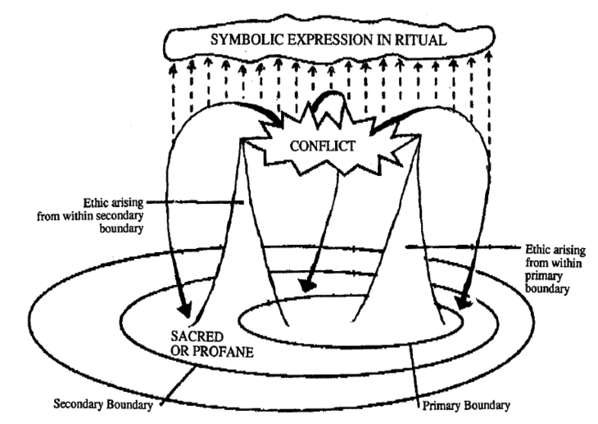
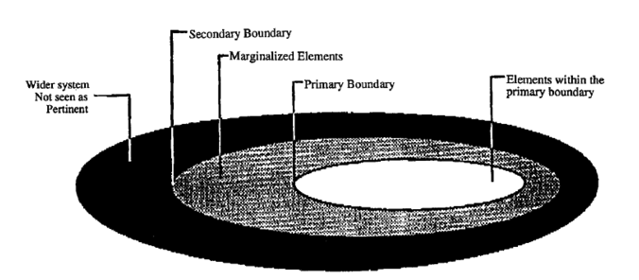
Systemic Intervention
Systemic Intervention advocates boundary critique and methodological pluralism together (Midgley, 2000)
  Boundary Critique: Needed to explore situations deeply
  Methodological Pluralism: Required to identify the most effective systemic response
Systemic Intervention is intended for use in practice to identify possible “action for improvement”
Theory of Marginalization (Midgley, 1992):
Boundary Critique Marginalization
Concepts of sacred and profane

Slide 9
Interagency Collaboration
Challenges of interagency collaboration:
  Not holistic
  Long-term process
  Too many meetings
  Missed opportunities
  Inaction, and too many poor solutions
  Higher transaction costs
  “Each agency seeks to preserve its autonomy and independence.
  Organizational routines are difficult to synchronize.
  Goals overlap but are not identical.
  Constituents bring different expectations and pressures to bear on each agency.
  Managers try to minimize the uncertainty of their own environments but are less concerned with minimizing uncertainty for others.”
  -- Weiss (1987, p. 3)
Example research into improving multi-agency collaboration:
  Cause-and-effect methods and frameworks (Ansell Gash, 2008; Emerson et al., 2012)
  SSM for activation in the event of a local disaster (Gregory & Midgley, 2000)
Very few governmental efforts to tackle wicked problems involve the design of a dedicated meta-organization to bring agencies together in a coordinated approach

Slide 10
Designing Organizations: “Ashby’s Law”
  Based upon the ability of biological species to block or regulate the flow of variety (disturbances) into the gene patterns to ensure their survival
Channels of communication between a Disturbance (D) occurring in the external environment (T) that drives the essential variables (E) outside a proper range of values
D –T -E transmission must be regulated in order for the organization (organism) to remain viable within this changed environment
Regulator (R) must directly reduce the variety in their environment (T) in order to stay in a homeostatic state.
  D = Disturbance
  T = External environment
  E = essential variables
  R = Regulator
The law of Requisite Variety also says that R's capacity as a regulator cannot exceed R's capacity as a channel of communication.
“Only variety can destroy variety”

Slide 11
Designing Organizations: Viable System Model
The Viable System Model (VSM) is a conceptual cybernetic model for diagnosing or designing organizations to be highly adaptable to changes within the organization and with its environment (Beer, 1979, 1981, 1985)
Design of organizations at all levels (which includes meta-organizations)
Dynamic model for continuously adaptation and self-organization in response to disturbances -- based upon theory of autopoiesis (Ashby, 1947; Von Foerster,2003; Maturana and Varela, 1980)
Influenced by the Law of Requisite Variety (Ashby, 1947; Ashby, 1956; Ashby, 1968).
Modeled after the human nervous system that regulates internal systems to keep in balance with their environment (Beer, 1972)
Viable system: a system that maintains its identity while maintaining a co-evolutionary –but still balanced - relationship with their niche (Espinosa, Harnden, & Walker, 2008).
In order to design and maintain a viable organization capable of tackling the complexity of a wicked problem, the organization must be closely attuned to it’s environment and dynamically adjust to disruptions to it (Beer, 1985).

Slide 12
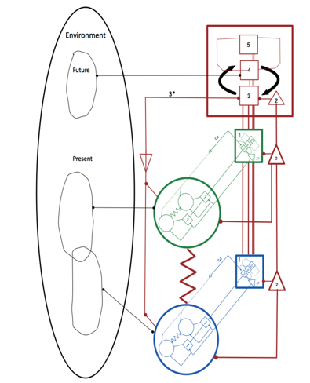

The Five Subsystems of the VSM
System 1 (S1): The operations of the organization where the production of products or services happens (Espinosa, Reficco, Martínez, & Guzmán, 2015). It is a viable organization itself.
System 2 (S2): Deals with the day-to-day operations, providing shared languages, protocols, procedures, and information. It is also involved in avoiding oscillations and providing conflict resolution when discord exists between S1s (Espinosa & Walker, 2006).
System 3 (S3): Responsible for regulatory issues such as resource distribution, accountability, and legal and corporation requirements (Espinosa & Walker, 2006). S3 also handles any resource bargaining to ensure all parts are running in the best interest of the whole organization.
System 3* (S3*): The auditing system used by S3 to monitors the activities of S1s (Hilder, 1995). It can probe the details of the operations without taking over and micromanaging.
System 4 (S4): “intelligence function of the organization”. It is responsible for understanding the total environment in which the organization is embedded (Hilder, 1995). It is concerned with “outside and then” (Beer, 1979) and is the facilitating mechanism by which the identity of the organization adapts.
System 5 (S5): Defines the identity of the organization and provides its ethos and purpose (Leonard, 2009). It also supplies logical closure to the SIF.

Slide 13
The VSM
Recursion
Homeostasis
Attenuation/Amplification
3 Channels for Coordination Among S1s
Auditing
Transduction
System 4: “Knowing the Environment”
The 3/4 Homeostat
System 5 and the Metasystem
Continuous Management of Variety
Notes:
Homeostasis: dynamic stability and it is a fundamental characteristic of a viable self-organizing organization.
Homeostatic mechanisms keep the internal environment in balance with its environment (Beer, 1985).
Attenuation/Amplification
Attenuate: Reduce or filter the variety flowing from the environment
Amplify: Increase its cognitive capacity to co-evolve with its environment
3 Channels for Coordination Among System 1s
Resource bargain to negotiate resources in each particular period
Accountability channel to make themselves responsible for the way they used these resource’s, and
Channel to intervene (only when a S1 behaves in ways counter to viability) by applying corporate or/governance industrial norms

Slide 14
Successful VSM Interventions
Successful Interventions:
  Angela Espinosa: Many interventions particularly in sustainability and sustainable communities (Espinosa & Walker, 2006; Espinosa, Cardoso, Arcaute, & Christensen, 2011; Espinoza & Walker, 2011; Espinosa & Walker, 2013)
  (Brocklesby, 2012): VSM to model the law enforcement response to the problem of organized transnational crime
  Other authors: (Flood & Zambuni, 1990; Brocklesby & Cummings, 1996; Devine, 2005; Christopher, 2007; Schwaninger & Ríos, 2008; Espejo & Reyes, 2011)
Criticisms:
  Too mechanistic (Checkland, 1980)
  Doesn’t provide methods for establishing shared understanding about purposes (Jackson, 1988)
Emerging Constructivist Approaches:
  Boundary critique with the VSM (Midgley et al., 1998; Yolles, 2001)
  Other constructivist approach to the VSM has been evolving from Beer’s followers (Harnden, 1989; Espejo & Reyes, 2011; Espinoza & Walker, 2011).

Slide 15
Research Questions
Overall Question: Can Systemic Intervention offer a methodological framework and mixed-method approach for designing viable interagency meta-structures that are capable of managing wicked problems?
Sub-questions:
  Can the Viable System Model provide an organizational design framework for creating adaptable and sustainable meta-organizational structures for the interagency?
  What benefits do Systemic Problem Structuring Methods bring to participative problem formulation of wicked problems and how do these relate to use of the VSM?
  Does the use of Boundary Critique ensure that the values and perspectives of all agencies are critically considered when setting boundaries around wicked problems and are important issues of marginalization and conflict revealed?

Slide 16
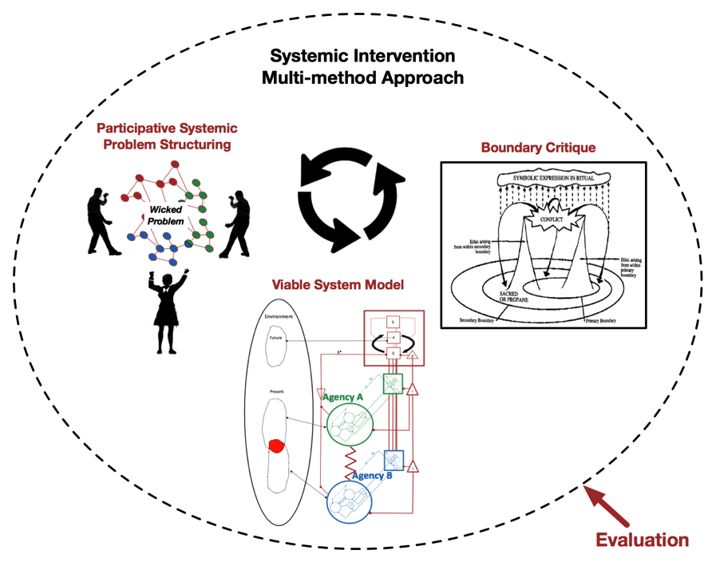
Systemic Intervention Methodology
Anticipatory Systems: Time permitting, an anticipatory systems model called AnticipatoRy Complex Adaptive Network Extrapolation (ARCANE) may be introduced into the Systemic Intervention

Slide 17


Example Systemic Intervention
Mixed Method Example
Crime on the Urban Edge
The interagency needs to act like a meta-organization, with a complex system structure to counter transnational organized crime (TOC) and Urban Gangs (and their convergence)
This problem exhibits all characteristics of a wicked problem
Methods must be developed that can design meta-organizations to be systemically aligned and capable of continuously adapting to wicked “environments”

Slide 18
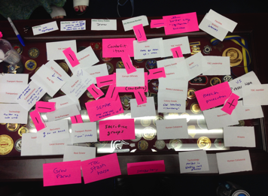
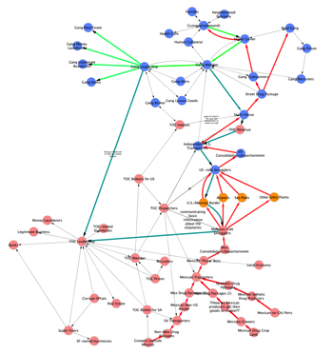
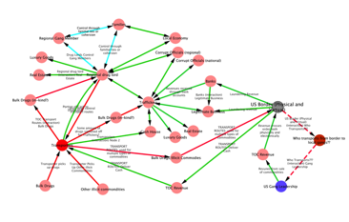
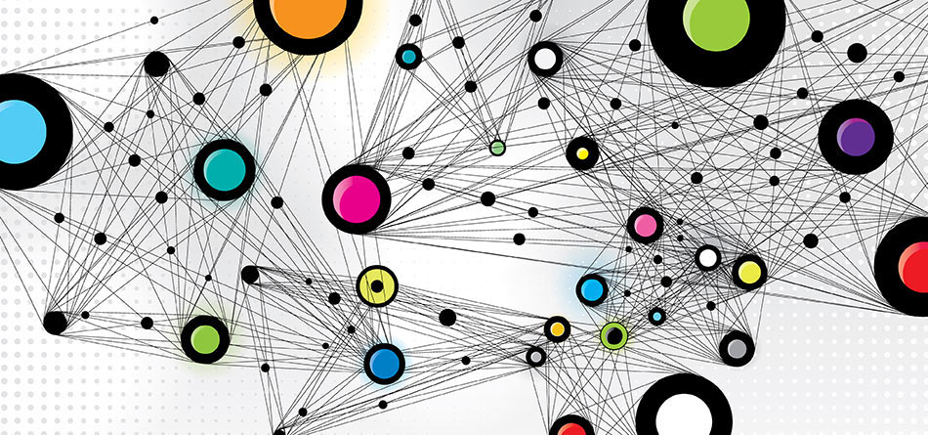


Systemic PSM
Individual Problem Structuring:
Interview Data Transcription and System Mapping:
Stakeholder Selection
Stakeholder Interviews
System Mapping
Interview Questions
Stakeholder 1
Stakeholder 2
System Map Consolidation
Participative Group Problem Structuring
Common Wicked System Map(s)
Boundary Critique

Slide 19
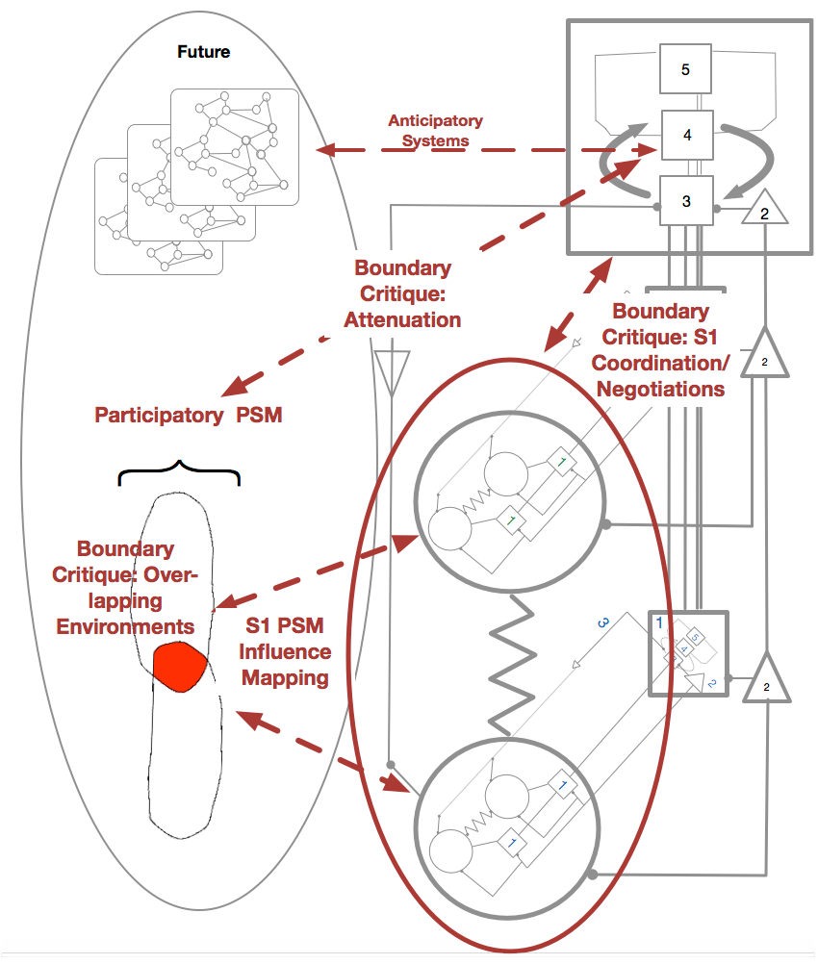
Viable System Model Intervention
Systemic PSM
The wicked problem structure(s) generated in the problem-structuring workshop will be utilized as the “Environment” for the VSM design.
VSM
Stakeholders will share their ideas and suggestions for the structure and function of each VSM sub-system.
Existing coordination mechanisms identified for use in in the new meta-organization.
outcome of this workshop will be a collaboratively generated VSM diagram of the meta-organization structure(s)
Note-takers to capture the whole design process (questions asked, disagreements, suggested alternatives, etc.).
Boundary Critique
Boundary critique will be used throughout the process as a means to evaluate any marginalization that may be happening in the VSM design and to negotiate conflicts among contending stakeholders.

Slide 20
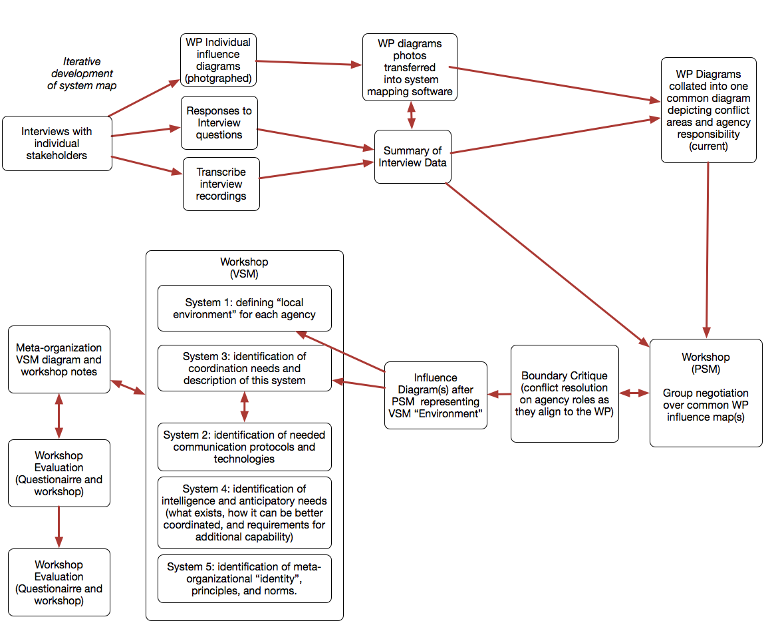
Workflow
Summary Report
  Written up and distributed to all stakeholders. It will also be used as a reference for the evaluation process
Evaluating the Systemic Intervention
  Using a questionnaire to collect data from stakeholder followed by a reflexive workshop
  Evaluation data collection procedures developed by Midgley et al. (2013) and by Espinosa et al. (2015) will be considered and perhaps adapted for use in this evaluation

Slide 21
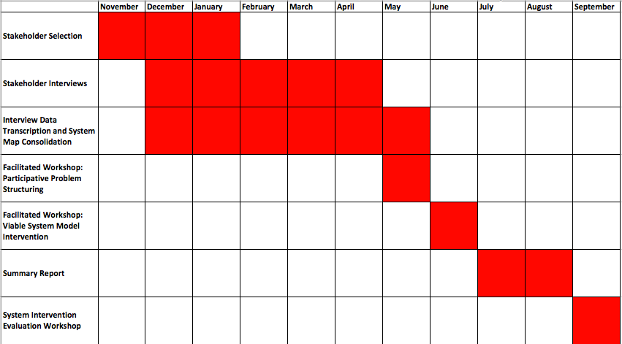
Agenda for Fieldwork

Slide 22
Conclusion
This research research will establish a Systemic Intervention process utilizing the:
  Viable System Model
  Systemic Problem Structuring Methods
  Boundary Critique
The desired outcome is to:
  Enable the flexible design of a wicked problem-focused, meta-organization that can be developed, adapted and dismantled as needs evolve
  Provide illustrative example (CUE) for evaluation and reflection to
  Enable conclusions to be drawn of the more general possibilities for using this combination of approaches in the context of wicked problems
Questions?

